Slide 1

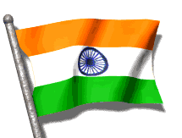

CLASS-UKG
SUBJECT-GK
TOPIC-OUR COUNTRY

Slide 2
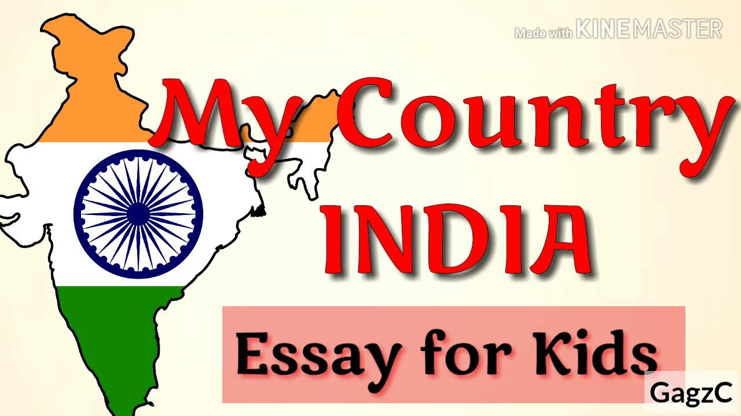
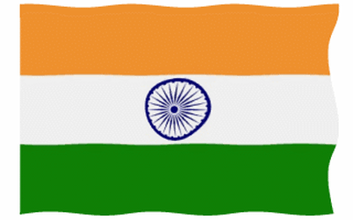
I love my country

Slide 3
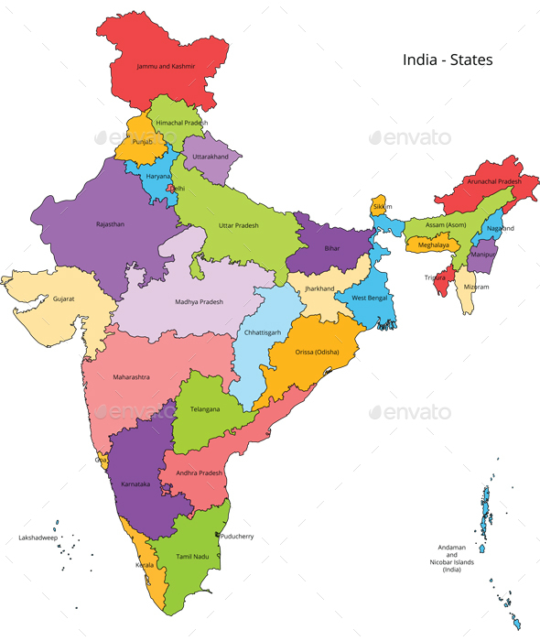
OUR COUNTRY
INDIA

Slide 4
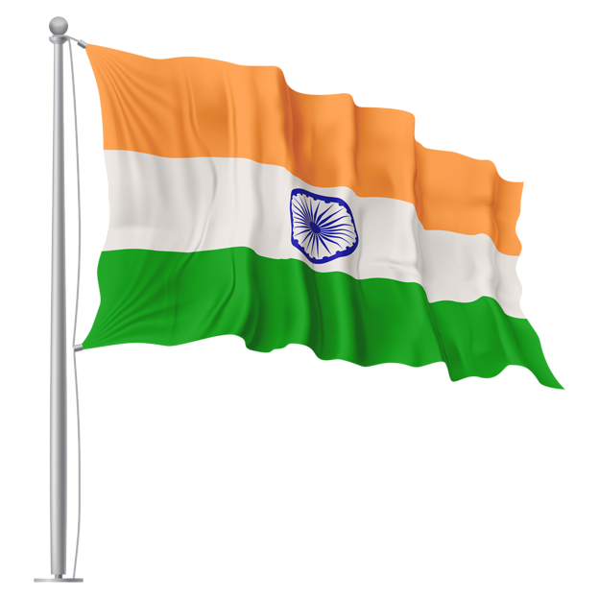

National Emblem
National Flag
Triranga
Lion capital of Ashoka at Sarnath

Slide 5
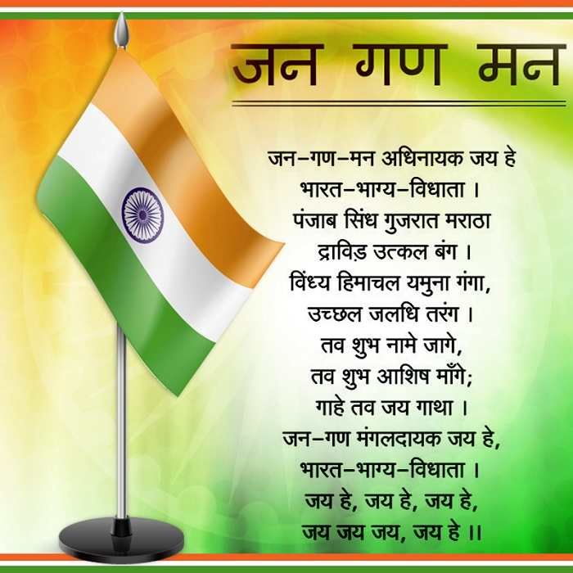
National Athem
jana gana mana adhi
nayak jaya hai....

Slide 6
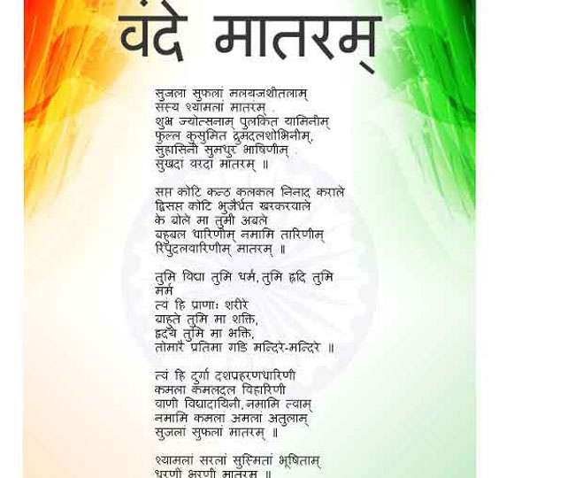
National
Song-
Vande
mataram

Slide 7
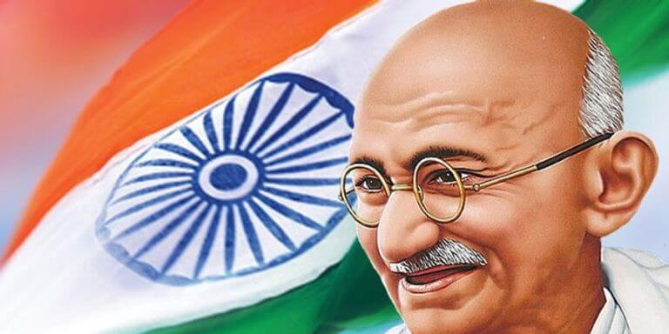
Father of Nation
Mahatma Gandhi

Slide 8
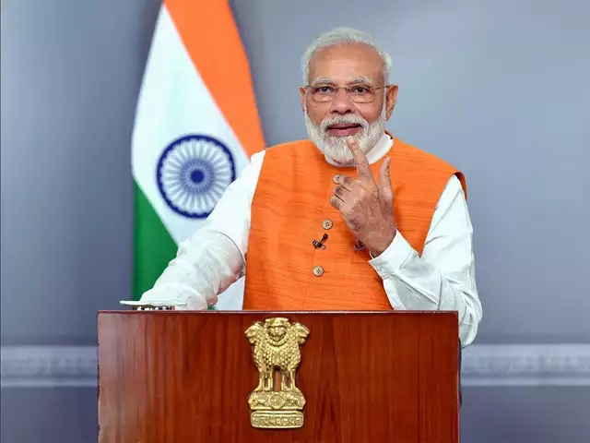
Prime minister of INDIA -
Prime minister of
INDIA-
Mr
Narendra
Modi

Slide 9
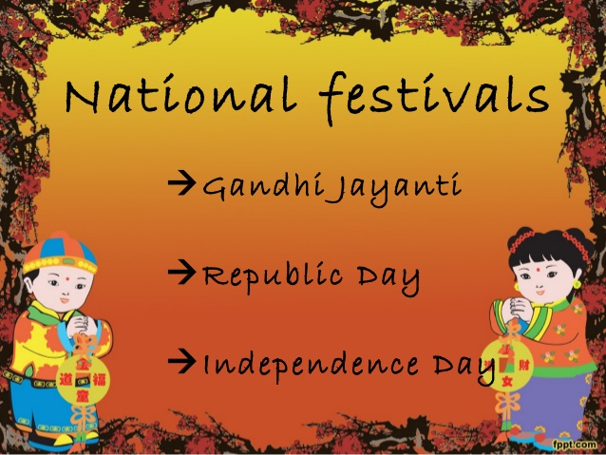
National festivals
Republic Day
Independence Day
Gandhi Jayanti

Slide 10
THANKING YOU
ODM EDUCATIONAL GROUP

