Slide 1


CLASS : UKG
SUBJECT : GK
CHAPTER : 6
CHAPTER NAME : FESTIVALS
TOPIC : RELIGIOUS AND HARVEST FESTIVALS

Slide 2
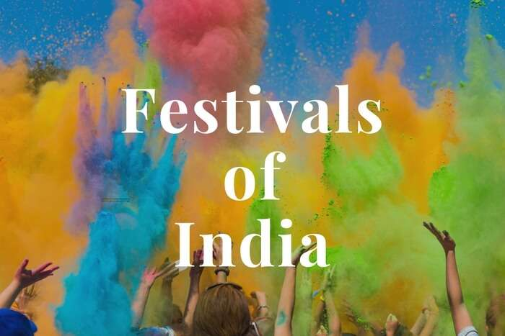

Slide 3
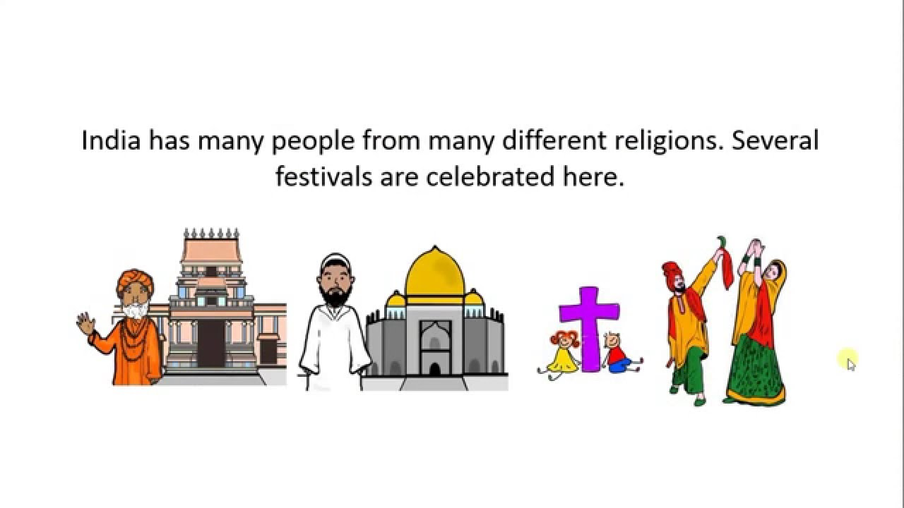

Slide 4
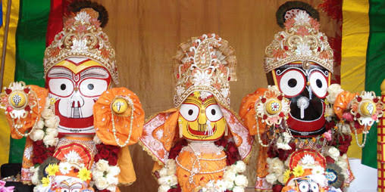
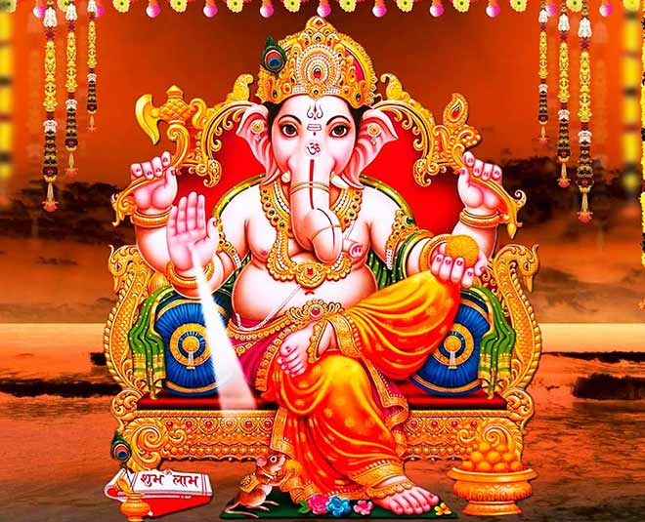
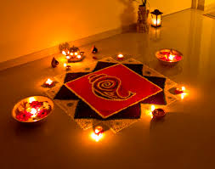
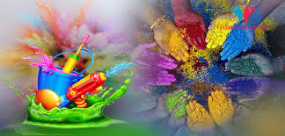
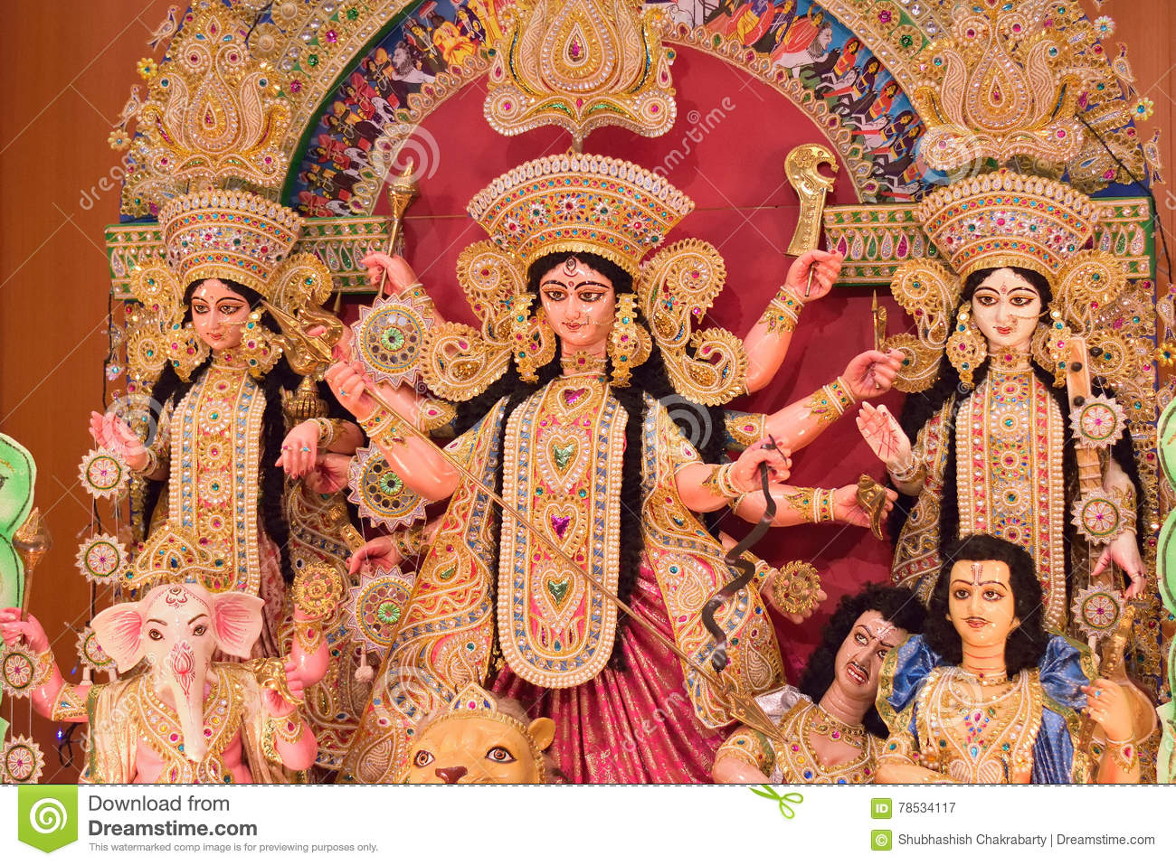
India is a land of festivals.
A wide variety of festivals celebrated in India.
There are many festivals and celebrations, the most exciting ones are mentioned below.

Slide 5
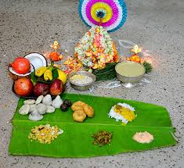
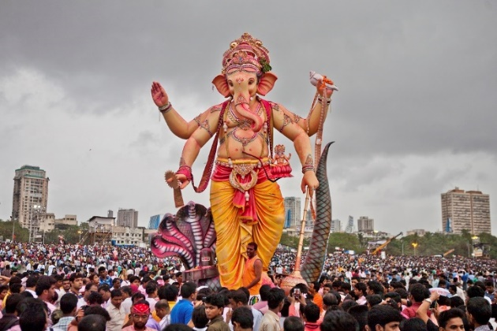
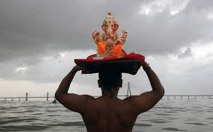
GANESH PUJA
Ganesh Chaturthi is one of the important Hindu religious festivals of India. It is the birthday of Lord Ganesha, the elephant-headed God. ( the God of prosperity and wisdom. )

Slide 6
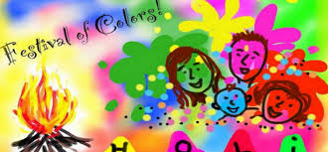
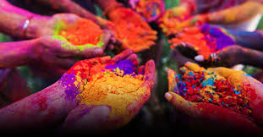
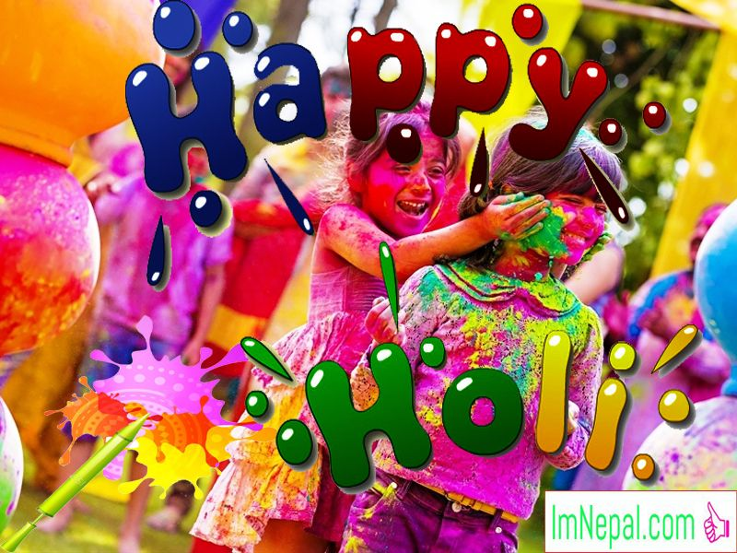
HOLI
HOLI IS THE FESTIVAL OF COLOURS.
PEOPLE ALL OVER INDIA CELEBRATE THIS FESTIVAL BY PLAYING COLOURS.

Slide 7
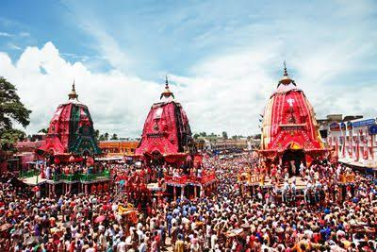
RATHA YATRA
Rath Yatra of Puri is a symbol of harmony, brotherhood and unity. Thousands of devotees come here from different corners of the country to take part in this yatra and get good luck by pulling the chariot of the Lord.

Slide 8
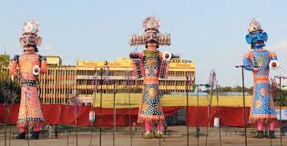
Durga Puja,Is a major festival of India. It celebrates the victory of good over evil as goddess Durga killed demon king Mahishasur.
DURGA PUJA
VIJAYA DASHAMI
It marks the day on which Lord Rama achieved victory over Ravana, the ten headed demon king of Lanka.

Slide 9
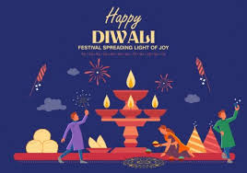
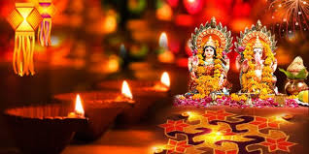
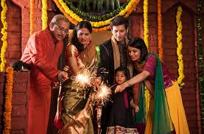
DIWALI
Diwali or Deepavali is also known as the festival of lights. It signifies peace and joy, the victory of good over evil, and light over darkness every day.

Slide 10
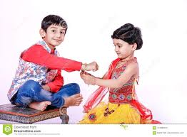
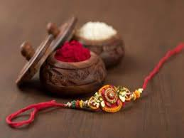
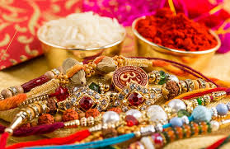
RAKSHA BANDHAN
On this day the sisters tie rakhi (a thread ) on their brothers’ right hand and pray for their safety and in return the brothers give gifts to their sister.

Slide 11
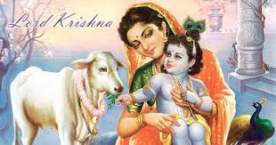
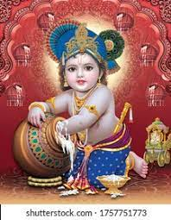
JANMASTAMI
One of the important festival is Janmashtami - the day Lord Krishna was born - and is observed with much pomp and fervor. It is also known as Krishna Janmashtami.

Slide 12
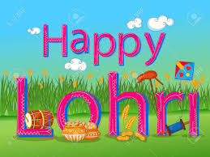
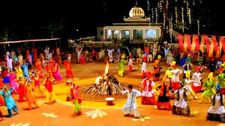
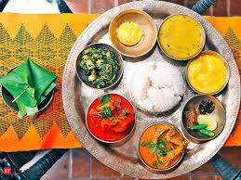
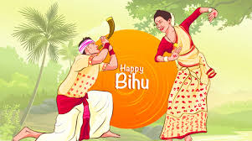
HARVEST FESTIVALS
India is an agricultural nation and harvesting season is a reason to rejoice for Indians. There are many different harvest festivals in India and they vary from one region to another.

Slide 13
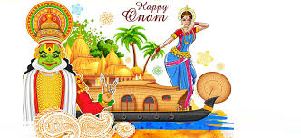
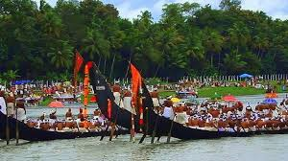
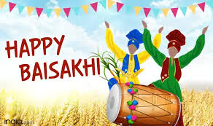
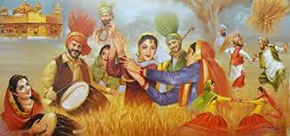
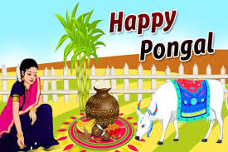
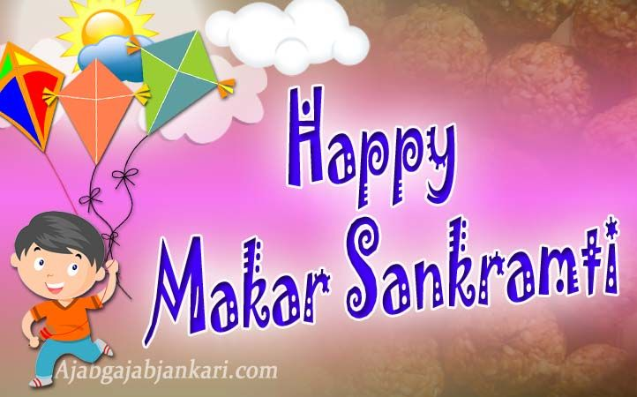
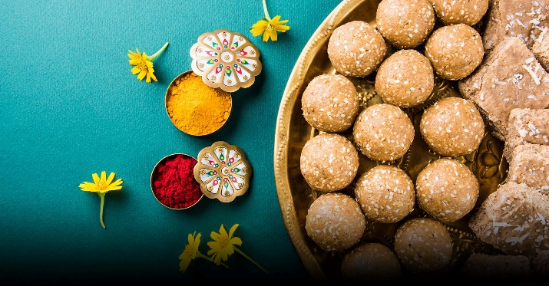

Slide 14
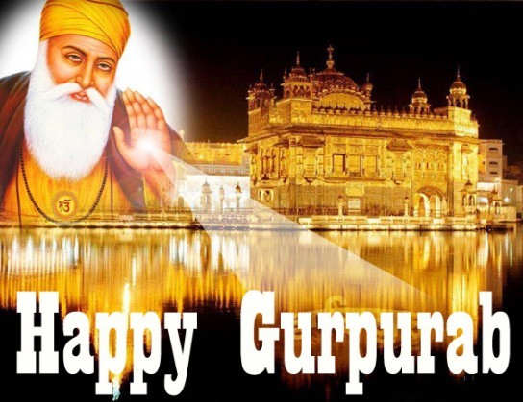
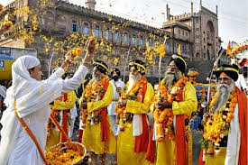
GURPURAB
Gurupurab is the festival where Sikhs celebrate the birth of their first guru — Guru Nanak. The literal meaning of the word Gurupurab is ‘the day of Guru’.

Slide 15
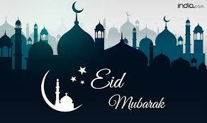
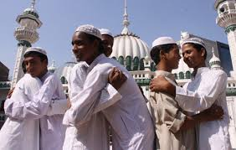
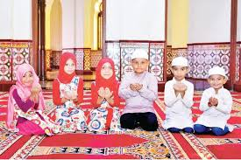
EID
MUSLIMS CELEBRATE ID-UL-FITR AND ID-UL-ZUHA.
ON THAT DAY THEY PRAY, PAY VISIT TO THEIR RELATIVES AND EXCHANGE GIFTS AND SWEETS.

Slide 16
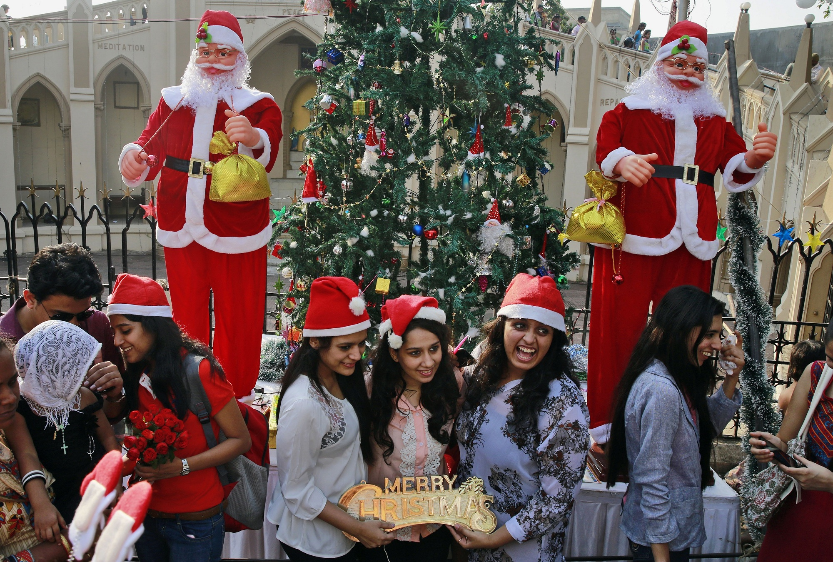
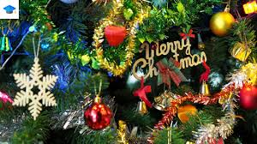
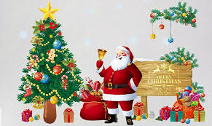
CHRISTMAS
Christmas is celebrated to remember the birth of Jesus Christ, as Christians believe the Son of God.

Slide 17
THANKING YOU
ODM EDUCATIONAL GROUP

