Slide 1

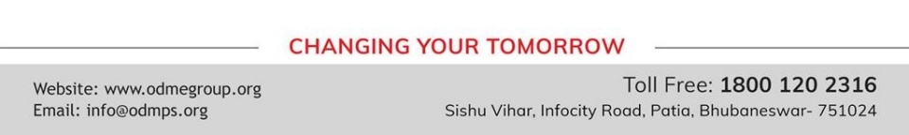
THE CONSTITUTION AND THE NEED FOR LAWS
SUBJECT : CIVICS
CHAPTER NUMBER:1
TOPIC NAME : 2. The Constitution and the Rule of Law, Legality of Laws, Laws and Dissent.

Slide 2



LEARNING OUTCOMES
The Pupil will be able to:-
Understand the importance of Rule and Regulations.
Analyze the role of Judiciary in safeguarding individual rights.
Identify the Acts made to ensure safety and to secure basic Human Rights.
Appreciate and respect individual identity.
Apply dissent whenever required.

Slide 3
RECAPITULATION
.Define the term Constitution?
2.Who is known as the father of Indian Constitution?
3 When was the Constitution came to force?
4. Write are the important features of Indian Constitution?
5.Explain why rules and laws are necessary for a society?

Slide 4

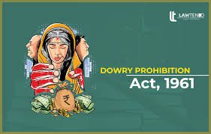

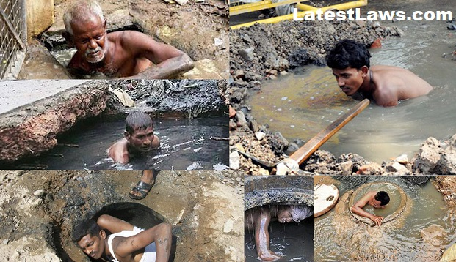

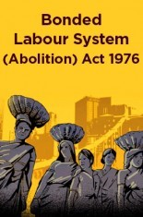
LAWS FRAMED BY CONSTITUTION
Dowry provision Act –1961.
Scheduled Caste and Schedule Tribe Act – 1989.
Employment of Manual Scavenges and Construction of Dry Latrines provision Act-1993.
The Bonded Labor System Abolition Act-1976.
Disabilities Act-1995.
Mizoram Liquor Total Provision Act-1995

Slide 5
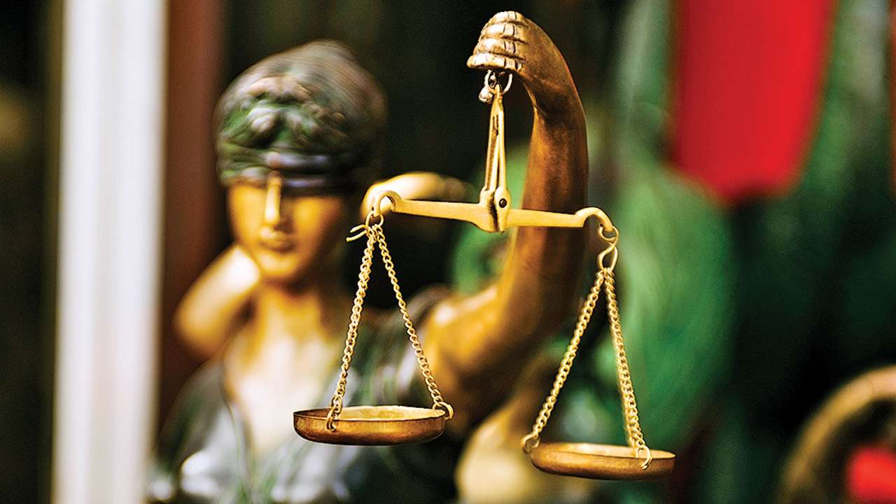
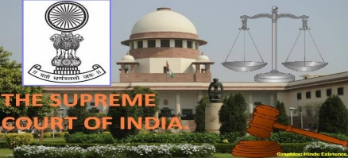
LEGALITY OF LAW
The Indian Constitution has provided for an independent and powerful judiciary that is
responsible for defending the rights of the common man.
It is entrusted with the job of upholding the legality of the Constitution.
If a law is enacted against the principles of the Constitution, then the Judiciary has the right to
declare it null and void. It is also known as judicial review.
The Judiciary also has the power to punish all breakers of law.

Slide 6
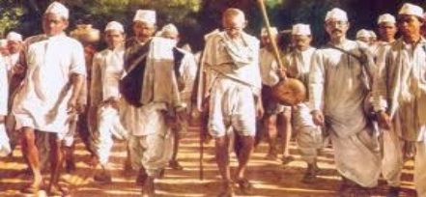
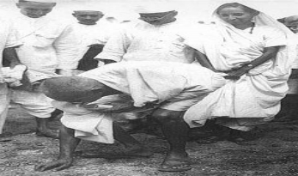
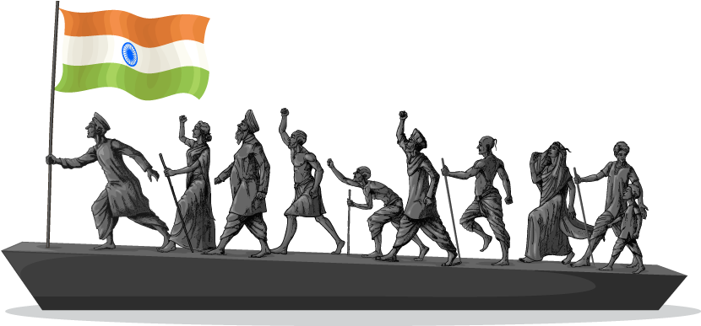
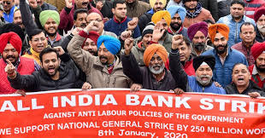
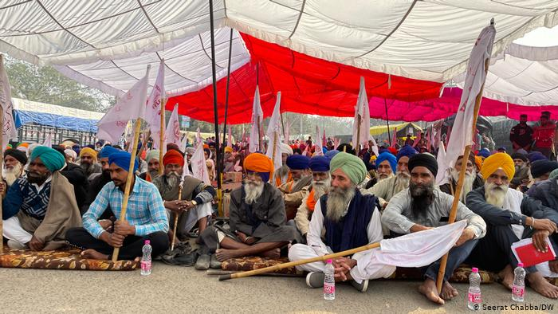
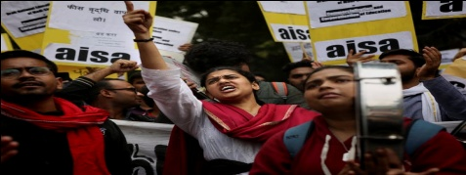
Laws and Dissent
Wherever there are laws, there is bound to be dissent or opposition to it. If a law goes against the
interest of a group of people then that group will protest to express its dissatisfaction, is known as
dissent.
We can express the dissent in various forms such as peaceful marches, non- cooperation, strike, hunger
strike, bandh, hartal, dharna.
The result of this type of dissent is sometimes government are forced to abolish or modify the laws.

Slide 7
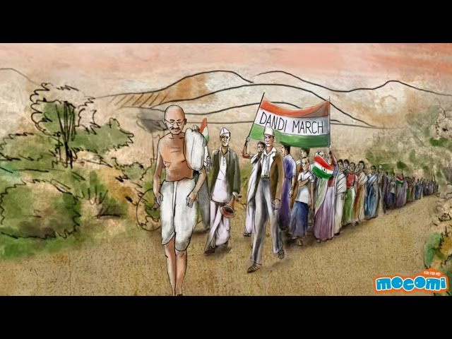
VIDEO ON INDIAN FREEDOM STRUGGLE
https://youtu.be/cPjRaw8CVr8

Slide 8



CONCLUSION
We need constitution because-:
It expresses the self determination of the citizens
It embodies the civil rights of the people
The constitution legal framework for democracy

Slide 9
THANKING YOU
ODM EDUCATIONAL GROUP

