Slide 1


THE CONSTITUTION AND THE NEED FOR LAWS
SUBJECT : CIVICS
CHAPTER NUMBER:1
TOPIC NAME : 1. Constitution: Introduction, The Indian Constitution, The need for laws.

Slide 2


LEARNING OUTCOMES
The Pupil will be able to:-
Gives information about constitution.
Understand the importance of constitution and the need for laws.
Analyze the role of constitution in a democratic country.
Identify the makers of Indian Constitution.
Implement the basic idea of constitution in their life.
Recognize the idea given in the preamble.

Slide 3

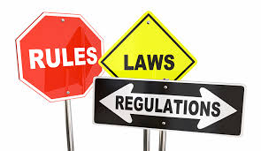


INTRODUCTION
All societies are bound by rules. These rules help to bring about order in human
lives. So rules were invented to resolve conflicts in an impartial and peaceful
manner.
Here we are going to study about our constitution which is a set of rules and
regulations.

Slide 4
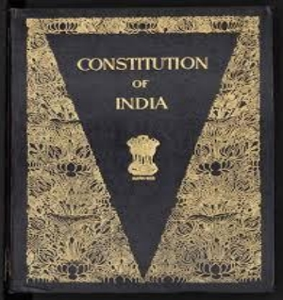
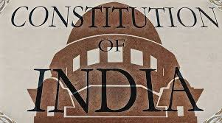
WHAT IS CONSTITUTION?
A Constitution is a set of rules, laws and principles according to which a country is governed. The rules and laws are specially created to suit the needs of the people of that country.
A Constitution is essential as it denotes the nature of the political system of a country whether it has a democratic system of government r a monarchical one. For example our Constitution declares that India is a secular democratic republic.

Slide 5
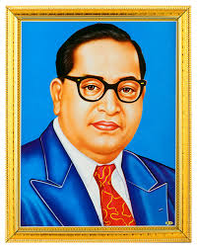
INDIAN CONSTITUTION
Constitution of India which was adopted by the Constituent Assembly on 26th November, 1949 and came into force on 26th January, 1950
Dr. B R Ambedkar is known as the father of Indian Constitution

Slide 6
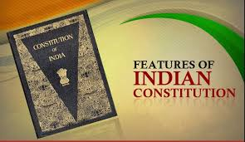
FEATURES OF INDIAN CONSTITUTION
• Indian Constitution is the lengthiest Constitution in the world
•It is a written Constitution
• It contains 448 Articles and 12 Schedules.
• It defines the powers the Indian Legislature , Executive and Judiciary
• It lays down the fundamental rights, duties of citizens and directive principles of the state policy.
• It also contains special provision for safeguarding the interest of the scheduled castes and schedules tribes.

Slide 7



NEED FOR LAWS
❖Every game has its own rules, if there is no rules there would be chaos and may be violence. Likewise in life we need to be governed by a set of rules and regulations to enjoy the life to the fullest.
❖Every country also governs by certain set of rules and regulations that suit to the needs of the people. Rules and regulations also to put an end to the evil practices and customs of society. For example, the practice of untouchability, the treatment of woman and tribal people, alcoholism and dowry system.

Slide 8
HOME ASSIGNMENT
1.Define the term Constitution?
2.Who is known as the father of Indian Constitution?
3 When was the Constitution came to force?
4. Write are the important features of Indian Constitution?
5.Explain why rules and laws are necessary for a society?

Slide 9

FACTS ABOUT INDIAN COSTITUTION
https://youtu.be/0t88M912C44

Slide 10
THANKING YOU
ODM EDUCATIONAL GROUP

