Slide 1


FESTIVALS OF INDIA
CLASS : UKG
SUBJECT : G.K.
TOPIC : FESTIVALS OF INDIA

Slide 2
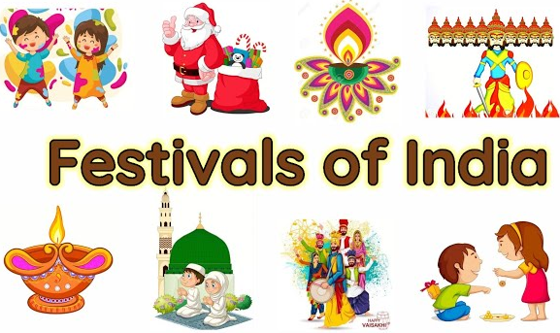

Slide 3
Our daily schedules keep us away from our close friends and relatives.
Festivals are the reason that brings us closer to everyone and makes our time wonderful and celebratory.
Festivals gives a good time to rejoice and built strong bonds between everyone.

Slide 4
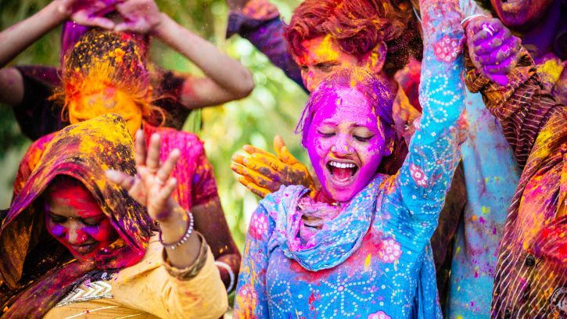
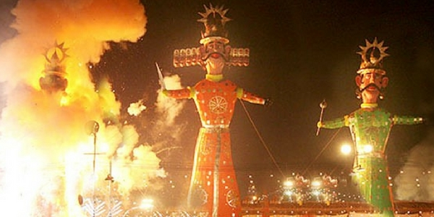
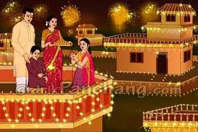
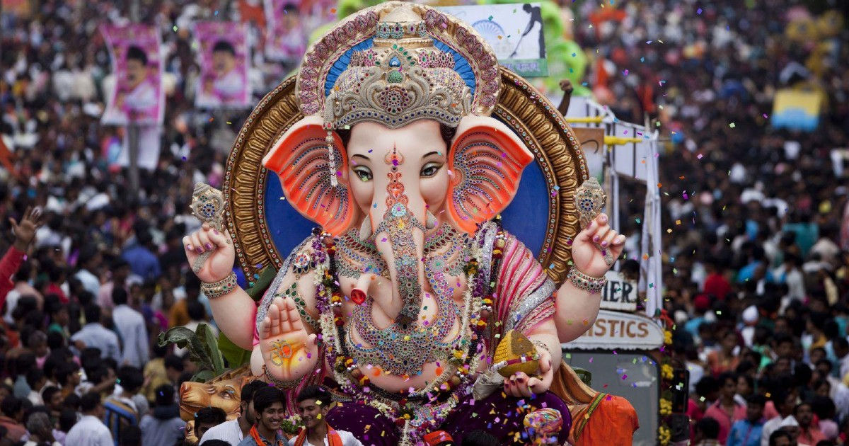
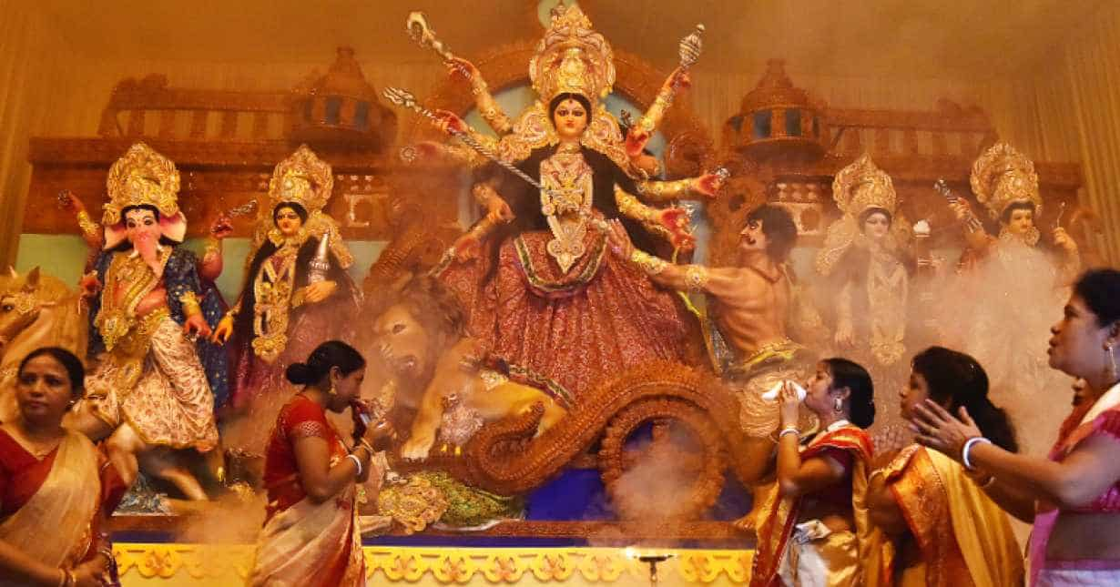
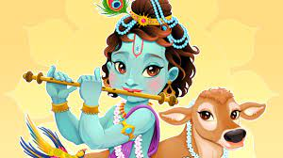
Some important festivals celebrated in India:

Slide 5
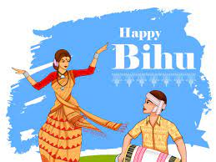
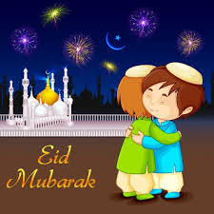
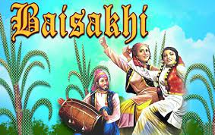
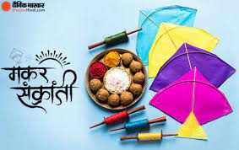
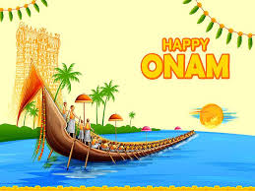
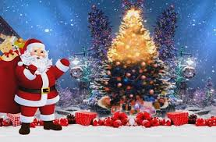

Slide 6
THANKING YOU
ODM EDUCATIONAL GROUP

