Slide 1

WELCOME TO ONLINE CLASS
CLASS : UKG
SUBJECT : ENGLISH
CHAPTER : 3 ( ‘oa’ sound words)
TOPIC : Revision .

Slide 2
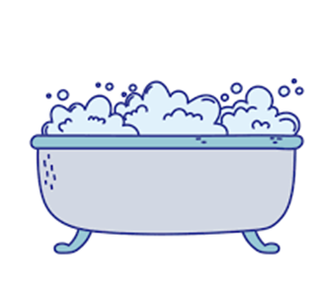

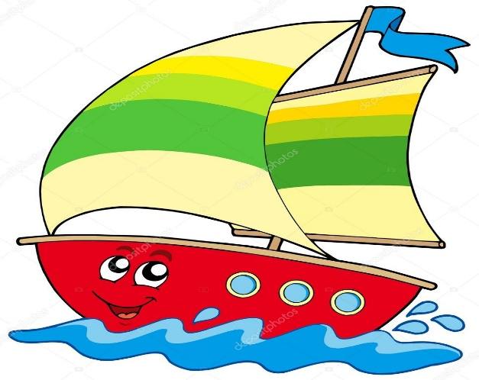
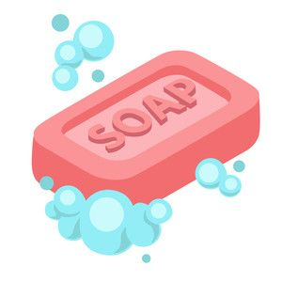
Name the pictures.
1.
3.
4.
2.

Slide 3

Fill in the blanks with appropriate letters to make a word .
1. Cup__ oard
4. Te__ e__ision
2. St__ve.
5. Bu__k__t
3. R__ __d
6. Cr__ __ k

Slide 4
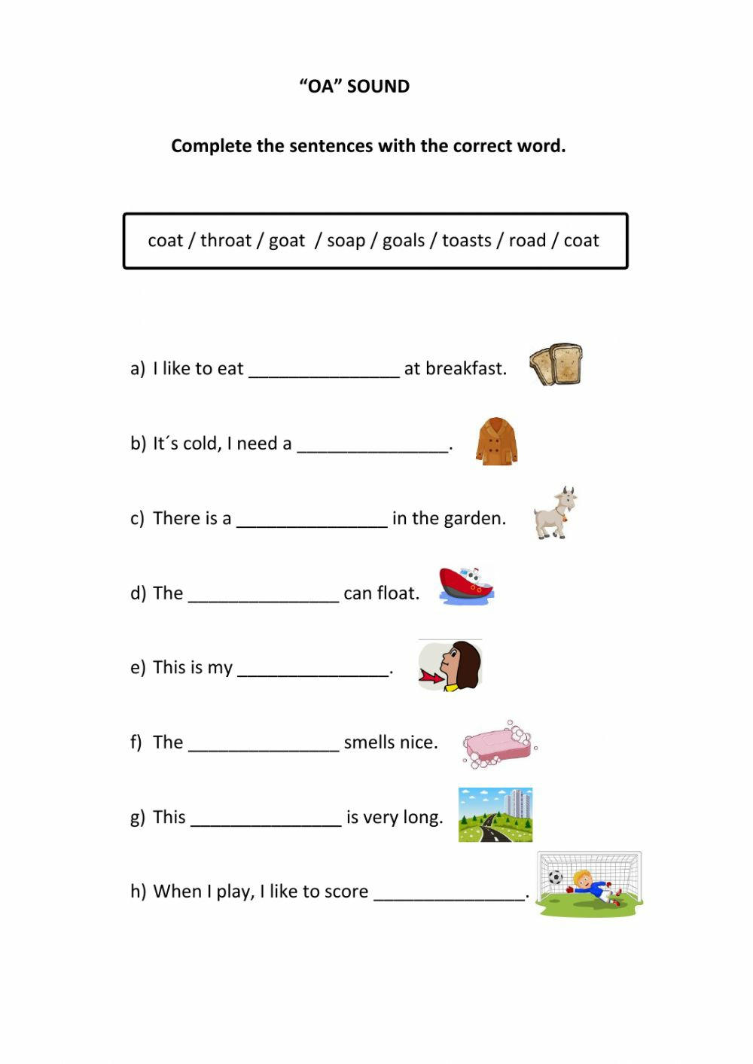
Complete the sentences with the correct word .
1. coat.
2. throat
3 . goat
4. soap
Goals
Toasts
7. road
8. boat

Slide 5
Home Assignment : Write 2 rhyming words for each word.
Goat ………………. …………………
2. Load ……………… …………………
3. Toast ………………. ………………..

Slide 6

THANKING YOU
ODM EDUCATIONAL GROUP

