Slide 1


WELCOME TO ONLINE CLASS
CLASS : UKG
SUBJECT : ENGLISH
CHAPTER : 9
TOPIC : “sh” sound word

Slide 2
Words with –sh sound Re- cap
ship
shoes
fish
shirt
dish
shop

Slide 3
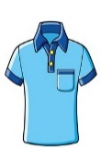
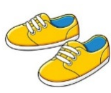

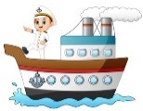
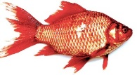

Read the sentences and identify – (sh sound words)
Sharat is wearing a and a . He goes to a .
He buys a toy and a toy for his friend, Sharmila.
He keeps the toy ship on a shelf in her room. She puts the toy in a round dish and keeps it near the .

Slide 4
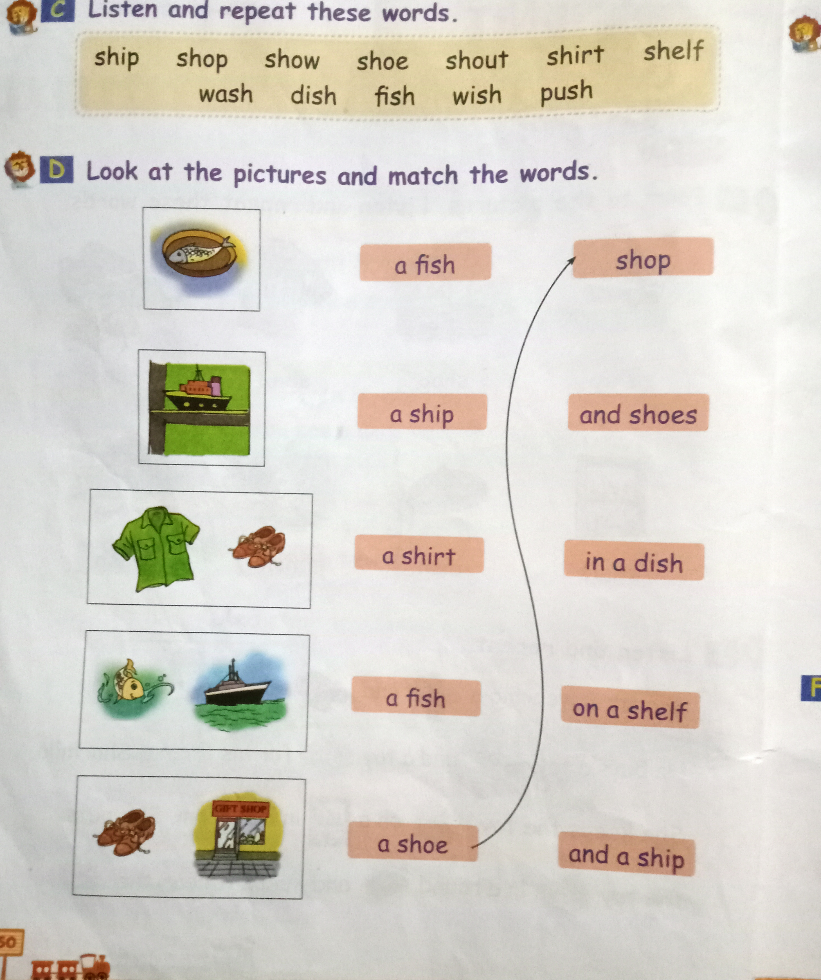
Class Assignment

Slide 5
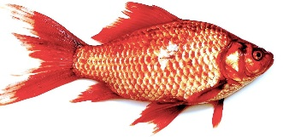
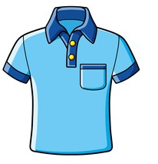
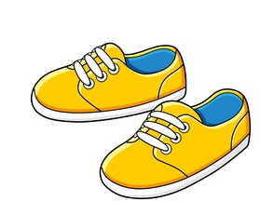
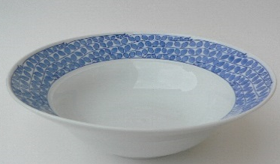
HOME ASSIGNMENT : circle the correct spelling.
fhses
fish
feesh
shart
shert
shirt
shoes
shoos
shues
desh
dish
deesh

Slide 6
THANKING YOU
ODM EDUCATIONAL GROUP

