Slide 1


CLASS : UKG
SUBJECT : ENGLISH
CHAPTER : 9
TOPIC : -sh sound word

Slide 2

DT. 7/12/21
WRITE THE WORDS IN NOTEBOOK AND UNDERLINE THE SH SOUND:
Ship 2. Shop
3. Shirt 4. Shoes
5. Shelf 6. Dish
7. Fish 8. Wash

Slide 3
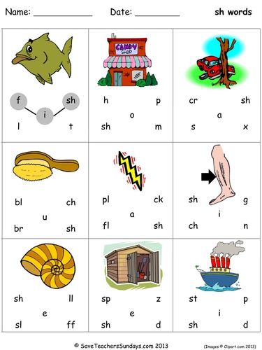
Join the letters with sh to make a correct word.

Slide 4

Home assignment: Circle the –sh sound words in the given sentences.
The sheep is on the ship.
The fish is on the dish.
She has a new shirt.
Wash your hands.
5. The book is on the shelf.
6. They have a flower shop.

Slide 5
THANKING YOU
ODM EDUCATIONAL GROUP

