Slide 1


WELCOME TO ONLINE CLASS
CLASS : UKG
SUBJECT : ENGLISH
CHAPTER : 9
TOPIC : “sh” sound word

Slide 2


Dt. 6.12.21
INTRODUCTION TO – sh SOUND
-sh makes ssssshhhh.. sound

Slide 3


Words starting with –sh sound
ship
shop

Slide 4
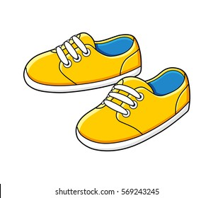
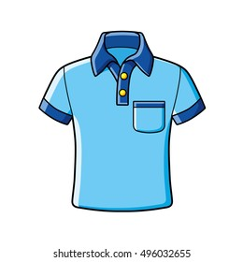
shoes
shirt

Slide 5
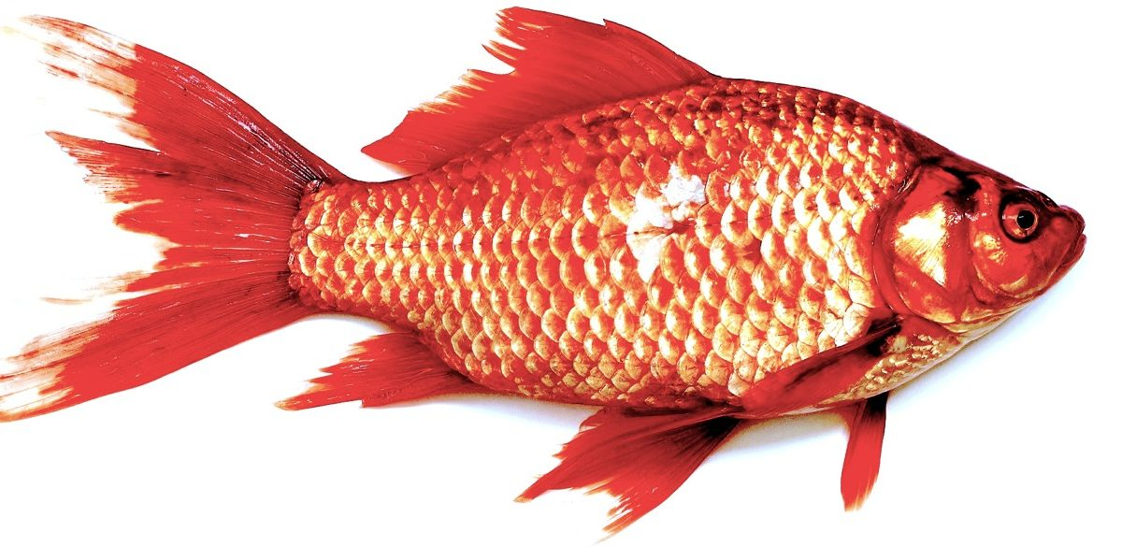
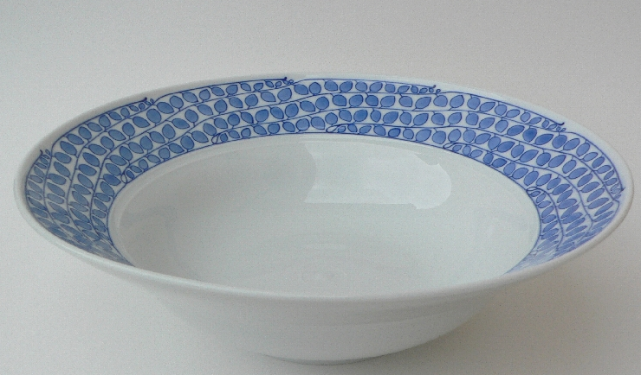
WORDS ENDING WITH – sh SOUND
fish
dish

Slide 6


Read the sentences and identify –sh sound words(oral)
Shut the door.
2. I got a new shirt.
3. I like to eat fish.
4. I lost my shoe.
5. My mother is in the shop.

Slide 7
HOME ASSIGNMENT : Read the words.
she 5. shoot
sheep 6. shed
shoe 7. shirt
4. shut 8. shelf

Slide 8
THANKING YOU
ODM EDUCATIONAL GROUP

