Slide 1

WELCOME TO ONLINE CLASS
SUBJECT-ENGLISH
CHAPTER- 4
TOPIC – “Revision - Rhyming Words “

Slide 2
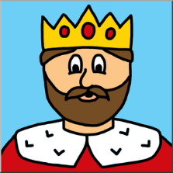
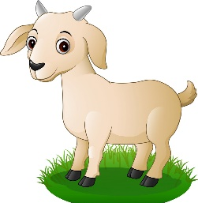



Class Assignment : Write in notebook .
Write two rhyming words for given pictures :
1.
Ring
Sing
2.
Boat
Coat
3.
String
King
4.
Man
Pan

Slide 3
ACTIVITY : PASS THE RHYME.
The teacher says a word aloud. The student says a word that rhymes with the given word and the game continues with next student .

Slide 4

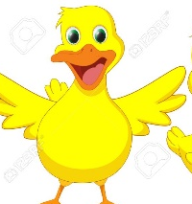

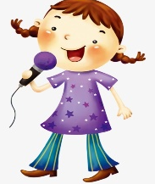







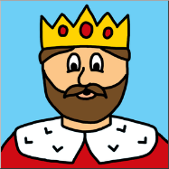






Home Assignment : Colour the thumb(red) for correct rhyming pictures .

Slide 5

THANKING YOU
ODM EDUCATIONAL GROUP

