Slide 1

WELCOME TO ONLINE CLASS
SUBJECT-ENGLISH
CHAPTER- 4
TOPIC - Uses of 'These' and 'This'

Slide 2



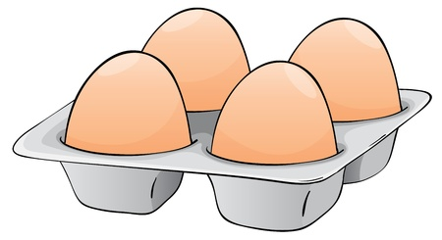



Answer the questions :
Class Assignment.
What are these ?
Ans. These are caps .
2. What is this ?
Ans. This is a chair .
3. What are these?
Ans. These are eggs.
4. What are these ?
Ans. These are bells.

Slide 3
Read the sentences and draw the picture in your notebook ( Home Assignment)
1. These are balls.
2. This is a fish.
3. These are fingers.
4. This is a net.

Slide 4

THANKING YOU
ODM EDUCATIONAL GROUP

