Slide 1


CLASS : UKG
SUBJECT : ENGLISH
CHAPTER : 9
TOPIC : Types Of Animals

Slide 2



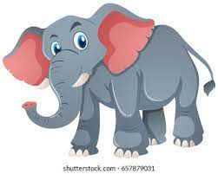
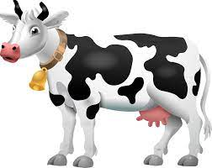
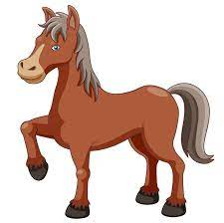
TYPES OF ANIMALS
Types of Animals
Pet(Animals that live at home)
Domestic(Animals that live on a farm)
Wild(Animals that live in the forest)

Slide 3


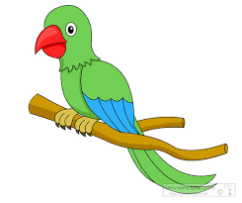
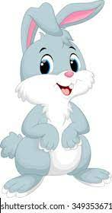
Animals that live at home
Dog
Cat
Parrot
Rabbit

Slide 4
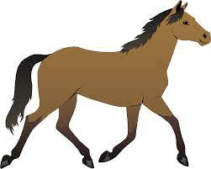
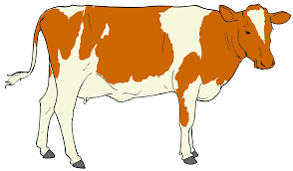
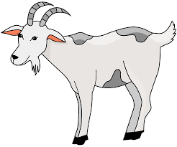
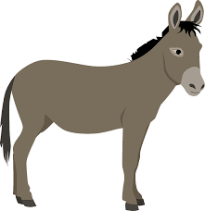
Animals that live on a farm
Cow
Horse
Goat
Donkey

Slide 5
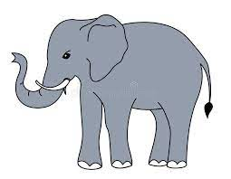

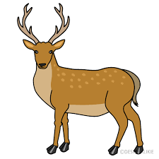
Animals that live in the forest
Elephant
Lion
Tiger
Deer

Slide 6
Home Assignment
Make a list of pet animals, domestic animals, wild animals
Pet
Domestic
Wild

Slide 7
THANKING YOU
ODM EDUCATIONAL GROUP

