Slide 1


PHYSICAL CHEMISTRY
CHAPTER NUMBER: 03
CHAPTER NAME: ELECTROCHEMISTRY

Slide 2
Lecture – 01: Electrochemical cell,Electrode potential,Standard Electrode potential,
Introduction
English chemist John Daniell and physicist Michael Faraday both credited as founder of electrochemistry .
Electrochemistry is the study of chemical reaction which take place at the interface of an electrode usually solid metal, semiconductor and an ionic conductor, the electrolyte.
It deals with the interaction between electrical energy and chemical change.
Study of electrochemistry is important for creating new technologies that are eco-friendly. The transmission of sensory signals through cells to brain and vice versa is also of electrochemical origin.

Slide 3
ELECTROCHEMICAL CELL
A device which is used to convert chemical energy produced in a spontaneous redox reaction into electrical energy is called electrochemical cell or Galvanic Cell.
Galvanic cell consists of two half cells and the reaction occurring in half cells are called half cell reactions. Each half cell consists of metallic electrode dipped in an electrolyte.
The half cell in which oxidation occurs is called oxidation half cell and the reaction taking place is called oxidation half cell reaction. The half cell in which reduction occurs is called reduction half cell and the reaction taking place is called reduction half cell reaction .
The electrode where oxidation occurs is called anode and the electrode where reduction occurs is called cathode.
Since at anode electrons are released, this electrode is rich in electrons and hence assigned negative charge and at cathode, electrons are gained and it is deficient of electrons and acts as positively charged electrode.

Slide 4
The electrodes of the two half cells are connected by a metallic wire through a voltmeter externally.
Electrons flow from anode to cathode in the external circuit and conventionally current flow in opposite direction i.e. from cathode to anode.
The two half cells are joined by a salt bridge internally that maintains electrical neutrality of the two half cells and complete the electrical circuit by allowing the ions to flow.
The salt bridge containing inert electrolytes like KCl, KNO₃, K₂SO₄ etc or solidified solution of such an electrolyte in gelatin or agar-agar. The ions of inert electrolytes don’t take part in redox reaction.

Slide 5
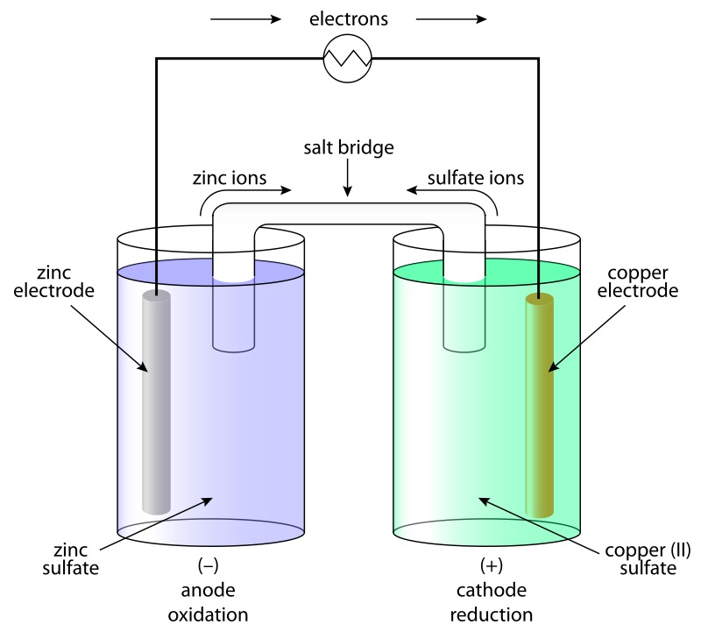
ELECTROCHEMICAL CELL:SCHEMATIC REPRESENTATION

Slide 6
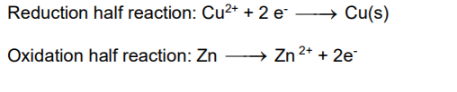
DANIELL CELL
The Electrochemical cell which converts the chemical energy liberated in the redox reaction between zinc and cupric ions to produce electrical energy is called Daniell cell.
The reaction is a combination of two half cell reactions:
Daniell cell has an electrode potential of 1.1 V when concentration of ions are unity.
When an external opposite potential is applied in Daniell cell then reaction continues till the opposite voltage reaches the value 1.1 V.
When the opposite potential is 1.1 V then reaction stops. When opposite potential is greater than 1.1 V then the reaction starts in opposite direction and it function as electrolytic cell, which is defined as the cell in which non-spontaneous reaction occurs using electric current.

Slide 7
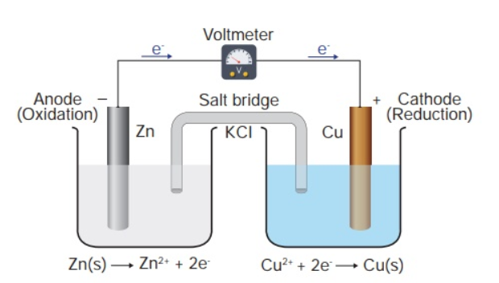
DANIELL CELL:SCHEMATIC REPRESENTATION
Zn Rod(Anode) dipped in 1M Zinc Sulphate solution and Cu Rod(Cathode) dipped in 1M Copper Sulphate solution.

Slide 8
ELECTRODE POTENTIAL
Electrode Potential (E): The tendency of an electrode to lose or gain electrons when it is in contact with solution of its own ions is called electrode potential. Or the electrical potential difference set up between the metal and its ions in the solution is called electrode potential.
When in the half cell, the electrode is in a solution of 1M conc. and the temperature is at 298K, pressure is at 1 bar then the electrode potential is called standard electrode potential(E⁰ ).
Electrode potential can be expressed in terms of oxidation potential and Reduction potential. Tendency of an electrode to lose electrons or to get oxidize is called oxidation potential. Tendency of an electrode to gain electrons or to get reduce is called reduction potential.
Standard oxidation potential and standard reduction potential of an electrode are same in magnitude with opposite in sign.
According to convention the standard reduction potentials are called standard electrode potentials. Electrode potential depends on the following factors:
i) Nature of the electrode. ii) Concentration of the electrolytic solution. iii) Temperature.

Slide 9
ELECTRODE POTENTIAL AND CELL POTENTIAL:MATHEMATICL EXPRESSION AND NOTATIONS
The difference between the two electrode potentials of the two electrodes is called cell potential or cell voltage or cell emf when no current is drawn from the cell.
Or
(Cathode is placed at Right and Anode at Left side )
The standard cell potential is given as:
Where : Standard Cell Potential
Where : Standard Reduction Potential of Cathode
Where : Standard Reduction Potential of Anode
At equilibrium, as the electrode potentials of the two half cells remain same so the emf of the cell is zero. But as in standard state the electrode potential of two electrodes are
not same so the standard cell potential ( ) of any Galvanic cell never becomes zero.

Slide 10


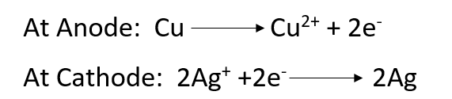

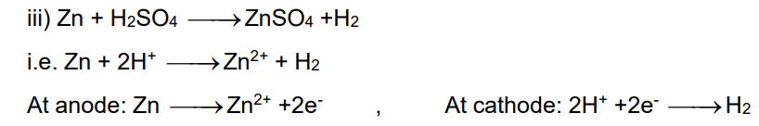
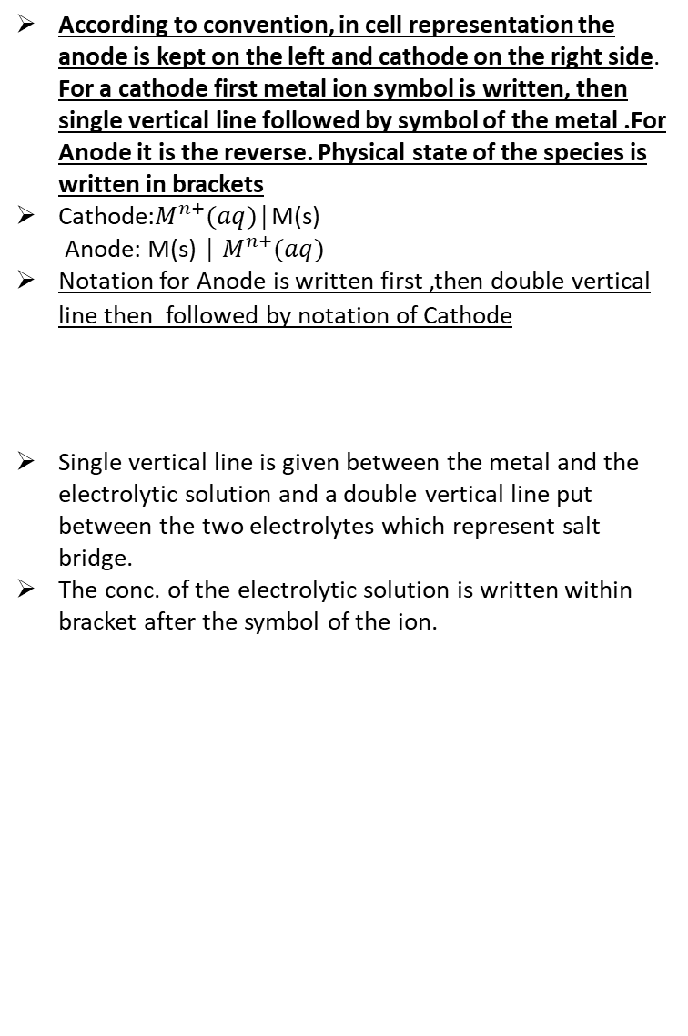
Lecture-02:Cell Representation,Measurement of Electrode potential;Standard Hydrogen Electrode
CELL REPRESENTATION OR CELL NOTATION
Examples of Cell notations:
According to convention, in cell representation the anode is kept on the left and cathode on the right side. For a cathode first metal ion symbol is written, then single vertical line followed by symbol of the metal .For Anode it is the reverse. Physical state of the species is written in brackets
Cathode:$M^{n+}(aq)$│M(s)
Anode: M(s) │ $M^{n+}(aq)$
Notation for Anode is written first ,then double vertical line then followed by notation of Cathode
Single vertical line is given between the metal and the electrolytic solution and a double vertical line put between the two electrolytes which represent salt bridge.
The conc. of the electrolytic solution is written within bracket after the symbol of the ion.
Cell Representation:
Cell Potential:
Cell Representation:
Cell Potential:
Cell Representation:
Cell Potential:
Zn(s)│Zn²⁺(aq)║ Cu²⁺(aq)│Cu(s)
Cu(s) │ Cu²⁺(aq)║ Ag⁺(aq)│Ag(s)
Zn(s)│Zn²⁺(aq)║ H⁺(aq)│H₂(g),Pt(s)

Slide 11
Measurement of Electrode potential;Standard Hydrogen Electrode(SHE)
The potential of individual half cell cannot be measured. We can measure only the difference between the two half cell potentials, that gives the EMF of the cell. This can be done using Standard Hydrogen Electrode (SHE).
Represented by Pt(s),H₂(g)l H⁺(aq)(if Anode ) and H⁺(aq)│H₂(g),Pt(s)(if Cathode) and assigned as zero potential at all temperature.
Reaction involved: H⁺(aq) + e- →1/2 H₂ (g)(the reaction is for SHE as Cathode. If SHE is Anode the reaction is just the reverse)
Platinum electrode coated with platinum black is dipped in an acidic solution and pure hydrogen gas bubbled through it.
The concentration of both the reduced and oxidised forms of hydrogen is maintained at unity and the gas is at 1 bar pressure and 298 K.
If SHE acts as anode(reference half cell) the other half as cathode and vice-versa.
Standard cell potential (Eº) = (SHE as anode)

Slide 12
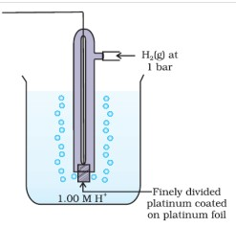
STANDARD HYDROGEN ELECTRODE

Slide 13
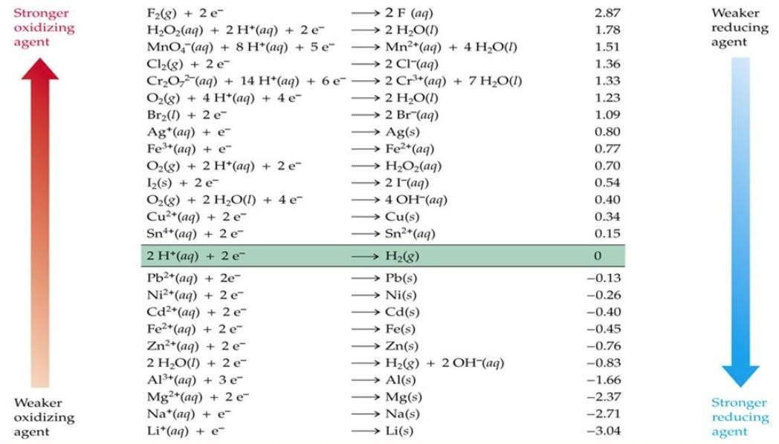
Lecture – 03:Electrochemical Series and its Applications
The arrangement of all electrodes in the increasing or decreasing order of their standard reduction potential values is called electrochemical series or activity series.
The -ve value of standard reduction potential indicates the electrode acts as anode when joined with SHE and the +ve value of standard reduction potential indicates the electrode acts as cathode when joined with SHE
Electrochemical Series

Slide 14

Application of Electrochemical Series
To compare the relative strength of oxidizing and reducing agent.
The substances which have higher reduction potentials are stronger oxidizing agent and which have lower reduction potentials are weaker oxidizing agent. So F₂ is the strongest oxidizing agent and Li⁺ is the weakest oxidizing agent.
The electrode having higher E⁰ value is converted into more stable reduced form. So in activity series F⁻ is most stable reduced form and Li is most unstable reduced form.
The electrode having lower E⁰ value acts as stronger reducing agent and having higher E⁰ value acts as weaker reducing agent. So Li is the strongest reducing agent and F⁻ is weakest reducing agent
The electrode having lower E⁰ value is converted into more stable oxidized form. So in activity series Li⁺ is most stable oxidized form and F₂ is most unstable oxidized form.
To predict whether a metal can liberate H₂ from acid or not:
The metals which have -ve reduction potentials can liberate H₂ from acid and the metals having +ve E⁰ value can’t liberate H₂ from any acids.
So Cu doesn’t dissolve in HCl as H⁺ can’t oxidize Cu to Cu²⁺ due to its lower E⁰ value. But Cu dissolve in HNO₃ where NO₃⁻ ion which has higher E⁰ value than Cu oxidize Cu to form Cu²⁺ .

Slide 15
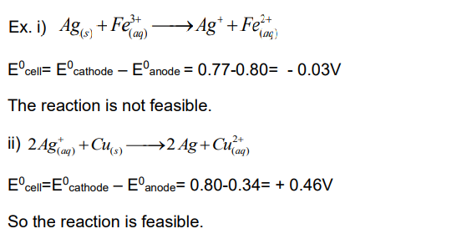
To predict the feasibility of redox reaction:
A redox reaction is feasible only if standard EMF of cell is +ve. Otherwise it is not feasible. Or a redox reaction is feasible only if the species which has higher reduction potential is reduced i.e. accepts electrons and the species which has lower reduction potential is oxidized i.e. loses the e- , otherwise the reaction is not feasible.
To compare the relative activity of metals:
Metals having lower reduction potential value can easily lose electrons and it has greater reactivity. So the metal having lower E⁰ value can displace metals with higher E⁰ value from their salt solution.
Ex. Mg > Zn > Fe > Cu > Ag

Slide 16
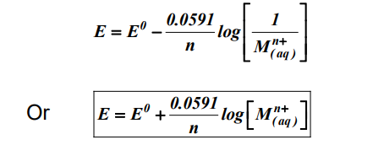

Lecture-04:Nernst Equation and its application ,Relation between gibbs free energy and EMF of cell
Nernst equation gives a relationship between reduction potential of an electrode and conc. of electrolyte in the solution.
Consider an electrode reaction, M ^{n+}(aq)+ n e⁻ → M(s)
Nernst Equation is
OR
Where
=Electrode potential of the electrode. and =Standard electrode potential of the electrode.
R = Universal gas Constant=8.314 J K⁻¹ mol⁻¹. n =No of electrons involved in electrode reaction .
F =1 faraday=96,500 C = Concentration of Solid atom=1M. = Concentration of ion of M.
At 25ºC, putting the values of above terms, the Nernst equation becomes

Slide 17

NERNST EQUATION FOR A GENERAL ELECTROCHEMICAL REACTION
For a general electrochemical reaction of the type.
The Nernst Equation can be Written as:
Converting to Natural Logarithm:
‘
Substituting Temperature value as 298K and
Value of R and F we get
= Cell potential at the given concentration.
= Standard Cell Potential.
R = Universal gas Constant=8.314 J K⁻¹ mol⁻¹
T = Temperature in Kelvin.
F = Faraday(F) 1F =96500 Coulombs.
n = No. of electrons involved in the reaction.
[C ] [D],[A],[B] represent concentration of species involved in the reaction in terms of Molarity(moles/L) and c, d, a, b are their respective stoichiometric coefficients.

Slide 18
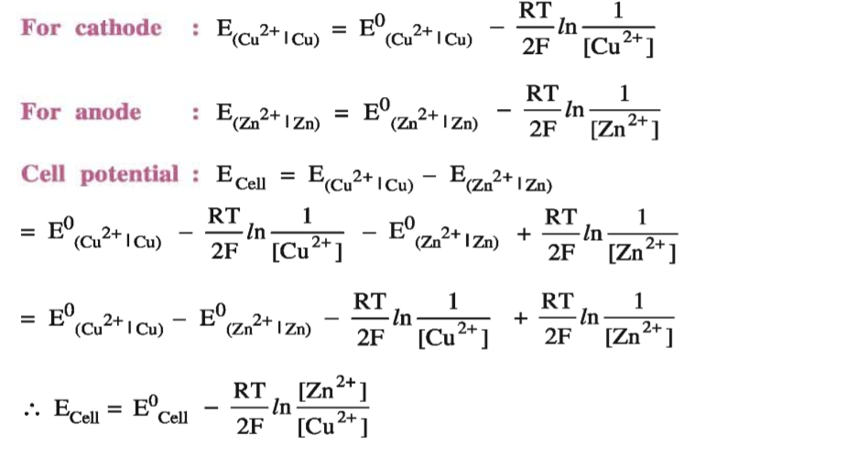
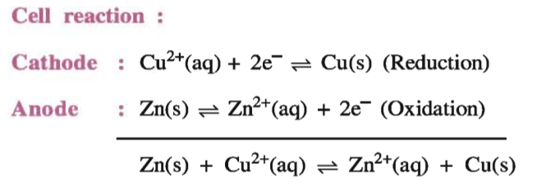
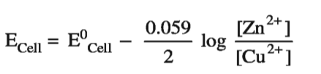
Application of Nernst Equation to Electrochemical cell
In a Daniel cell :
At 25ºC the above equation becomes

Slide 19

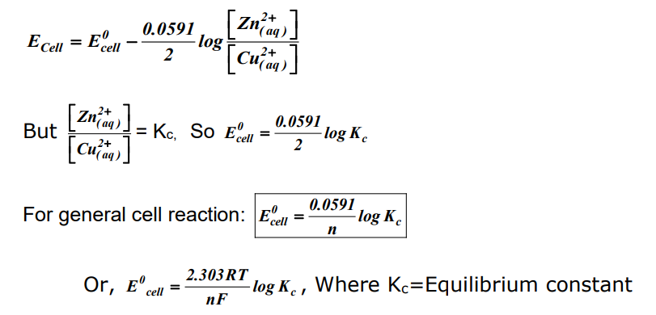
Relation between Cell Potential and Equilibrium Constant
Consider the Daniell cell:
At equilibrium conc. of Cu²⁺ and Zn²⁺ ions don’t change and the electrode potentials of the two electrodes remain same.
So E_{cell} =0 According to Nernst equation:

Slide 20
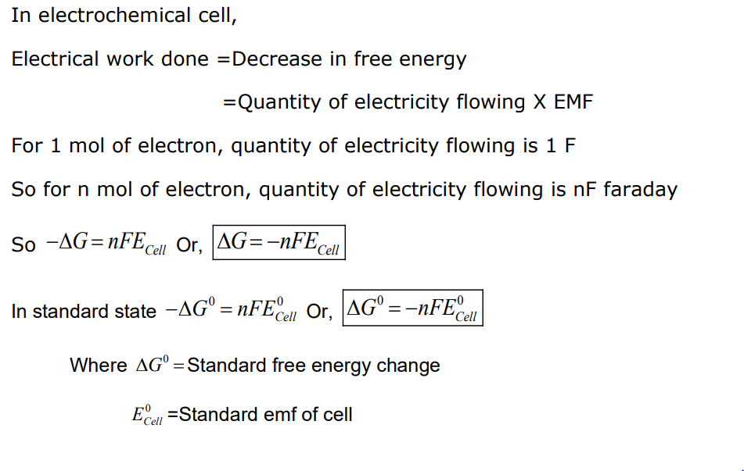
Relation between Cell Potential and Gibb’s Free Energy
The electrical work done by the cell results decrease in free energy of the system and electrical work done on the cell results increase in free energy of the system.

Slide 21

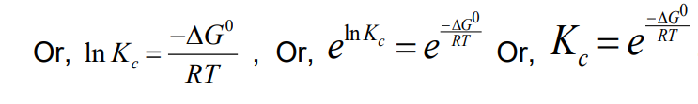

Relation between Gibb’s Free Energy and Equilibrium Constant

Slide 22

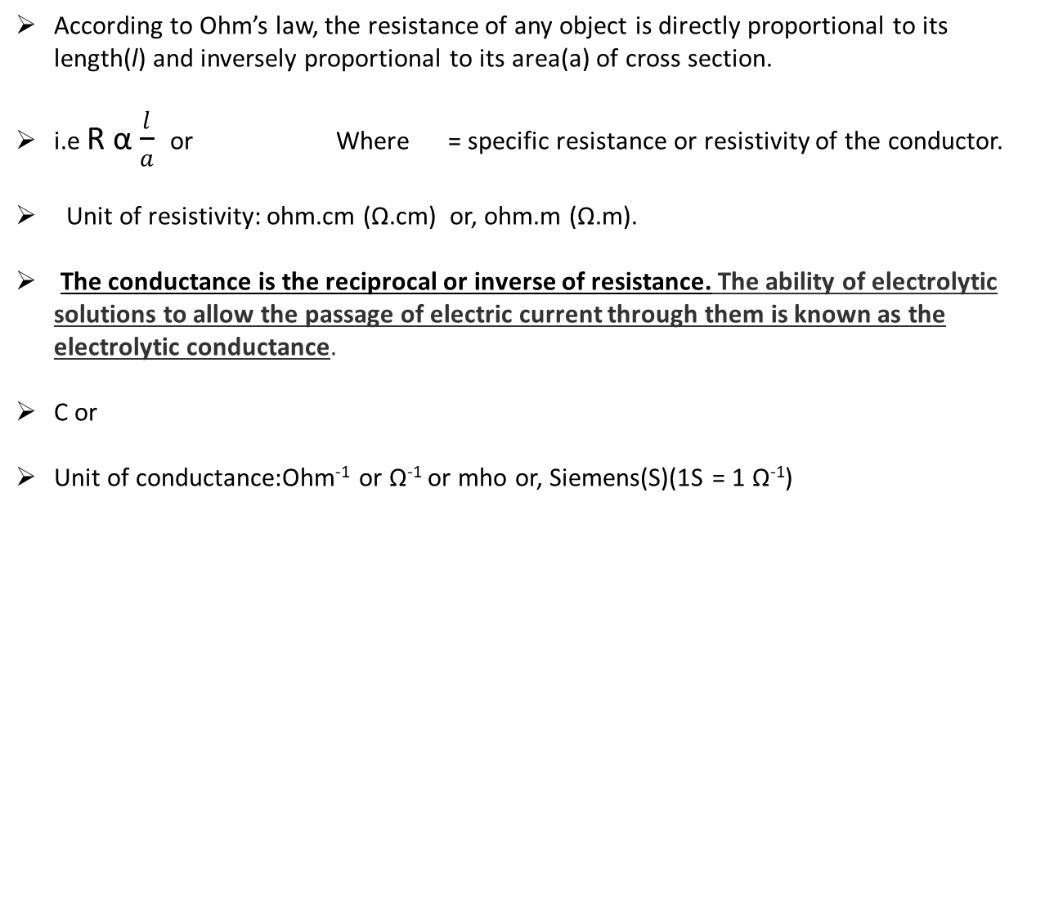
Lecture-05:Resistance and Conductance,Electronic and Electrolytic Conductance
According to Ohm’s law, the resistance of any object is directly proportional to its length(l) and inversely proportional to its area(a) of cross section.
i.e R α $\frac{l}{a}$ or Where = specific resistance or resistivity of the conductor.
Unit of resistivity: ohm.cm (Ω.cm) or, ohm.m (Ω.m).
The conductance is the reciprocal or inverse of resistance. The ability of electrolytic solutions to allow the passage of electric current through them is known as the electrolytic conductance.
C or
Unit of conductance:Ohm⁻¹ or Ω⁻¹ or mho or, Siemens(S)(1S = 1 Ω⁻¹)

Slide 23
Electronic and Electrolytic Conductance
Conductors are of two types :
(i) Electronic conductors
(ii) Electrolytic conductor
Electronic Conductors: These are the metallic conductors in which the conductance is due to movement of electrons. The electronic conductance depends on:
  The nature and structure of metal
  The no. of valence electrons per atom
  Temperature
The electronic conductance decreases with increase in temperature. This is because with increase in temp, the kernels start vibrating which produce hindrance in the flow of electrons.

Slide 24
(ii) Electrolytic conductance:The conductance of electricity by ions present in the solutions is called electrolytic or ionic conductance. The electrolytic conductance depends on:
  The nature of the electrolyte.
  Size of ions produced and their solvation.
  The nature of solvent.
  Concentration of the electrolyte.
  Temperature.
  The electrolytic conductance increases with the increase in temperature due to increase in dissociation or decrease in ionic attraction.
  Measurement of Electrolytic conductance: For the measurement of ionic or electrolytic conductance, there are two problems like:
  Passing direct current changes the composition of solution.
  The solution can’t be connected to bridge like a metallic wire.
So alternating current is used for ionic conductance to prevent the change in composition of the solution The conductivity cell is used to connect the solution with the bridge like metallic wire . The conductivity cell consists of two platinum electrodes coated with platinum black.

Slide 25
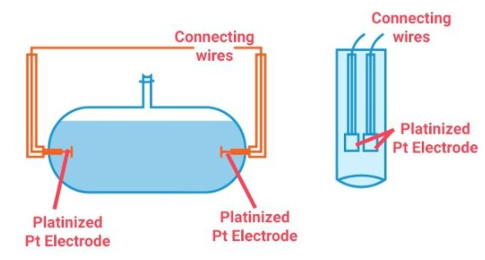
CONDUCTIVITY CELLS

Slide 26
Lecture-06:Types of Electrolytic Conductance,Specific Conductance,Molar Conductance,Equivalent Conductance
Types of electrolytic conductance:
The electrolytic or ionic conductance is of three types like
  Specific conductance
  Molar conductance
  Equivalent conductance
  Specific conductance or conductivity:
  We know
  or
  Where (kappa) is called Conductivity or specific conductance of the electrolyte and is given by:

Slide 27
  Specific conductance or conductivity( ):Definition and unit
The quantity l/a is called as Cell constant symbolized by ‘G*’.For a given conductivity cell, the cell constant value remains fixed.
The cell constant is usually determined by measuring the resistance of the cell containing a solution whose conductivity is already known. For this purpose, KCl solutions are used whose conductivity is known accurately at various concentrations.
So, Where = Cell Constant
When l=1cm, a= 1cm², then
So specific conductance of a solution is defined as the conductance of the solution of 1 cm length and having 1 cm² as the area of cross section.
When l=1 cm, a = 1cm² ,then V=1cm³ So,
So specific conductance of a solution is defined as the conductance of the solution having volume 1 cm^{3.}
Unit of is:Ohm⁻¹.cm⁻¹ or Ohm⁻¹m⁻¹ or S m⁻¹ or, S. cm⁻¹ 1S.cm⁻¹=100 S. m⁻¹

Slide 28
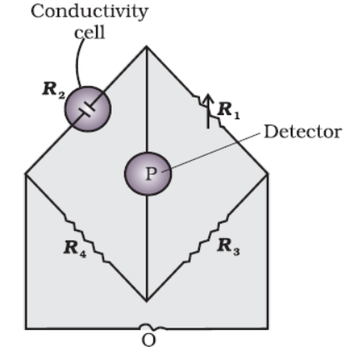

Measurement of Resistance or Conductivity of any solution
Once the cell constant is determined using KCl solutions ,it can be used for measuring the resistance or conductivity of any solution.
The set up for the measurement of the resistance is shown in the Figure to the right(known as wheat-stone bridge). It consists of two resistances R₃ and R₄ (known resistances), a variable resistance R₁ and the conductivity cell having the unknown resistance R₂ . The Wheatstone bridge is fed by an oscillator O (Oscillator O is the source of A.C power.)
P is a suitable detector (a headphone or other electronic device) and the bridge is balanced when no current passes through the detector. Under these conditions:
Once the cell constant and the resistance of the solution in the cell is determined, the conductivity of the solution is given by the equation:
Arrangement of Wheatstone bridge Circuit to measure Conductivity of a solution

Slide 29
  Molar Conductance or Molar Conductivity( ):Definition and unit
It is defined as the conductance of a solution containing 1 mole of electrolyte kept between two electrodes which are 1 cm apart from each other.
Let 1 mole of the electrolyte is present in V ml (cm³) of solution and is its specific conductance. Conductance of V ml solution = x V.
So
Let M be the molarity of the solution, then volume of solution containing 1 mole of electrolyte is
So,
Unit: Ohm⁻¹ cm². mol⁻¹ or, S cm². mol⁻¹ or, S m². mol^{-1.} 1 S m² mol⁻¹ = 10⁴ S. cm². mol⁻¹
Limiting Molar Conductance: The molar conductance of an electrolyte at infinite dilution or zero concentration is known as limiting molar conductance.( )

Slide 30

  Equivalent Conductance or Equivalent Conductivity ( ):Definition and unit
The term ‘equivalent conductance’ can be defined as the net conductance of every ion that is produced from one gram equivalent of a given substance.
It can be calculated using the following formula: ,where V is the volume of the solution containing 1 gram-equivalent of electrolyte.
Let N be the Normality of the solution, then volume of solution containing 1 gram-equivalent of electrolyte is
So,
Unit: Ohm⁻¹ cm². equivalent⁻¹ or S cm². equivalent⁻¹
Equivalent Conductance =$\frac{Molar Conductance}{n}$ Where n=$\frac{Molecular Mass}{Equivalent Mass}$

Slide 31
Lecture-07:Variation of Conductance or Conductivity with Dilution for Strong and Weak Electrolyte,Debye-Huckel Equation,Kohlrausch’s Law and its Applications
The specific conductance of an electrolyte decreases with dilution. This is because on dilution the ions present per 1 cm³ volume of the solution decreases.
It has been found that the decrease in specific conductance on dilution of a solution is more than compensated by increases in its volume.
For strong electrolytes the molar conductance increases slowly with dilution because for a strong electrolyte the dissociation is complete in solution, so on dilution the no of ions remain constant but with dilution the inter ionic attraction decrease and mobility of ions increases due to which the conductance increases.
For weak electrolyte, the molar conductance increases steeply with dilution. This is because with dilution the dissociation of electrolyte increases and the no. of ions from 1 mol of electrolyte in total volume of solution increase.

Slide 32
Debye-Huckel Equation
This variation of molar conductance with concentration(for strong Electrolytes) is given by Deby-Huckel-Onsagar equation which is:
= Molar conductance at infinite dilution.
= Molar conductance at given concentration.
C= Concentration of Electrolyte.
A = Constant depending on the type of electrolyte i.e. on the charges of Cation or anion produced by dissociation of electrolyte.
For NaCl type A = 1-1, For CaCl₂ type A = 2-1.

Slide 33
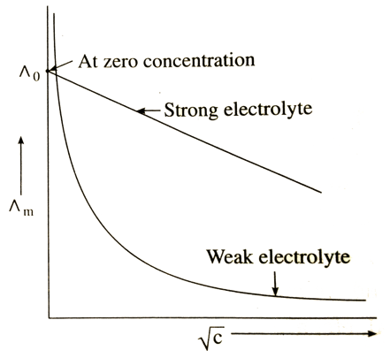
Variation of Molar conductance with Dilution for Strong and Weak Electrolyte and measurement of limiting molar conductance
It is possible to determine the molar conductance at infinite dilution in case of strong electrolyte by extrapolation of curve of vs .
On contrary, the value of molar conductance of weak electrolyte at infinite dilution cannot be determined by extrapolation of the curve as the curve becomes almost parallel to y-axis when concentration approaches to zero.
So molar conductance of weak electrolyte at infinite dilution is determined by infinite dilution.
Variation of Molar conductance with Concentration( vs graph ) for Strong and Weak Electrolyte (Slope of the graph=- A)

Slide 34
Kohlrausch’s law
Kohlrausch’s law states that ‘The limiting molar conductance of an electrolyte is the sum of individual contributions of the cation and anion of the electrolyte at infinite dilution’.
Where = Limiting molar conductance of an electrolyte.
= Limiting molar conductance of cation.
= Limiting molar conductance of Anion.
= Number on cations as per the chemical formula of the electrolyte.
= Number on Anions as per the chemical formula of the electrolyte.
For Example:

Slide 35
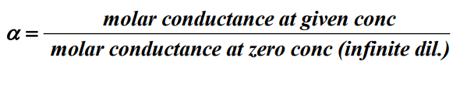

Application of Kohlrausch’s law
Calculation of limiting molar conductance for weak electrolyte: The molar conductance of weak electrolyte at infinite dilution can’t be obtained experimentally. It can be obtained indirectly by applying Kohlrausch’s Law:
For example :molar conductance of CH₃COOH can be determined in the following way;
(ii) Calculation of degree of dissociation:The degree of dissociation is defined as the fraction of total no of molecules which undergo dissociation. It can be obtained as:
or
(iii) Calculation of dissociation constant of weak electrolyte( ): By knowing the value of and Concentration(‘C’) , value can be determined by the following formula:

Slide 36
Lecture-08:Electrolysis ,Electrolytic Cell,Faraday’s Laws of Electrolysis,Predicting Products of Electrolysis
The device in which electrical energy is used to bring about a non-spontaneous redox reaction is called Electrolytic Cell.
Two metallic electrodes are kept immersed in an electrolyte. The one connected to +ve terminal of the battery is called anode and the one connected –ve terminal of the battery is called cathode.
When no electric current is passed the ions of the electrolyte move randomly and due to passage of electric current the ions migrate towards oppositely charge electrodes and get neutralized. This process is called electrolysis.
Like Galvanic cell here reduction takes place at cathode and oxidation takes place at anode.
Some important applications of the process of electrolysis are Electroplating, Electro refining etc.
The metals which have higher reducing power like Na, Mg, Al can be reduced by electrochemical reduction. Copper can be purified by electrolysis method.

Slide 37
FARADAY’S LAWS OF ELECTROLYSIS:
First Law of Electrolysis: The mass or amount of the substance deposited or liberated at any electrode during electrolysis is directly proportional to the amount of electricity passed through the electrolyte.
Mathematically, W α Q
or W=ZQ
Where W = amount of substance produced at electrode
Q = quantity of electricity passed through electrolyte
Z = Proportionality constant called electrochemical equivalent of the substance.
When Q = 1 C, then Z=W
So electrochemical equivalent (Z) is defined as mass of the substance deposited or liberated by passing 1 coulomb of electricity through the electrolyte.
Again where I=Current in Amperes and t=Time in seconds
So,

Slide 38
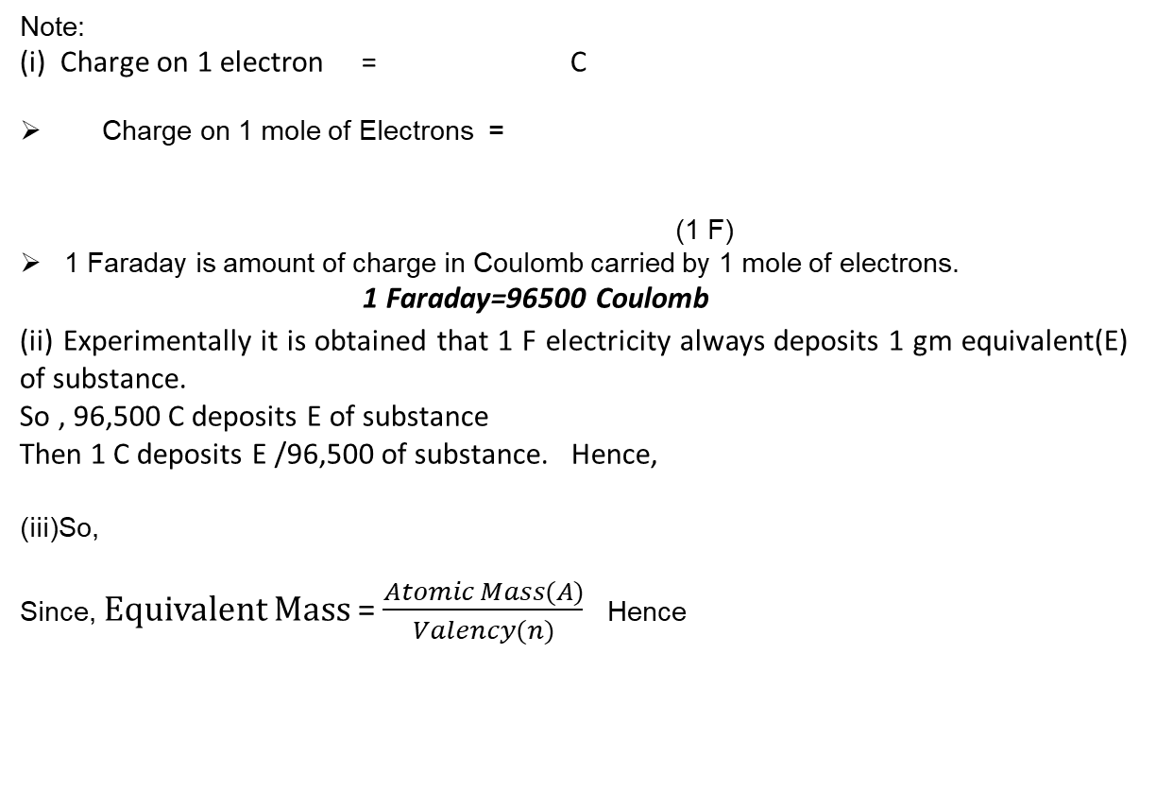
Some Important points regarding 1 Faraday and Electrochemical Equivalent
Note:
(i) Charge on 1 electron = C
Charge on 1 mole of Electrons =
(1 F)
1 Faraday is amount of charge in Coulomb carried by 1 mole of electrons.
1 Faraday=96500 Coulomb
(ii) Experimentally it is obtained that 1 F electricity always deposits 1 gm equivalent(E) of substance.
So , 96,500 C deposits E of substance
Then 1 C deposits E /96,500 of substance. Hence,
(iii)So,
Since, Equivalent Mass =$\frac{Atomic Mass(A)}{Valency(n)}$ Hence

Slide 39
Second Law of Eelctrolysis:
When same amount of electric current is passed through different electrolytes connected in series, then masses of the substances produced at the electrodes are directly proportional to their equivalent masses
Considering two electrolytic solutions like CuSO₄ solution and AgNO₃ solution which are also connected in series.
By Faradays 2nd Law of electrolysis
W₁ α E₁ W₂ α E₂
_{Hence}
By Faradays 1st Law of electrolysis : and
So from all the above equations we finally obtain that :
Suppose
W1: | Mass of Cu deposited | E1: | Equivalent mass of Cu
W2: | Mass of Ag deposited | E2: | Equivalent mass of Ag

Slide 40
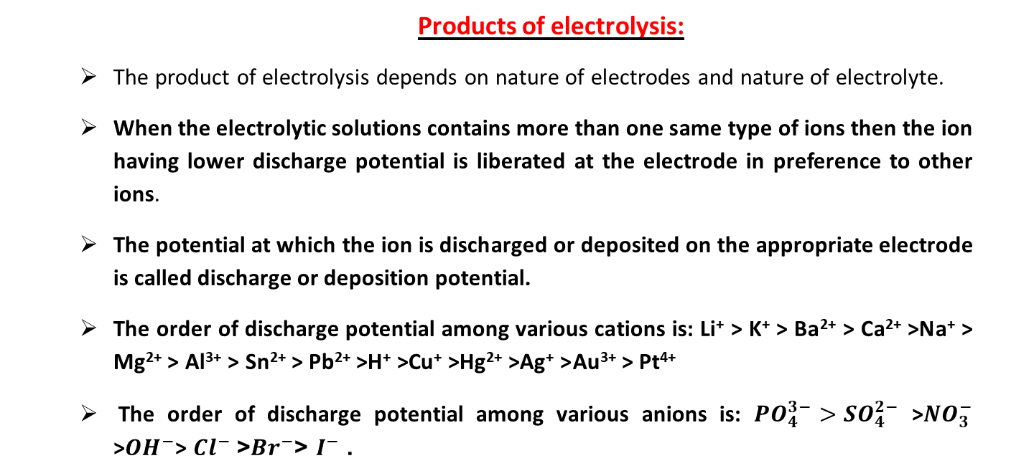
Products of electrolysis:
The product of electrolysis depends on nature of electrodes and nature of electrolyte.
When the electrolytic solutions contains more than one same type of ions then the ion having lower discharge potential is liberated at the electrode in preference to other ions.
The potential at which the ion is discharged or deposited on the appropriate electrode is called discharge or deposition potential.
The order of discharge potential among various cations is: Li⁺ > K⁺ > Ba²⁺ > Ca²⁺ >Na⁺ > Mg²⁺ > Al³⁺ > Sn²⁺ > Pb²⁺ >H⁺ >Cu⁺ >Hg²⁺ >Ag⁺ > Au³⁺ > Pt⁴⁺
The order of discharge potential among various anions is: ${PO}_{4}^{3−}{>SO}_{4}^{2−}$ >${NO}_{3}^{−}$ >${OH}^{−}$> ${Cl}^{−}$ >${Br}^{−}$> $I^{−}$ .

Slide 41
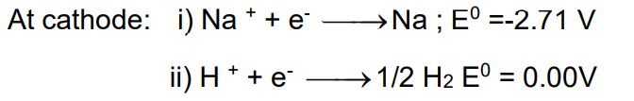
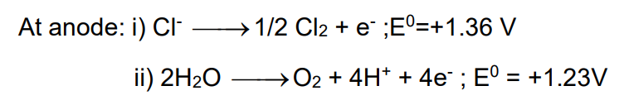
Higher the value of reduction potential more is its power to get deposited at cathode and Higher the value of oxidation potential more is its power to get discharged at anode.
During electrolysis of aqueous NaCl following reactions can occur at electrodes:
The reaction with higher Eº value is preferred and hence H₂ is obtained at cathode.
The following Reactions can occur at Anode during electrolysis of NaCl
As Eº value of H₂O is lower so it should be oxidized at anode. But instead of H₂O , the Cl⁻ ion is oxidized at anode due to over potential of H₂O.
Over-Potential: Some electrode reactions (generally process of liberation of gases ) although feasible at their reduction potential value but they are kinetically so slow that at lower potential doesn’t seem to take place. To occur these processes some extra voltage is required to that of theoretical value. So over potential is defined as difference between the potential required for the evolution of gas and its standard electrode potential.

Slide 42
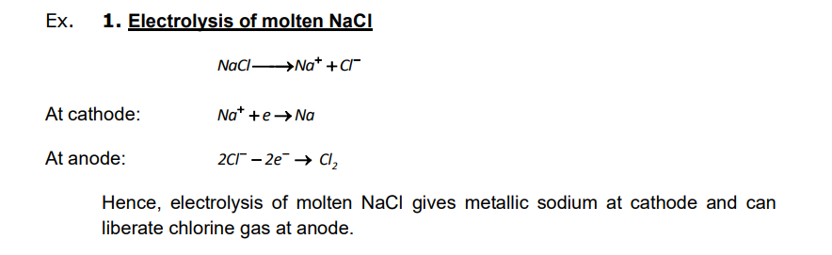
Products of electrolysis: Some Examples

Slide 43
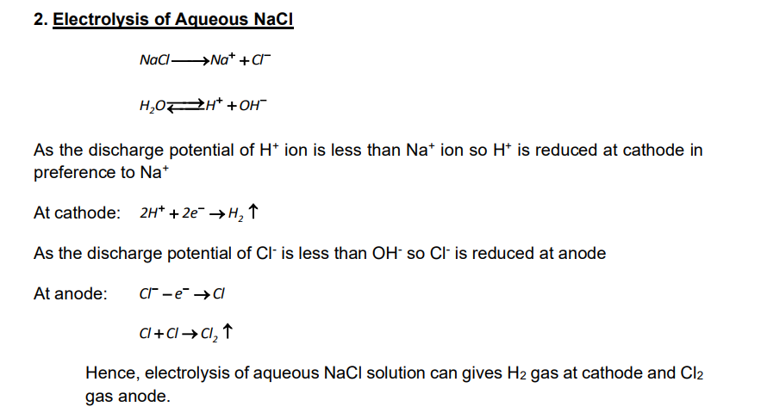

Slide 44
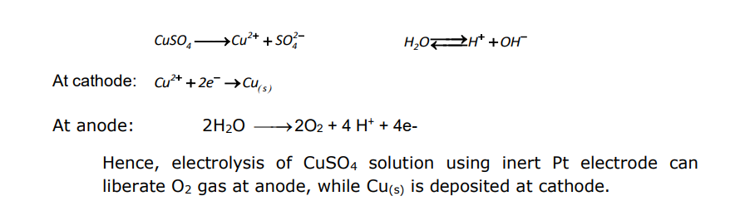

Slide 45
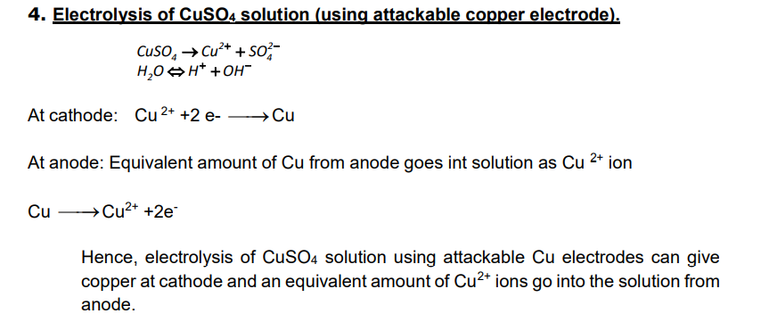

Slide 46
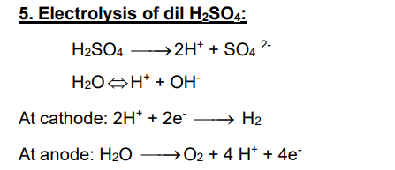

Slide 47
Lecture-09:Cells and Batteries ,Types of Cell ,Primary Cell,Secondary Cell,Dry Cell,Mercury Cell,Lead Storage Battery,Ni-Cd Cell,Fuel Cell
Cell or Battery: The Galvanic cell which is used as a source of electrical energy from chemical energy of spontaneous redox reaction is called cell or battery.
The battery may consist of a single cell or a number of cells connected in series.
It is of 2 types like :
Primary cell
Secondary cell
Primary cell: the cell in which the reaction occurs only once and it becomes dead after use over a period of time and can’t be reused again is called primary cell. Ex. Dry cell ,Mercury cell etc.
Secondary cells are those which can be recharged again and again for multiple uses. e.g. lead storage battery and Nickel – Cadmium Storage Cell.

Slide 48
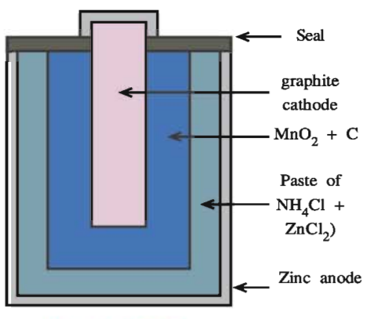
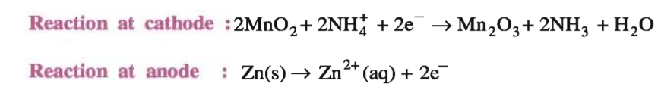
DRY CELL
Anode : Zn container
Cathode : Carbon (graphite) rod
surrounded by powdered MnO₂ and carbon.
Electrolyte : NH₄Cl and ZnCl₂
_{Overall Reaction:}
The standard potential of this cell is 1.5 V
and it falls as the cell gets discharged continuously and once used
it cannot be recharged.
DRY CELL(Leclanche Cell)

Slide 49
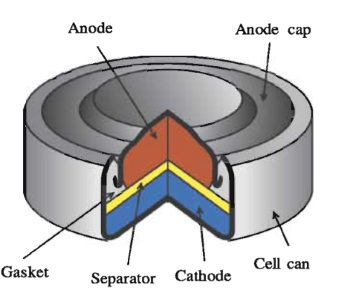
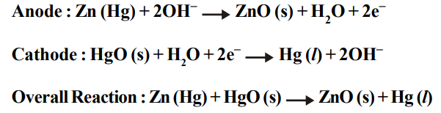
MERCURY CELL
These are used in small equipments like watches, hearing aids.
Anode : Zn – Hg Amalgam.
Cathode : Paste of HgO and carbon.
Electrolyte : Paste of KOH and ZnO.
The cell potential is approximately 1.35V and remains constant during its life.
MERCURY CELL

Slide 50
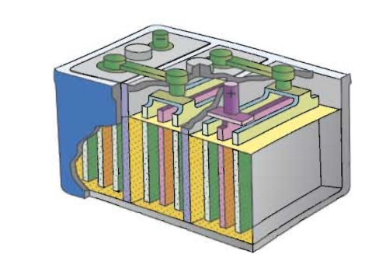
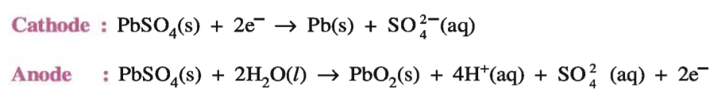
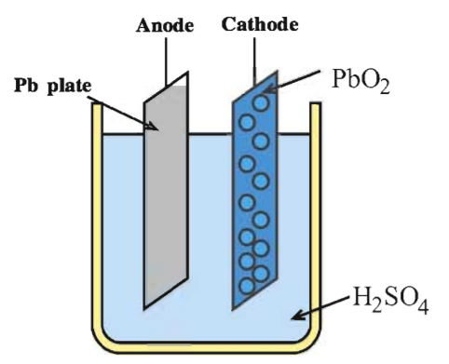
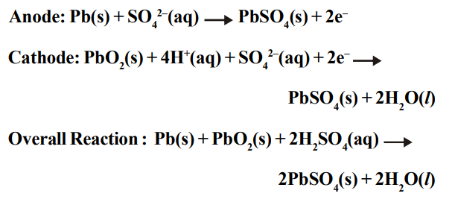
LEAD STORAGE BATTERY
It consists of 6 cells each producing 2V
Anode : Lead (Pb)
Cathode : Grid of lead packed with lead oxide (PbO₂ )
Electrolyte : 38% solution of H₂SO₄
Charging Reactions:
Dis-Charging Reactions:
It is used in automobiles and invertors.
LEAD STORAGE BATTERY

Slide 51
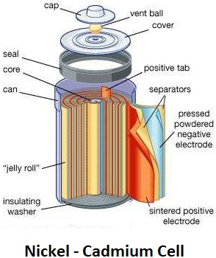
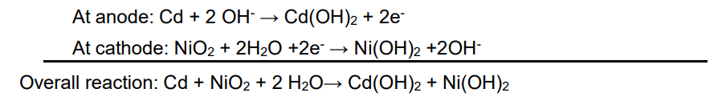
NICKEL-CADMIUM STORAGE CELL
Anode:Cadmium.
Cathode:Metal grid containing NiO₂
Electrolyte:KOH.
Cell Reactions:
On recharging the above reaction is reversed i. e. Cd(OH)₂ at anode is converted into Cd and Ni(OH)₂ at cathode is converted into NiO₂
EMF of Ni-Cd cell is 1.4 V and it is used in calculators.

Slide 52
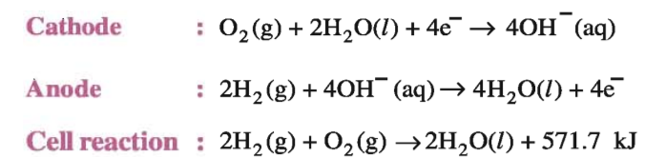
Fuel cells:
The electrochemical cell in which the energy produced from the combustion of fuels like H₂, CO, CH₄, CH₃OH etc. is directly converted into electrical energy are called fuel cells
H₂-O₂ fuel cell:
  It has E_{cell} of about 1.23 V.
  It is used as a source of energy in Apollo space programme.
  It consists of porous carbon electrodes containing suitable catalysts like Pt, Pd etc and conc. KOH or NaOH solution as electrolytes.
  H₂ and O₂ are bubbled through the porous electrodes into the NaOH or KOH solution.

Slide 53
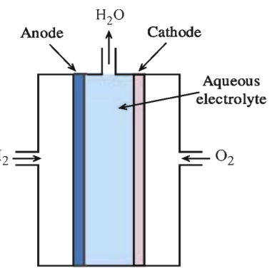
Fuel cells:
  Advantages:
    Fuel cells don’t cause any pollution.
    They give an efficiency of 70% compared to thermal plants which have efficiency 40%.
    Fuel cells never become dead.
Fuel cell

Slide 54
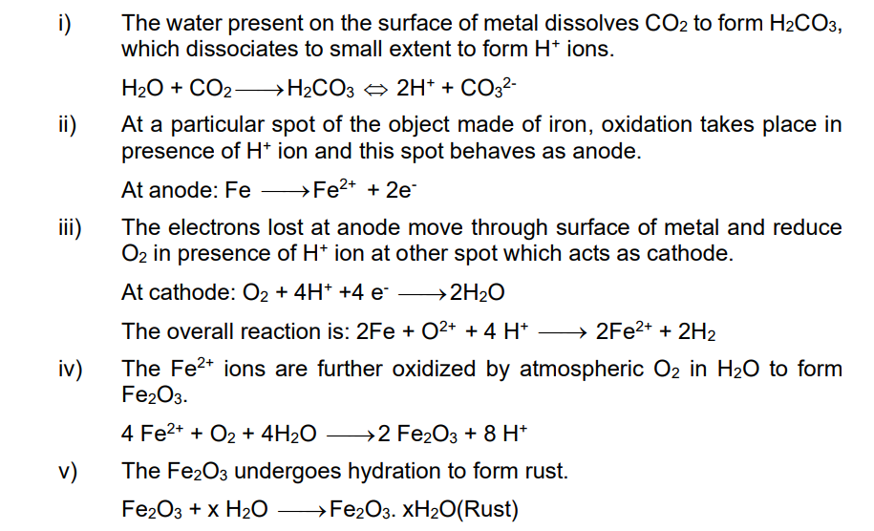
Lecture10:Corrosion,its Mechanism and its Prevention
Corrosion:
The process of slowly eating of metal in contact with water and air due to formation of oxides, sulphides and sulphates is called corrosion.Ex. Rusting of iron, tarnishing of silver, development of green coating on copper and bronze etc.
Rusting of iron: Rusting of iron is an electrochemical phenomenon and the formation of rust involves the following steps:

Slide 55
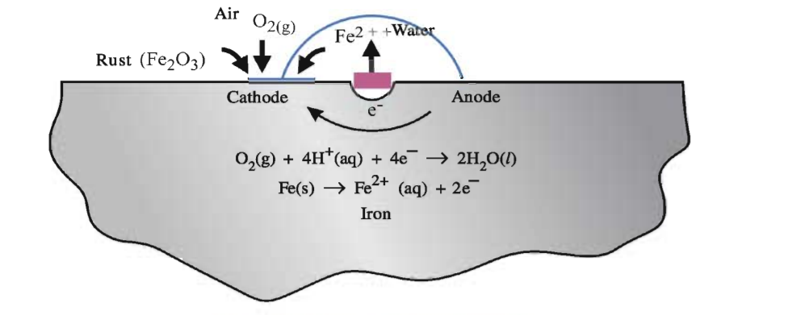
Mechanism of Corrosion

Slide 56
Prevention of Corrosion
Corrosion can be prevented by:
By covering the surface of metal with paint or by some chemicals like bisphenol.
By covering the surface of metal with inert or less reactive metals like Sn, Cr ,Cu etc.
Bu sacrificial protection i.e. the surface of metal is coated with more reactive metals like Mg, Zn which corrodes themselves but saves iron metal.
The metals whose reduction potential value has higher –ve than Iron are more reactive and hence can be used for sacrificial protection.
The electroplating of Zn on iron is called Galvanisation. Galvanizing is the process of immersing iron or steel in a bath of molten zinc to produce a corrosion resistant, multi-layered coating of zinc-iron alloy and zinc metal.
Alkaline medium inhibits the rusting of iron. Rusting of iron decreases with decrease in conc. of H⁺ ion on its surface. Alkaline medium prevents the availability of H⁺ ion which reduce rate of oxidation of Fe to Fe²⁺ . So rate of rusting process decreases.

Slide 57
THANKING YOU
ODM EDUCATIONAL GROUP

