Slide 1


CLASS-UKG
SUBJECT-STORY
TOPIC-BETTER ALONE
(ENGLISH)

Slide 2


A rich man had
only one son

Slide 3
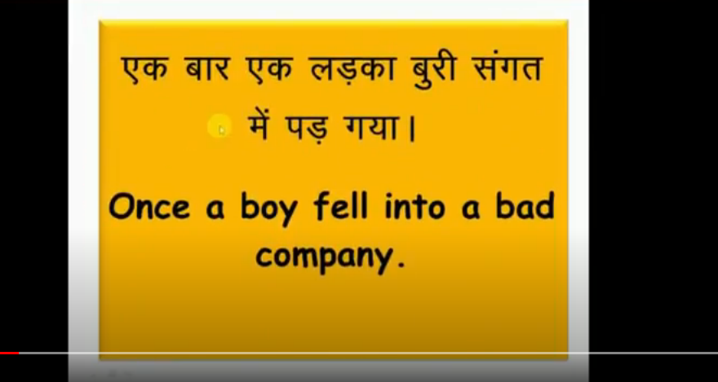
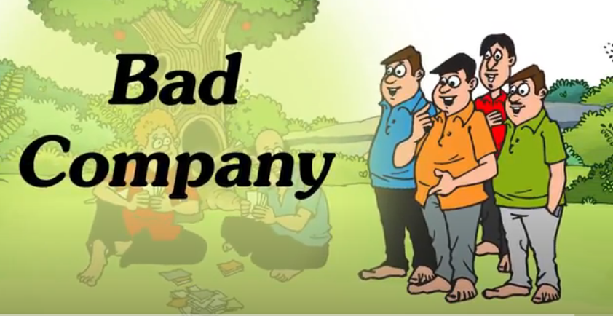
The boy fell in to the bad

Slide 4
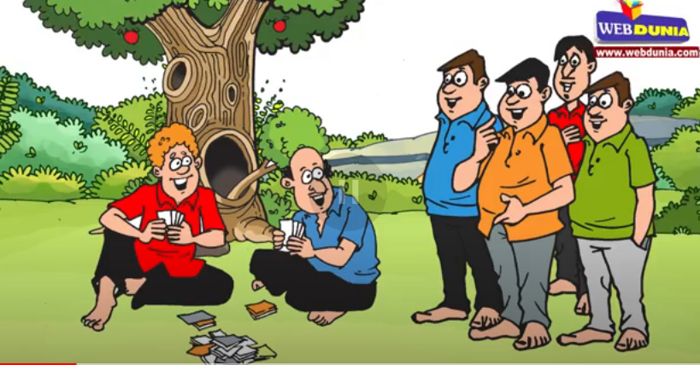

He developed many bad habits.

Slide 5
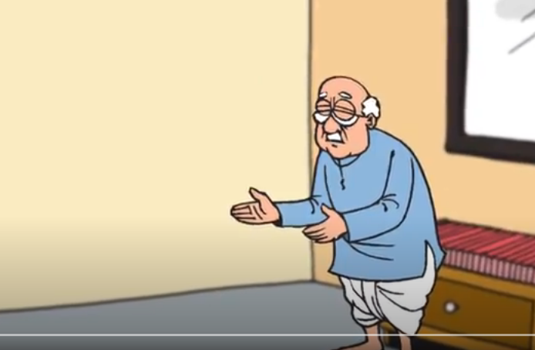
The man was much worried about the habits of his son.
He tried his best to mend his habits. But he could not succeed.

Slide 6

One day he thought of a plan to teach his son a lesson.

Slide 7
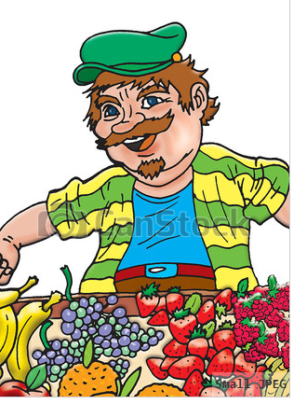


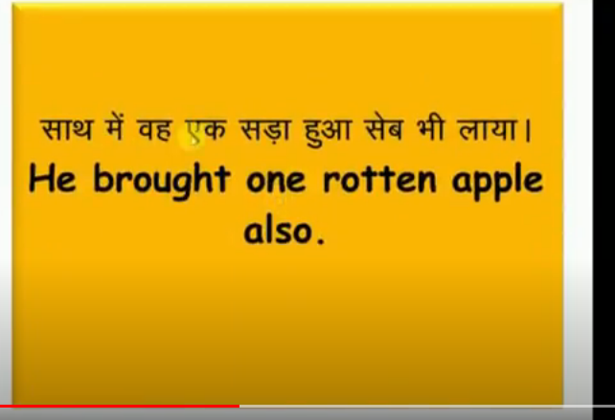
He went to the market and purchased some fresh apples .

Slide 8
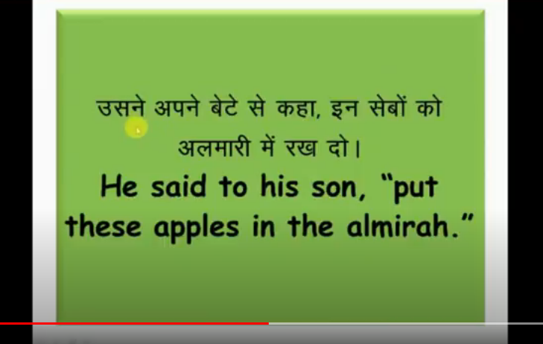

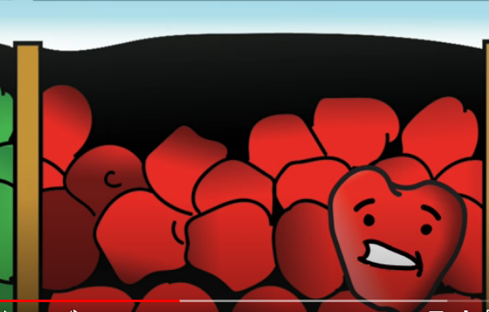
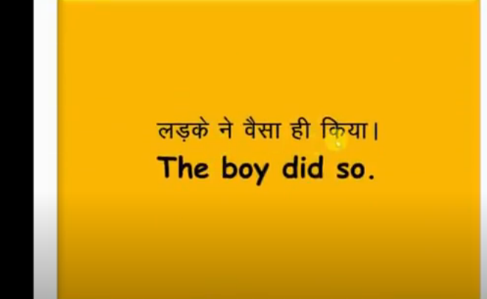

Slide 9
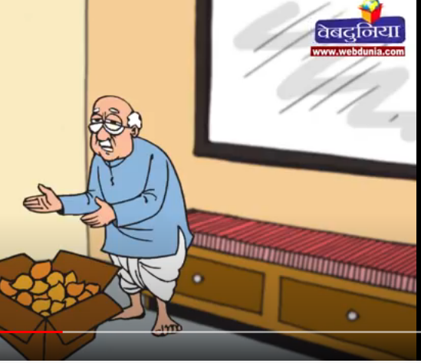

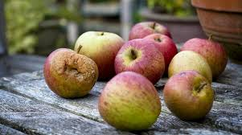
After some days father asked to
his son to bring all the apples.
When the son opened the
almirah. He was surprised to note that all the apples had become rotten.

Slide 10
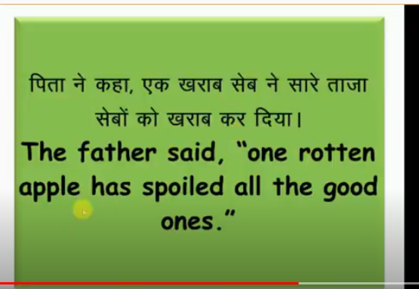
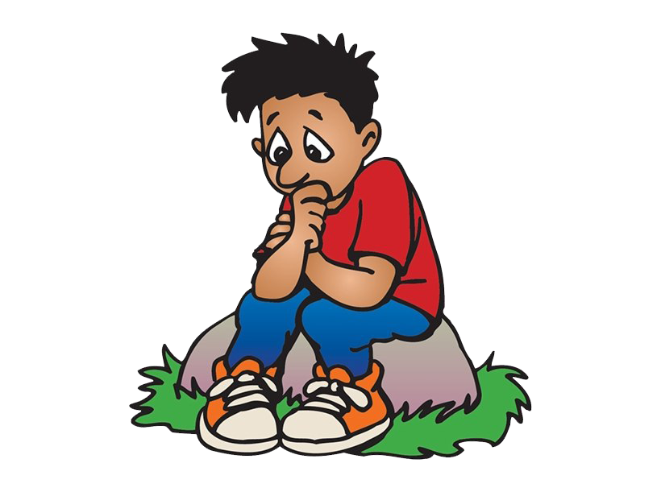
His son felt very sad

Slide 11


In the same way one bad friend could spoil all others.

Slide 12


The boy gave up bad company and became good again..

Slide 13


MORAL OF THE STORY IS
Better alone than in bad company.

Slide 14
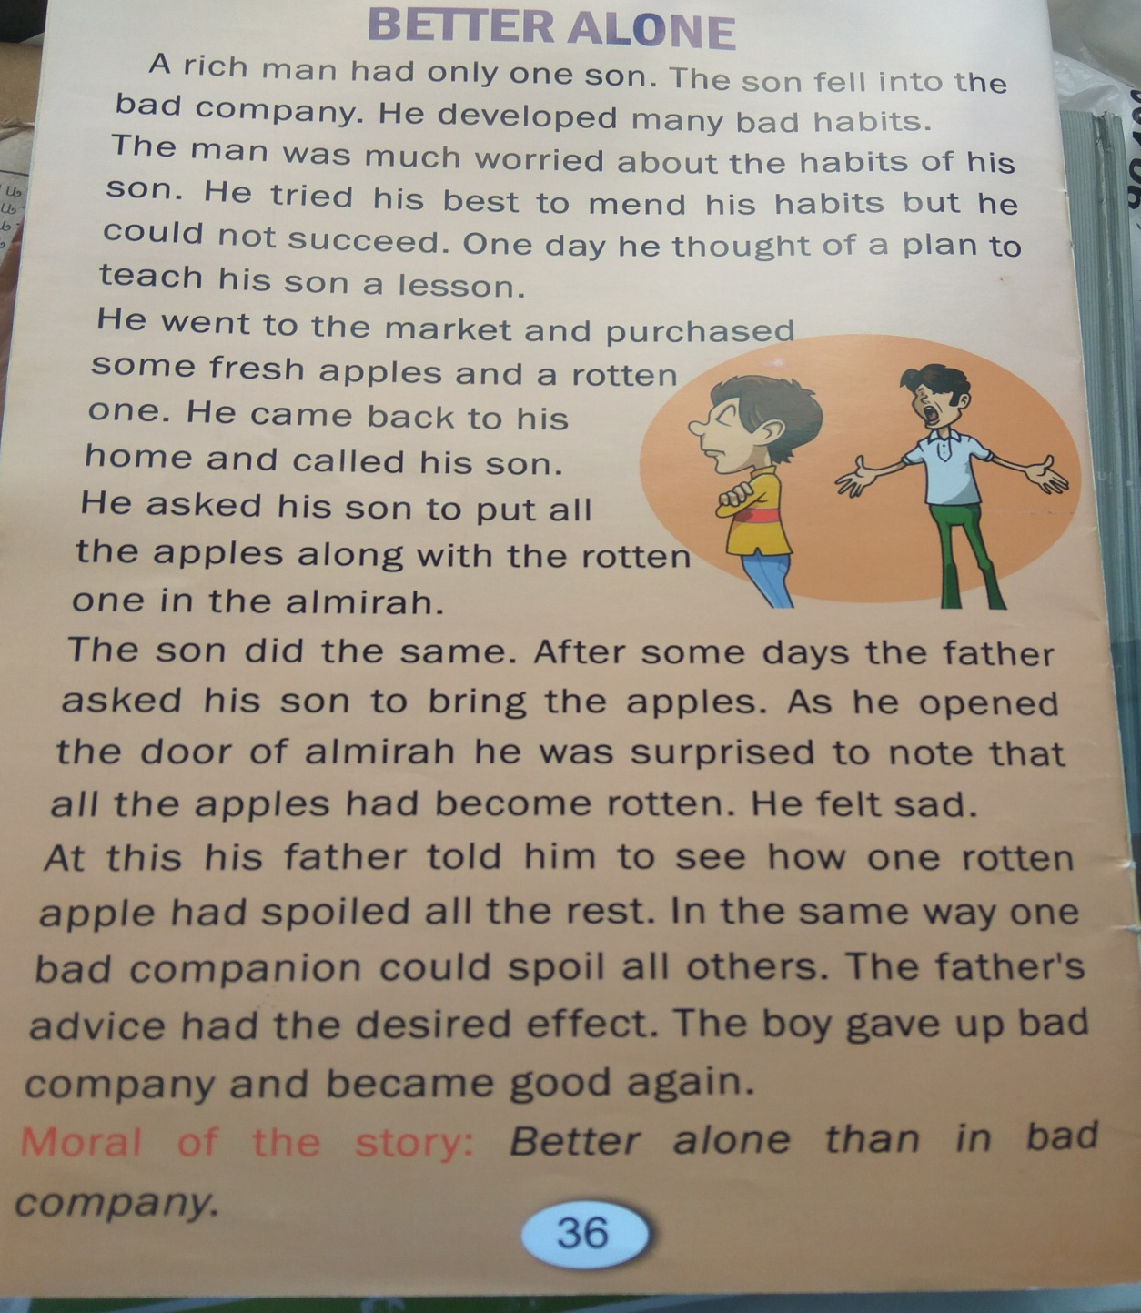

Slide 15
THANKING YOU
ODM EDUCATIONAL GROUP

