Slide 1



CLASS : NURSERY
DATE : 31.08.2021
SUBJECT : ENGLISH
TOPIC-BK PG NO-70,71
SUB-TOPIC-LETTER T (In bk)

Slide 2





Recapitulation
Notes:
CW

Slide 3

Identification of letter-L

Slide 4
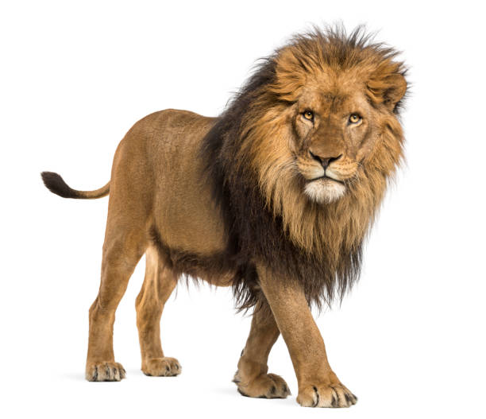


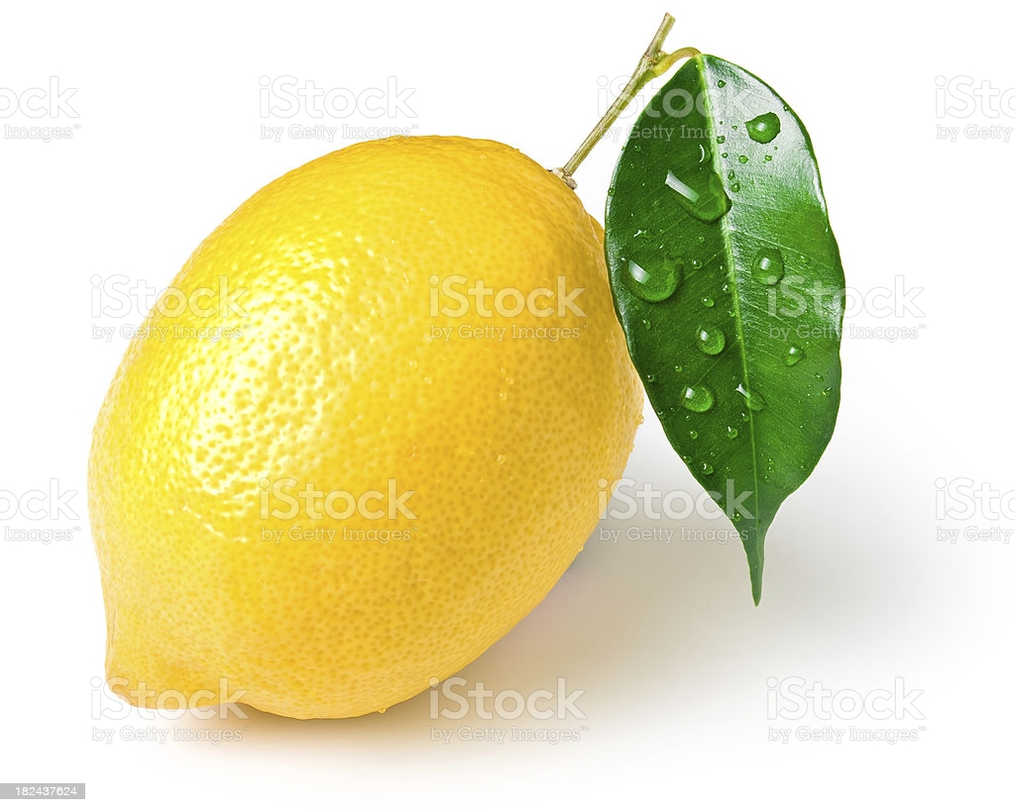
Picture related to letter-L
LOTUS
LION
LEMON
LEAF
Notes:
LEAF

Slide 5

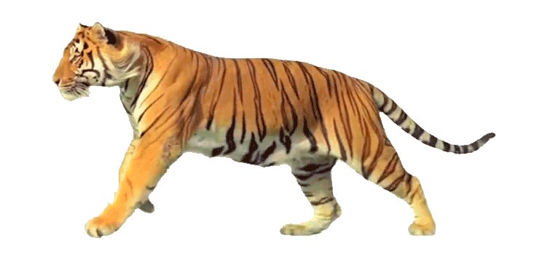

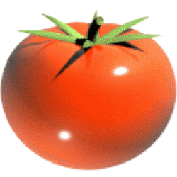
Identify the given pictures

Slide 6


Identification of letter T

Slide 7
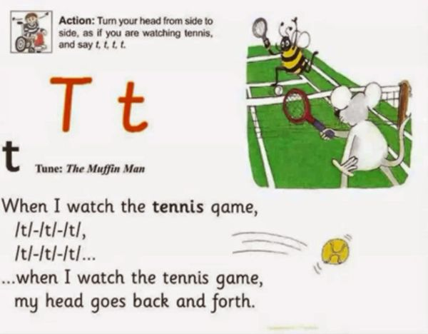
Phonetic song of letter-T

Slide 8
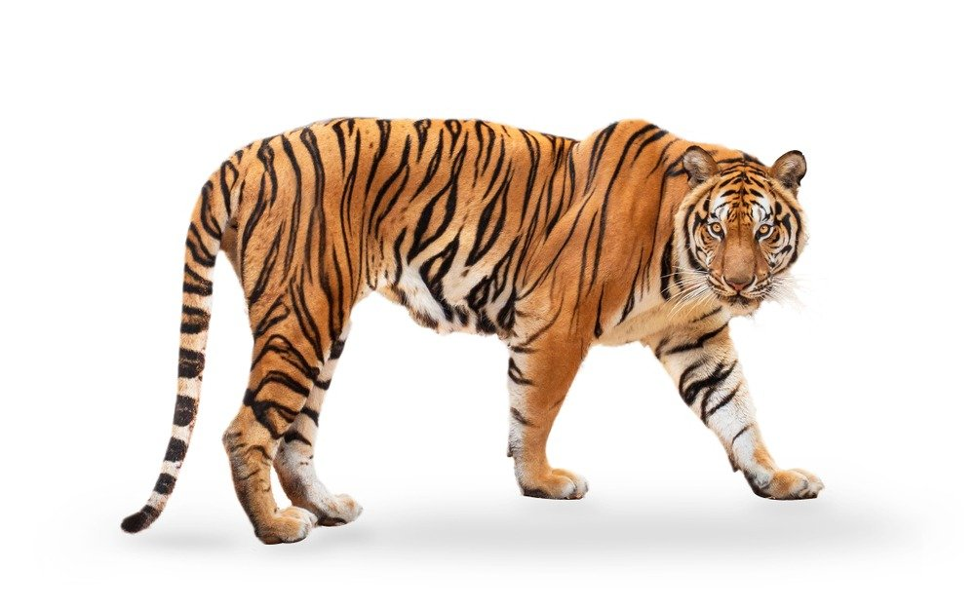

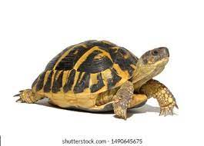
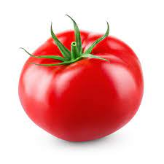
Pictures related to letter T
TIGER
TREE
TORTOISE
TOMAT0
Notes:
CW

Slide 9
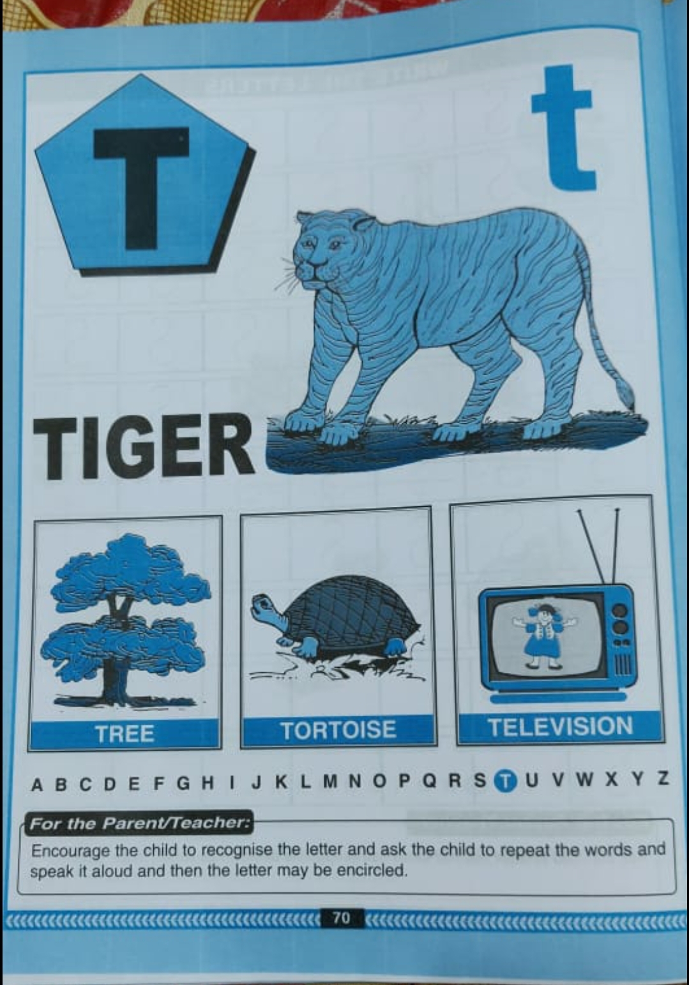
Read it five timesBk Pg-no-70
CW
31/08/21

Slide 10
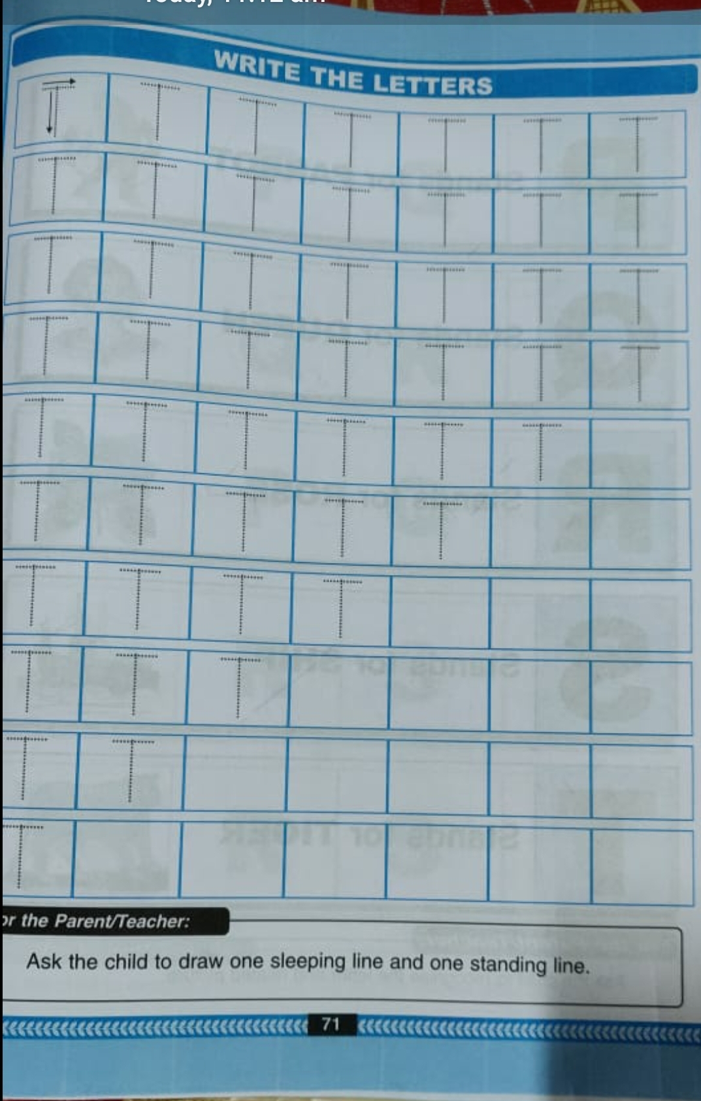
Trace and write letter-T(bk pg no-71)
CW
31/08/21
Notes:
31/08/21

Slide 11

ASSIGNMENT
31/08/21
1 .Practice phonic sound of letter T
2.
Complete the work given in bk
3.PRACTICE TO READ BK PG NO-70 -LETTER T

Slide 12
THANKING YOU
ODM EDUCATIONAL GROUP

