Slide 1



CLASS : NURSERY
DATE -30/11/21
SUBJECT : ENGLISH
SUBJECT : ENGLISH
TOPIC- ACTIVITY IN NT BK

Slide 2


Identification of letter C

Slide 3
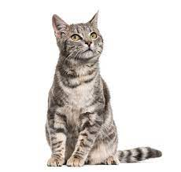
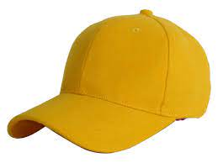
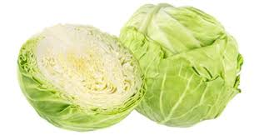
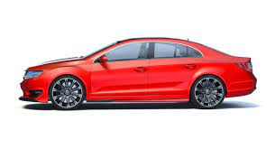
Picture releted to letter -C

Slide 4


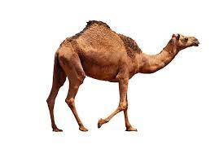
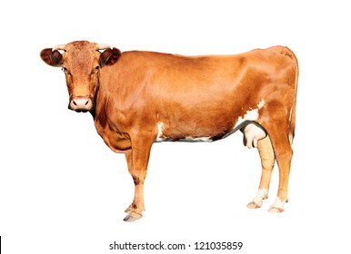
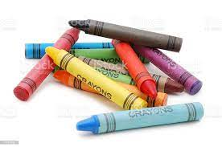
Identify and name the picture
CAKE
CAMEL
CANDLE
COW
CRAYONS

Slide 5






Slide 6

HI children

Slide 7

Hi children let‘s write in nt bk
Activity in nt bk
Notes:
Hi children let‘s write in a book

Slide 8





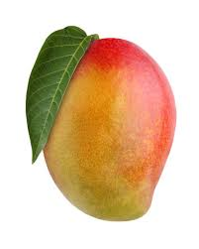


ACTIVITY
CW
30/11/21
2.Write the first letter of the given picture

Slide 9

30/11/21
ASSIGNMENT
1 .Practice todays activity at home
.2.Complete the work given in nt bk
Notes:
.

Slide 10
THANKING YOU
ODM EDUCATIONAL GROUP

