Slide 1



CLASS : NURSERY
DATE 29/07/21
SUBJECT : ENGLISH
SUBJECT : ENGLISH
TOPIC BK PG NO-87
SUB-TOPIC-LETTER -IN NT .BK

Slide 2







Identify the given letter

Slide 3

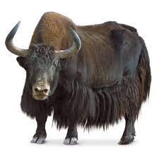
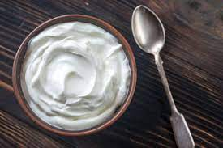
Identify the given pictures

Slide 4


Identiffication of letter Y

Slide 5

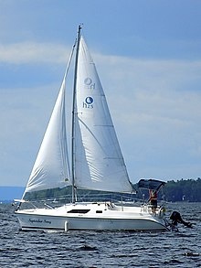
PICTURE RELATED TO LETTER-- Y
Y0-YO
YAK
YELLOW
YACHT
Notes:
YELLOW

Slide 6
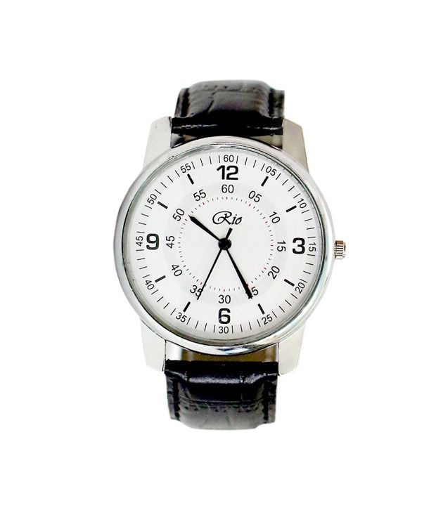

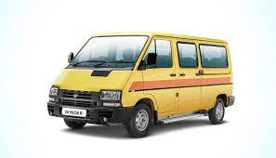
MATCH THE LETTER WITH RELATED PICTURE
CW
29/07/21
W
Y
V
X
Notes:
29/07/21

Slide 7

29/07/21
ASSIGNMENT
1 .Practice phonic song sound of letter -Y
2.Complete the work given in note bk
Notes:
.3’

Slide 8
THANKING YOU
ODM EDUCATIONAL GROUP

