Slide 1



CLASS : NURSERY
DATE 28/07/21
SUBJECT : ENGLISH
SUBJECT : ENGLISH
TOPIC BK PG NO-87
SUB-TOPIC-LETTER -IN BK

Slide 2







Identify the given letter and tell one word related to the letter

Slide 3
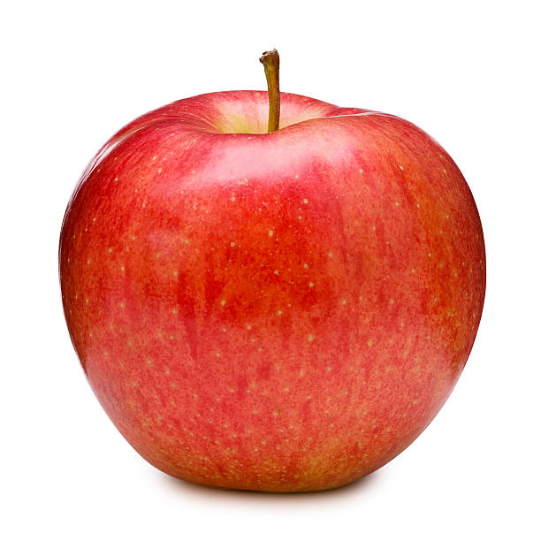

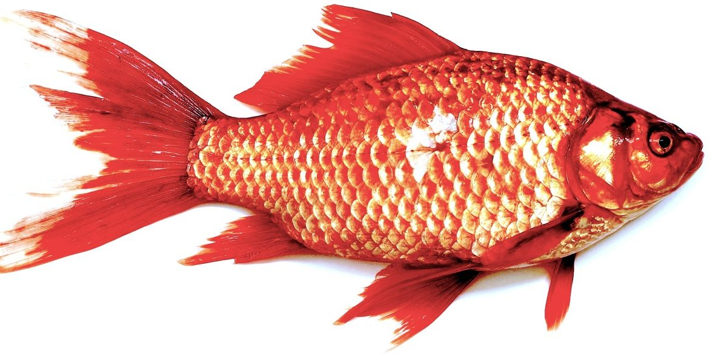
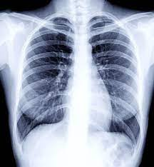
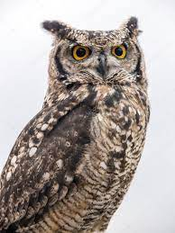
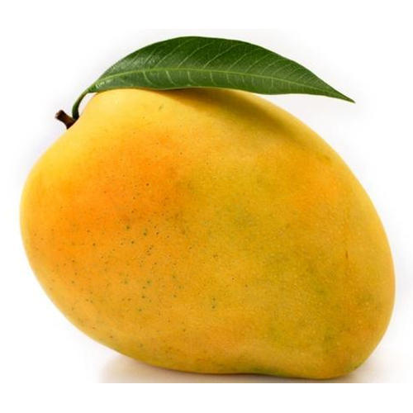
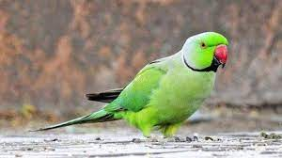
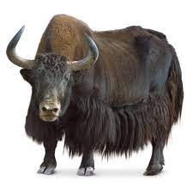
Identify and say the first letter of the given picture

Slide 4

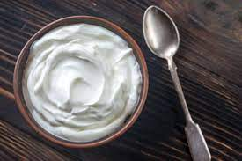
Identify the given pictures

Slide 5


Identiffication of letter Y

Slide 6

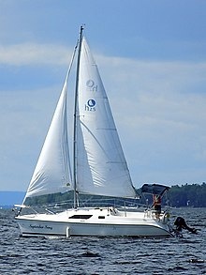
PICTURE RELATED TO LETTER-- Y
Y0-YO
YAK
YELLOW
YACHT
Notes:
YELLOW

Slide 7
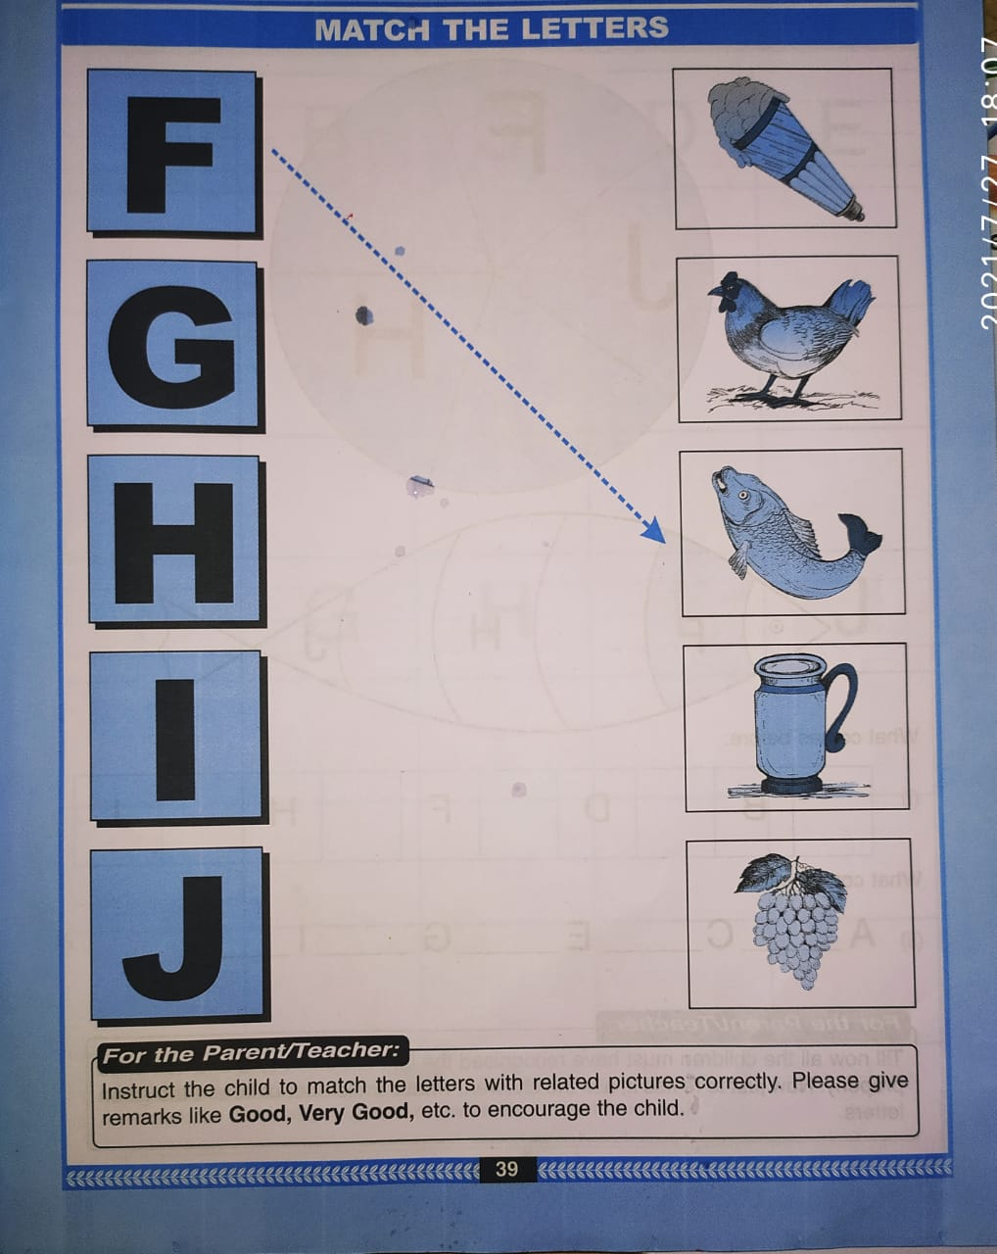
BK PG NO-39
C W
28/07/21
Notes:
28/07/21 C W

Slide 8

28/07/21
ASSIGNMENT
1 .Practice phonic song sound of letter -Y
2.DO BK PG NO-7
Notes:
.3’

Slide 9
THANKING YOU
ODM EDUCATIONAL GROUP

