Slide 1



CLASS : NURSERY
DATE 27/07/21
SUBJECT : ENGLISH
SUBJECT : ENGLISH
TOPIC BK PG NO-87
SUB-TOPIC-LETTER -Y ACTIVITY

Slide 2







Identify the given letter and tell one word related to the letter

Slide 3
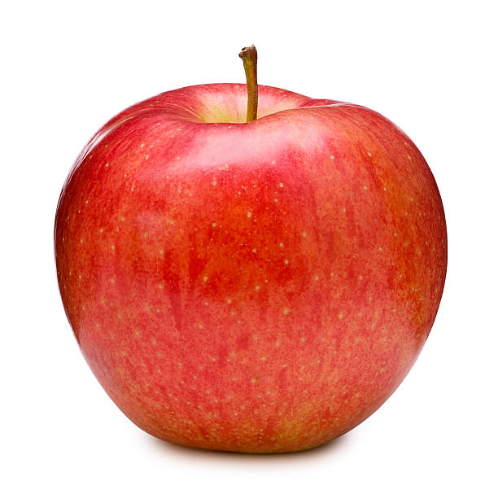

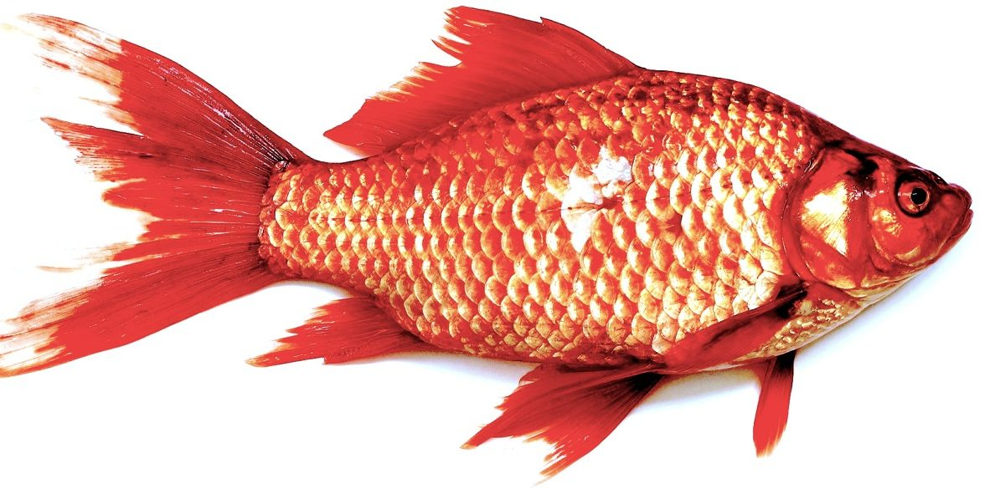
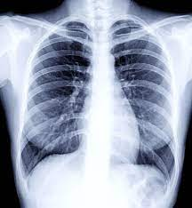
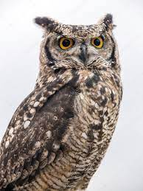
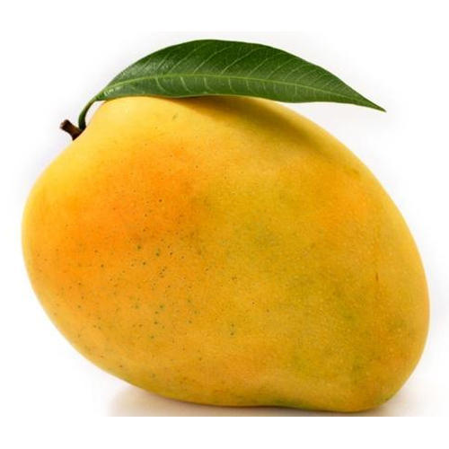
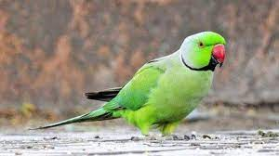
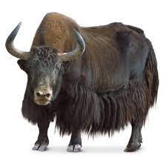
Identify and say the first letter of the given picture

Slide 4

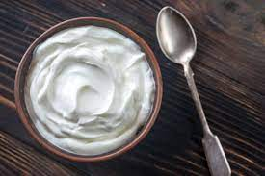
Identify the given pictures

Slide 5


Identiffication of letter Y

Slide 6

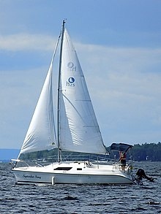
PICTURE RELATED TO LETTER-- Y
Y0-YO
YAK
YELLOW
YACHT
Notes:
YELLOW

Slide 7
ACTIVITY ON LETTER-Y
Encircle letter Y in a given word
APPLE
YELLOW
CAR
YAK
YARN
GOAT
YOU
FAN
BAT
YACHT
RAT
YES

Slide 8

27/07/21
ASSIGNMENT
1 .Practice phonic song sound of letter -Y
2. Complete the work given in note bk
Notes:
.3’

Slide 9
THANKING YOU
ODM EDUCATIONAL GROUP

