Slide 1



CLASS : NURSERY
DATE -25/11/21
SUBJECT : ENGLISH
SUBJECT : ENGLISH
TOPIC - BK PG NO-14 ,15
SUB-TOPIC-LETTER-C – IN NT BK

Slide 2


Identification of letter C

Slide 3
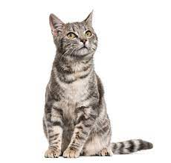

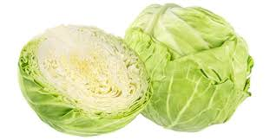
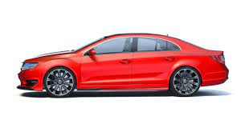
Picture releted to letter -C

Slide 4


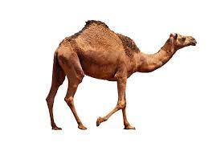
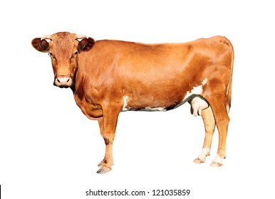
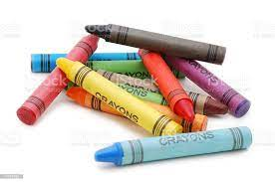
Identify and name the picture
CAKE
CAMEL
CANDLE
COW
CRAYONS

Slide 5

HI children

Slide 6

Hi children let‘s write in nt bk
C IN NT BK -
Notes:
Hi children let‘s write in a book

Slide 7
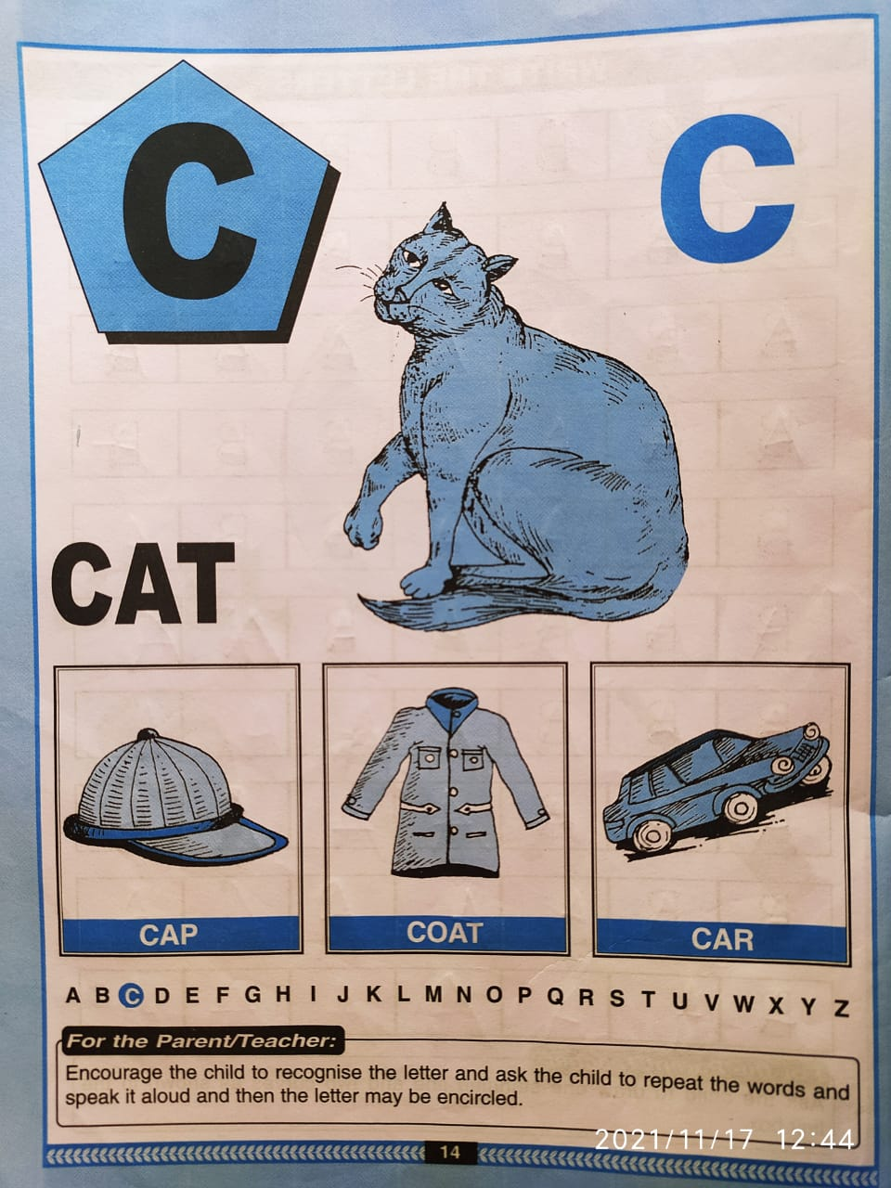

Slide 8
C Stands for Cap
CW
25/11/21

Slide 9


Trace and write
CW
25/11/21

Slide 10


25/11/21
ASSIGNMENT
1 .Practice phonic song of letter -C
.2.Complete the work given in nt bk
Notes:
.

Slide 11
THANKING YOU
ODM EDUCATIONAL GROUP

