Slide 1



CLASS : NURSERY
DATE : 25.08.2021
SUBJECT : ENGLISH
TOPIC-BK PG NO-46,47
SUB-TOPIC-LETTER L (In nt bk)

Slide 2




Recapitulation
Notes:
CW

Slide 3


Slide 4


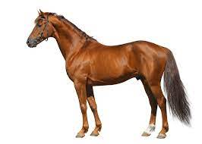
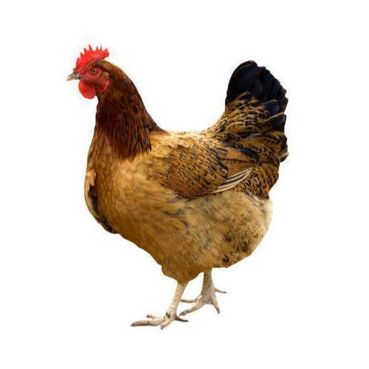
Pictures related to letter-h
HAT
HOUSE
HEN
HORSE
Notes:
HORSE

Slide 5





Slide 6



Slide 7
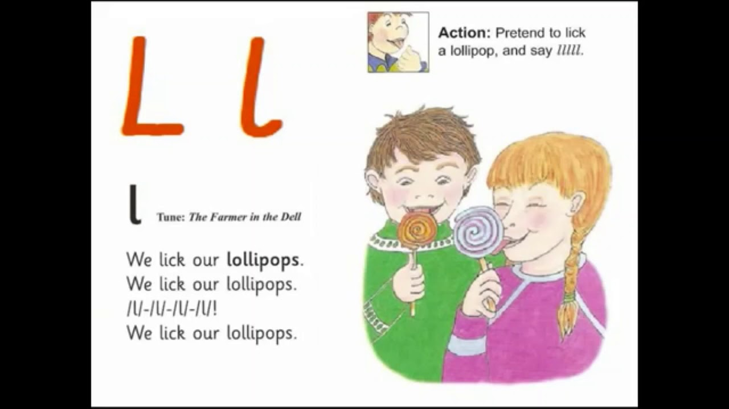
PHONETIC SONG ON LETTR -L

Slide 8
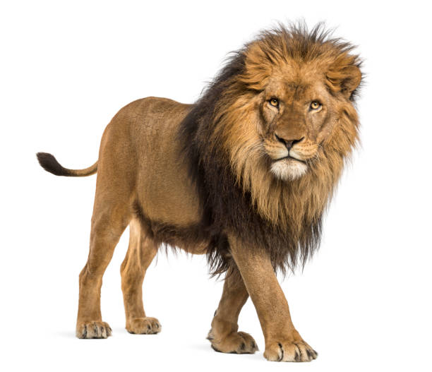


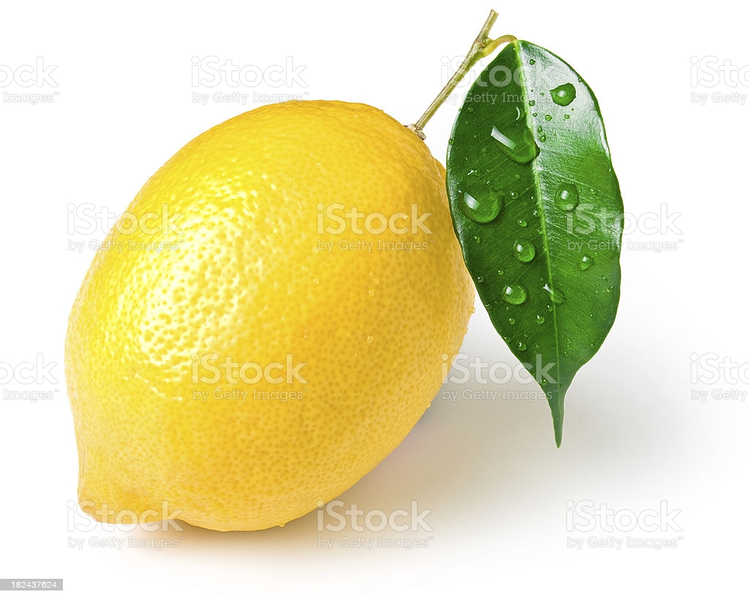
Picture related to letter-L

Slide 9
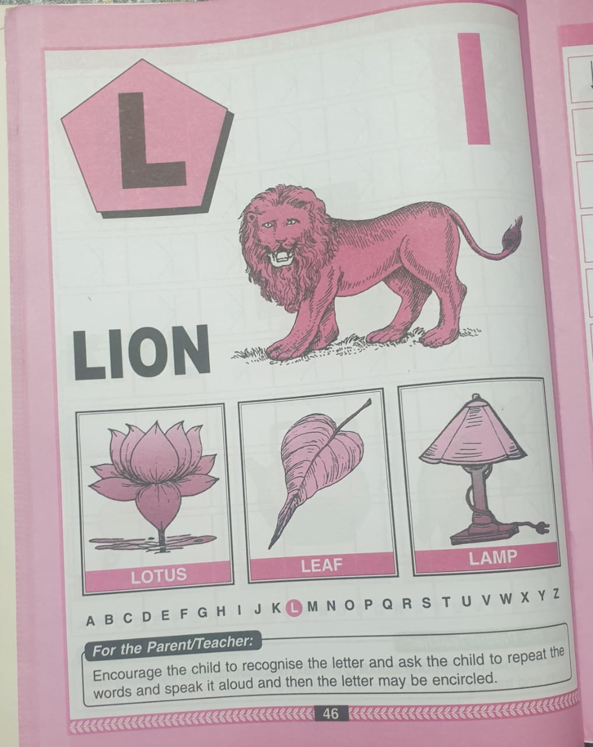
Bk pg no-46
CW
25/08/21
Notes:
25/08/21

Slide 10
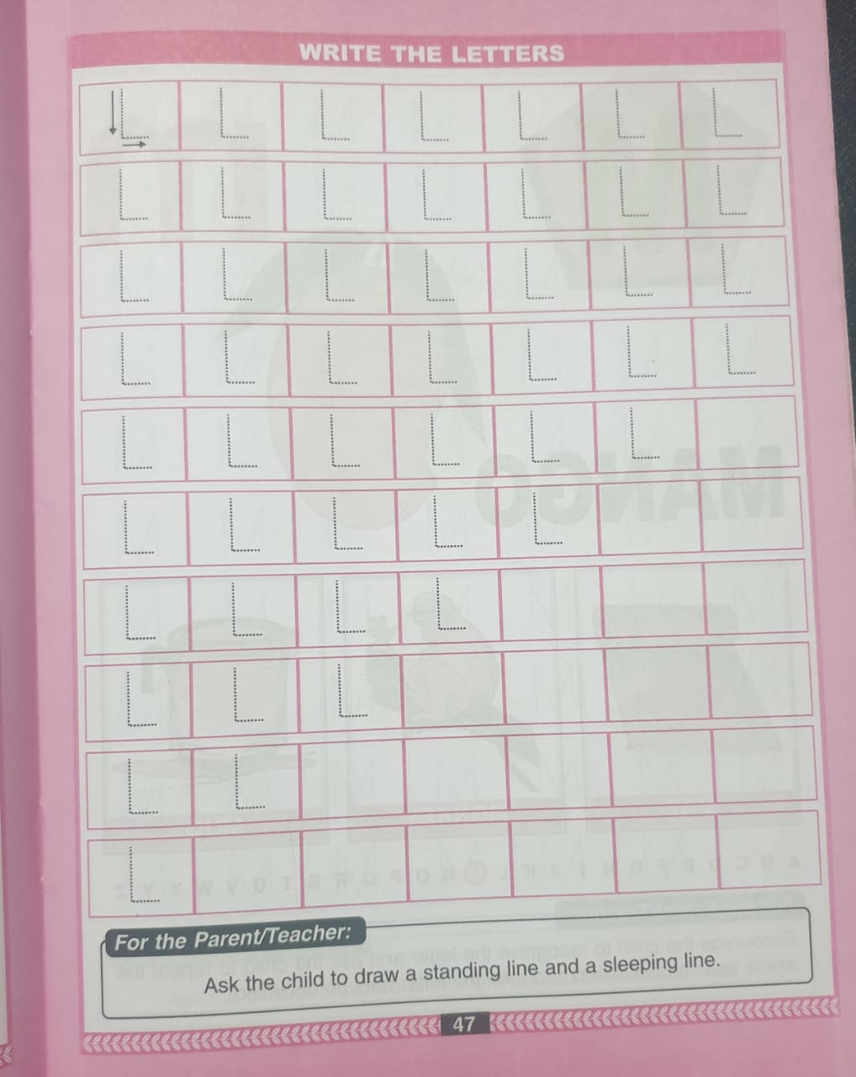
Trace and write(bk pg no47)
CW
25/08/21

Slide 11

ASSIGNMENT
25/08/21
1 .Practice phonic sound of letter L
2.
Complete the work given in bk
3.PRACTICE TO READ BK PG NO-46 -LETTER L

Slide 12
THANKING YOU
ODM EDUCATIONAL GROUP

