Slide 1



CLASS : NURSERY
DATE -24/11/21
SUBJECT : ENGLISH
SUBJECT : ENGLISH
TOPIC - BK PG NO-14 ,15
SUB-TOPIC- LETTER-C – IN BK

Slide 2


RECAPITULATION

Slide 3


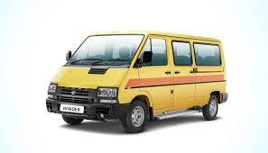

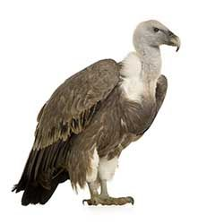
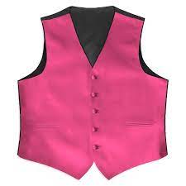
PICTURE RELATED TO LETTER V
VAN
VASE
VEGETABLES
VULTURE
VIOLIN
VEST
Notes:
VULTURE

Slide 4
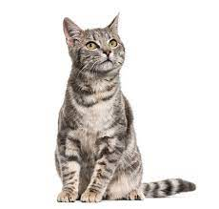

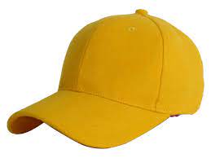

Identify and name the picture

Slide 5


Identification of letter C

Slide 6
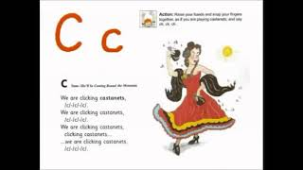

Slide 7
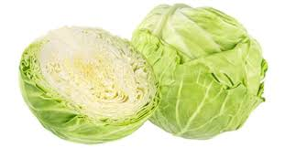
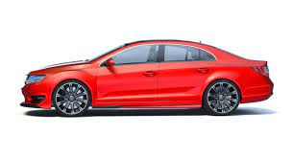
Picture releted to letter -C

Slide 8

HI children

Slide 9

Hi children let‘s write in bk
C IN BK PG NO -14,15
Notes:
Hi children let‘s write in a book

Slide 10
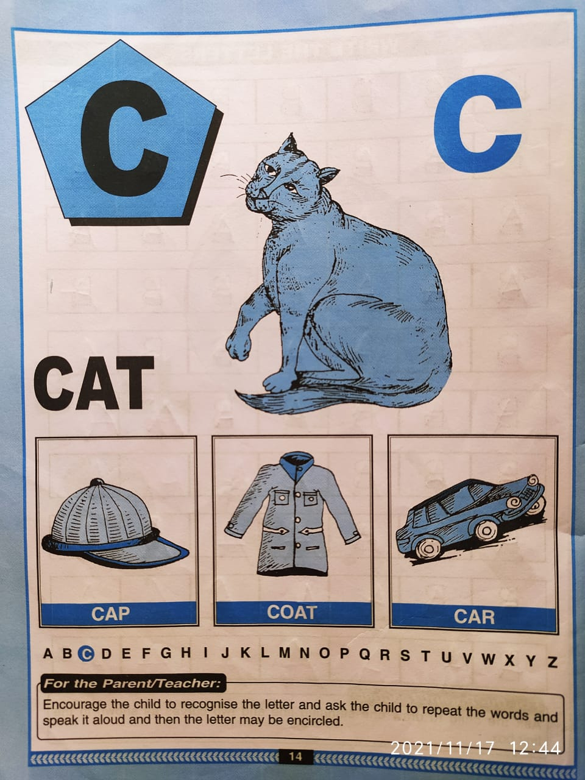

Slide 11
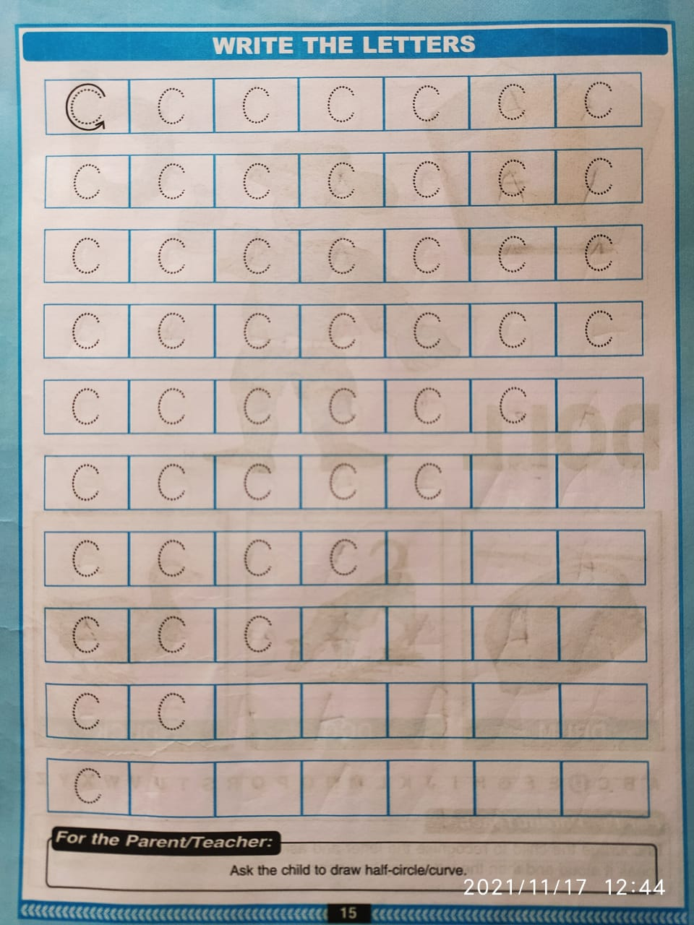

Slide 12
Circle and color letter C
(In nt bk)
HW
T
F
C
T
C
C
S
C
L
R
B
C
C
C
Notes:
(In nt bk)

Slide 13


24/11/21
ASSIGNMENT
1 .Practice phonic song of letter -C
.2.Complete the work given in bk pg no-15
Notes:
.COMPLETE BK PG NO-38

Slide 14
THANKING YOU
ODM EDUCATIONAL GROUP

