Slide 1



CLASS : NURSERY
DATE -23/11/21
SUBJECT : ENGLISH
SUBJECT : ENGLISH
TOPIC- BK PG NO-81,82
SUB-TOPIC-LETTER -V IN NT BK

Slide 2






Identify the given letter and tell one word related to the letter
Notes:
B

Slide 3



Slide 4


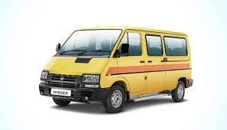

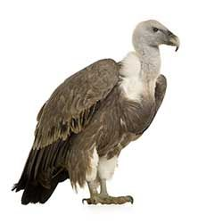
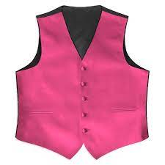
PICTURE RELATED TO LETTER V
VAN
VASE
VEGETABLES
VULTURE
VIOLIN
VEST
Notes:
VULTURE

Slide 5

HI children

Slide 6

Hi children let‘s write in bk
LETTER V IN BK PG NO
Notes:
Hi children let‘s write in a book

Slide 7
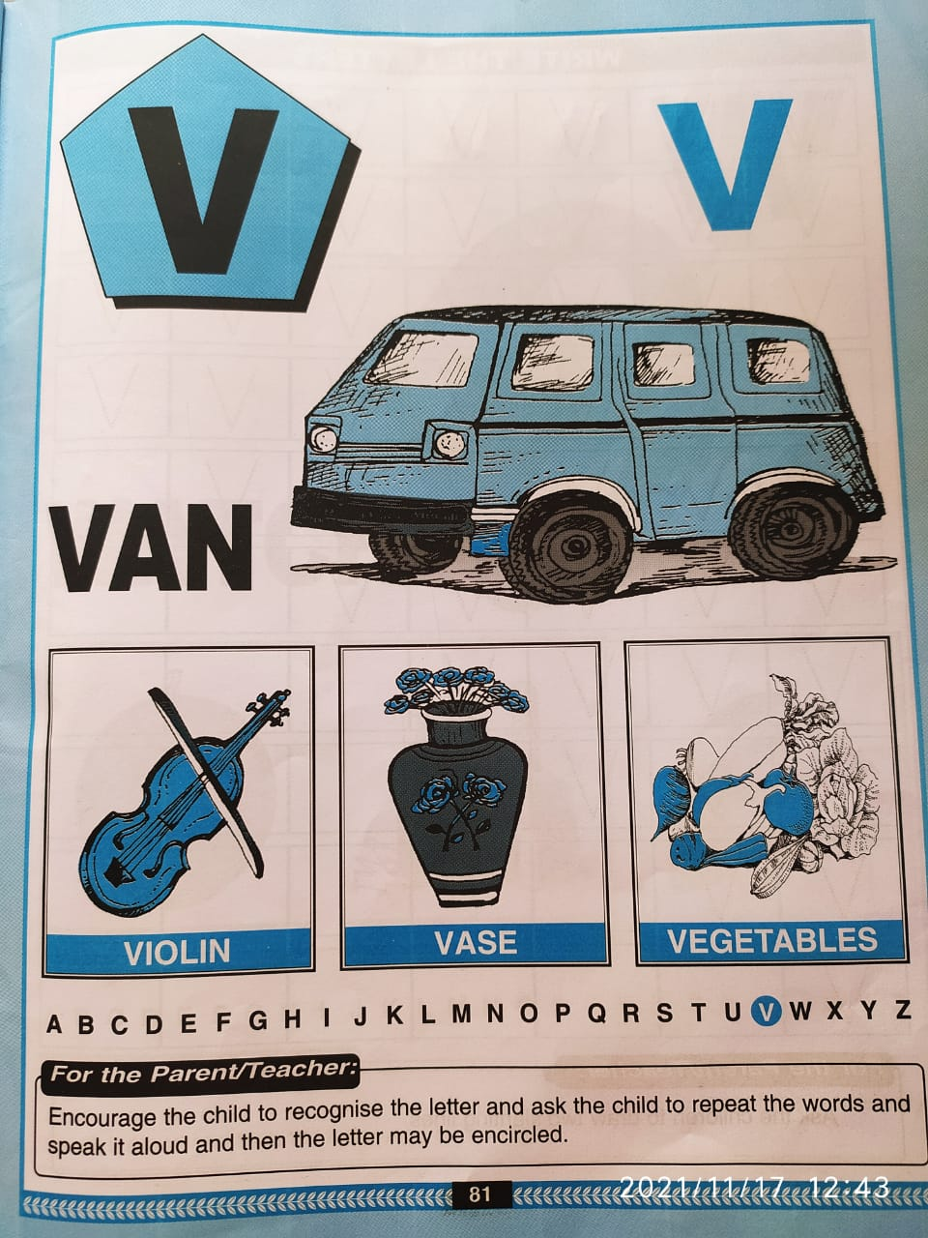
In bk pg no -81

Slide 8
V stands for vase
CW
23/11/21

Slide 9


Trace and write
CW
23/11/21

Slide 10
Say and write
HW

Slide 11

23/11/21
ASSIGNMENT
1 .Practice phonic song sound of letter -V
2. Do the work given in nt bk
Notes:
.

Slide 12
THANKING YOU
ODM EDUCATIONAL GROUP

