Slide 1



CLASS : NURSERY
DATE : 23.09.2021
SUBJECT : ENGLISH
TOPIC- :ALPHABETS
SUBTOPIC:REVISION-8 ORAL & IN NOTE BK

Slide 2
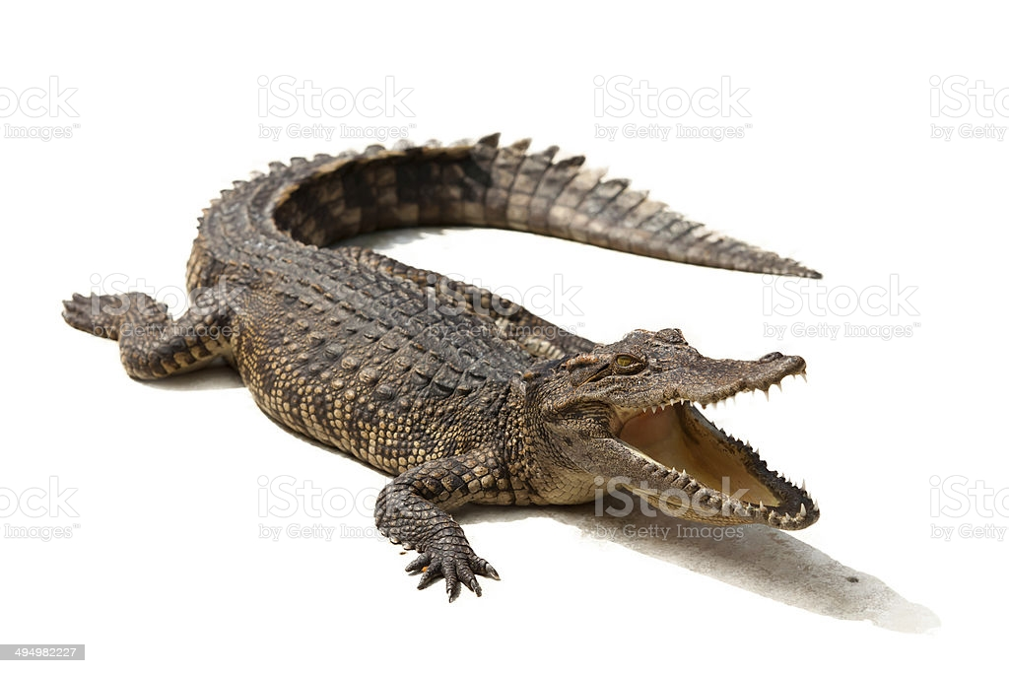

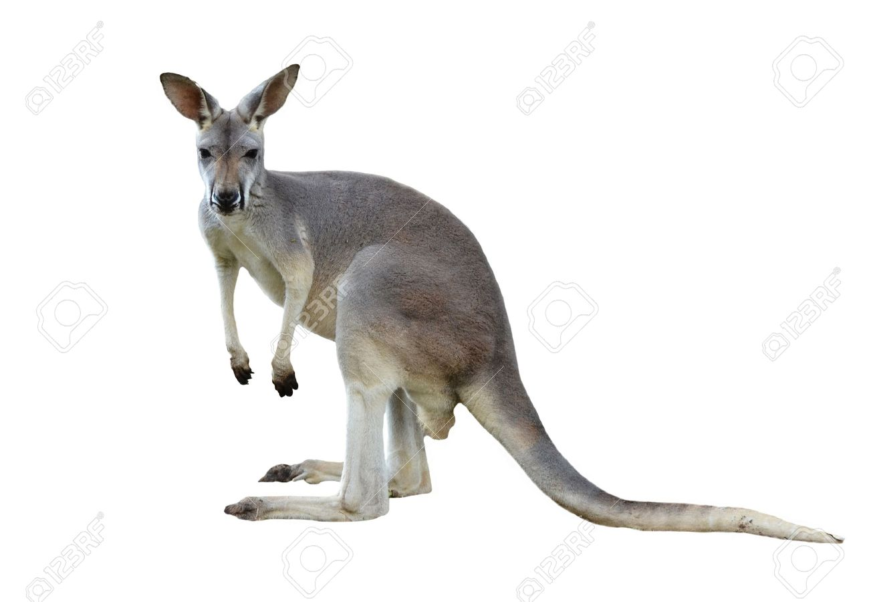

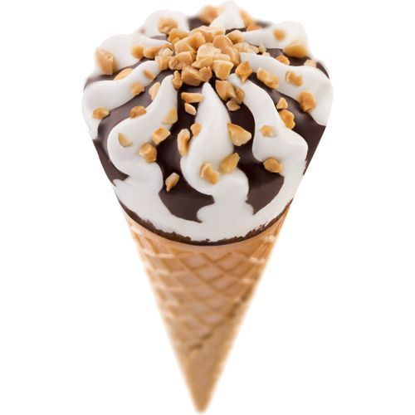
Q.1- Identify and tell the first letter of the given pictures(Revision-Oral)

Slide 3

Revision -8
In note book
Notes:
Revision -5 In

Slide 4

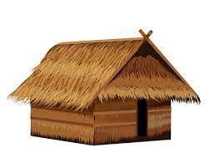
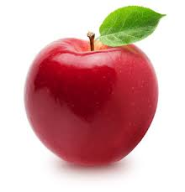
Revision -8
CW
23/09/21
Q See the picture and colour the related letter given in a grid.
F
H
B
E
T
L
A
M
K
Notes:
M

Slide 5
Circle and color letter L & K given in a circle
H W
23/09/21
L
T K M H
H
L T K L
T H L M K
K T M L H
Notes:
K T

Slide 6

23/09/21
ASSIGNMENT
Practice the revision work
1.
2.Do the work given in note bk
Notes:
2.Do the work given in note bk

Slide 7
THANKING YOU
ODM EDUCATIONAL GROUP

