Slide 1



CLASS : NURSERY
DATE -22/11/21
SUBJECT : ENGLISH
SUBJECT : ENGLISH
TOPIC- BK PG NO-81,82
SUB-TOPIC-LETTER -V

Slide 2








Identify the given letter and tell one word related to the letter
Notes:
B

Slide 3
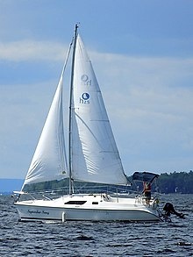
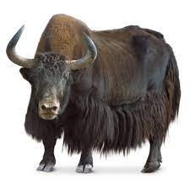

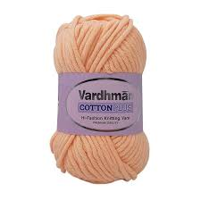
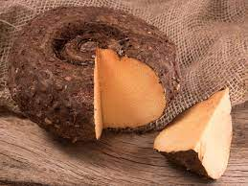
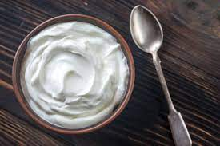
Recapitulation

Slide 4
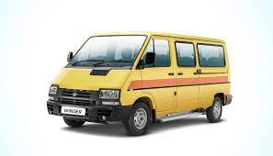

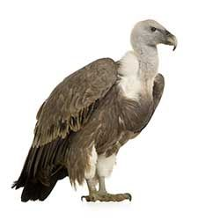

Identify the give picture
Notes:
VEGETABLES

Slide 5



Slide 6
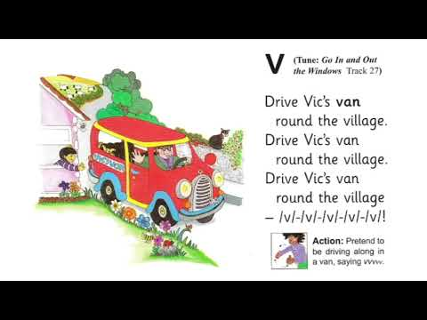
Phonic song on letter-V

Slide 7

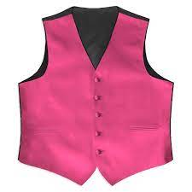
PICTURE RELATED TO LETTER V
VAN
VASE
VEGETABLES
VULTURE
VIOLIN
VEST
Notes:
VULTURE

Slide 8

HI children

Slide 9

Hi children let‘s write in bk
LETTER V IN BK PG NO
Notes:
Hi children let‘s write in a book

Slide 10
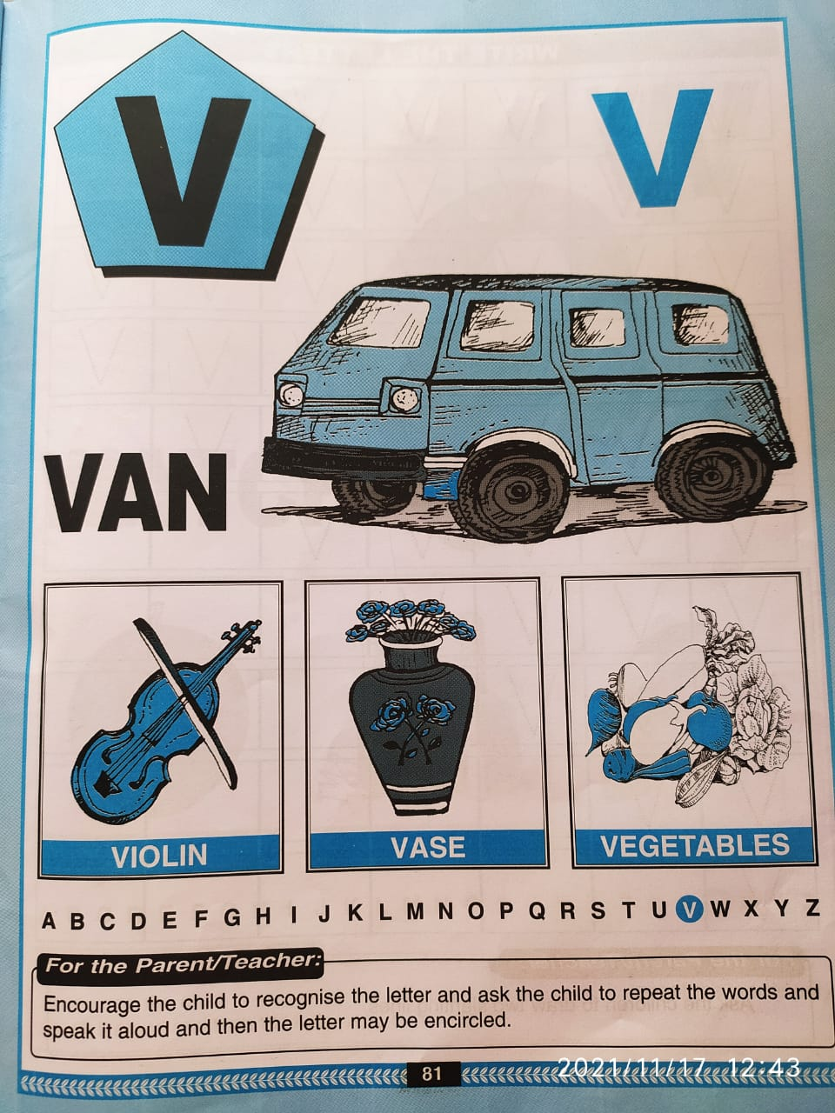
In bk pg no -81

Slide 11
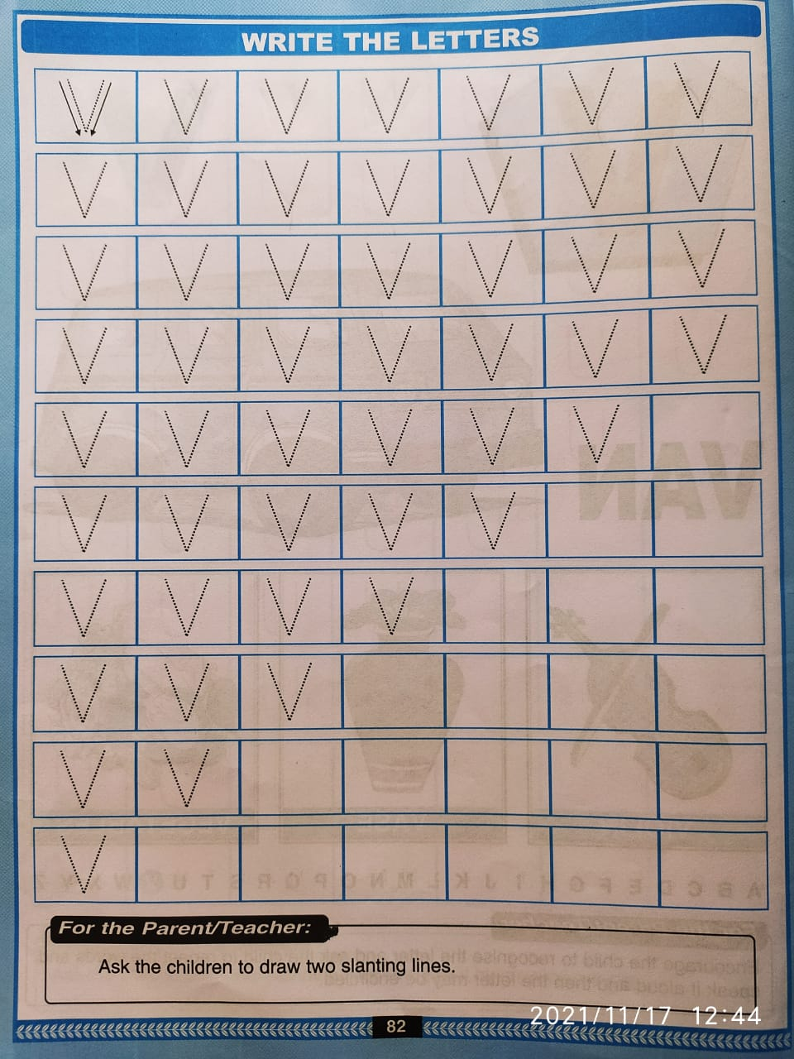
Trace and write
CW
22/11/22

Slide 12

Identify and encircle letter V
HW
W V Y N V
V Y W V K
K Y V W V
V W V

Slide 13

22/11/21
ASSIGNMENT
1 .Practice phonic song sound of letter -V
2. Do the activity given in nt bk
Notes:
.

Slide 14
THANKING YOU
ODM EDUCATIONAL GROUP

