Slide 1



CLASS : NURSERY
DATE : 22.09.2021
SUBJECT : ENGLISH
TOPIC- :ALPHABETS
SUBTOPIC:REVISION-7 ORAL & IN NOTE BK

Slide 2
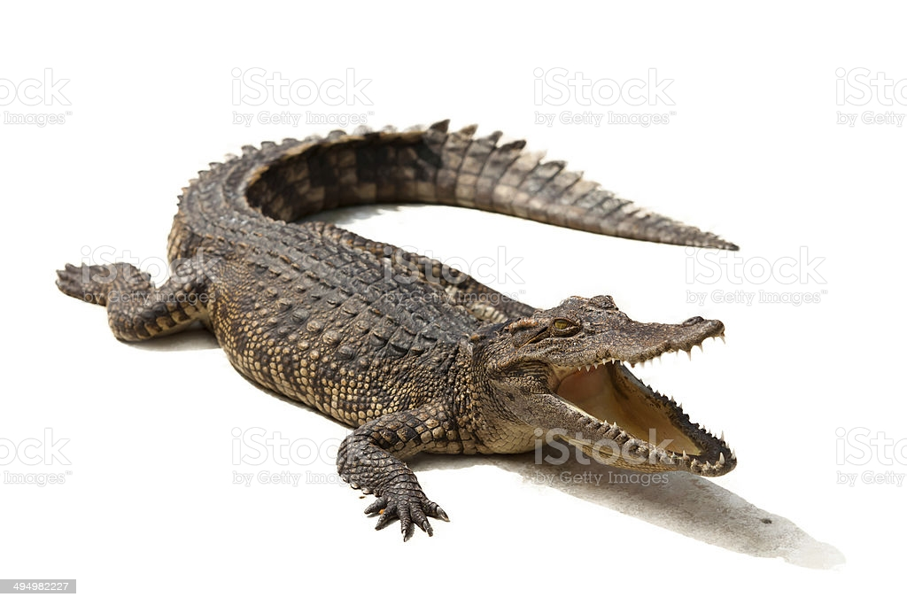

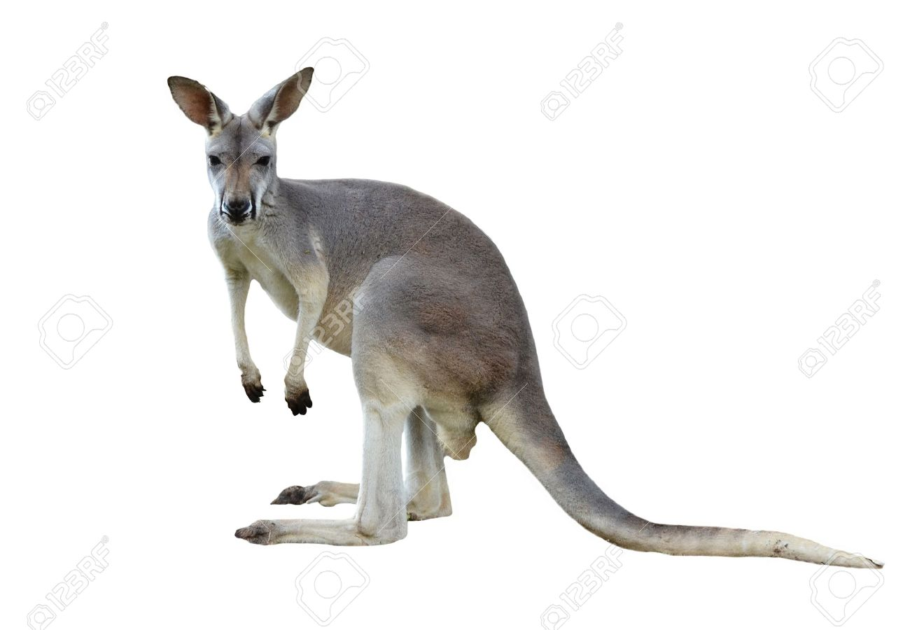

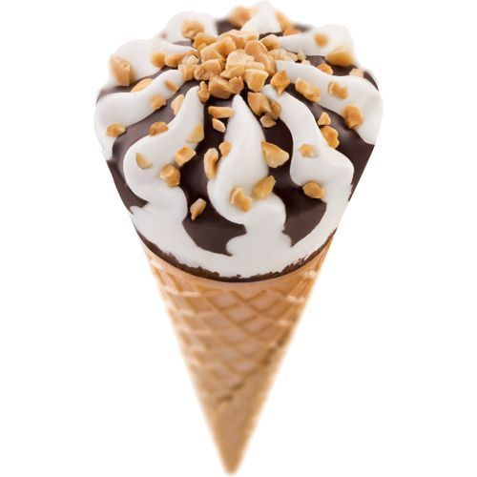
Q.1- Identify and tell the first letter of the given pictures(Revision-Oral)

Slide 3

Revision -7
In note book
Notes:
Revision -5 In

Slide 4
Revision -7
CW
22/09/21
Q1. Match with the same letter.
A K
F L
T A
L F
K T
Notes:
L E T

Slide 5








SAY AND WRITE
H W
22/09/21
Notes:
16/09/21

Slide 6

22/09/21
ASSIGNMENT
Practice the revision work
1.
2.Do the work given in note bk
Notes:
2.Do the work given in note bk

Slide 7
THANKING YOU
ODM EDUCATIONAL GROUP

