Slide 1



CLASS : NURSERY
DATE : 21.09.2021
SUBJECT : ENGLISH
TOPIC- :ALPHABETS
SUBTOPIC:REVISION-6 ORAL & IN NOTE BK

Slide 2
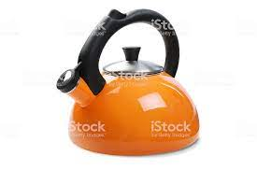
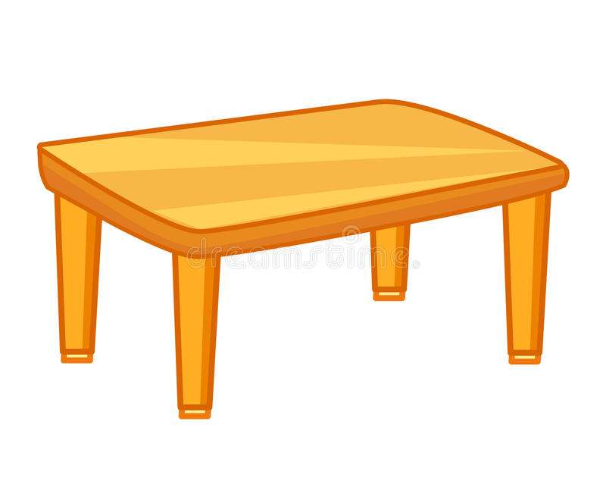
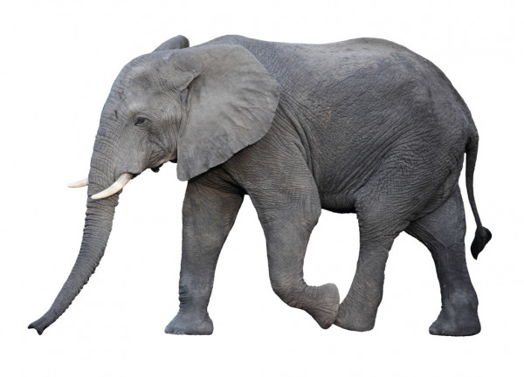

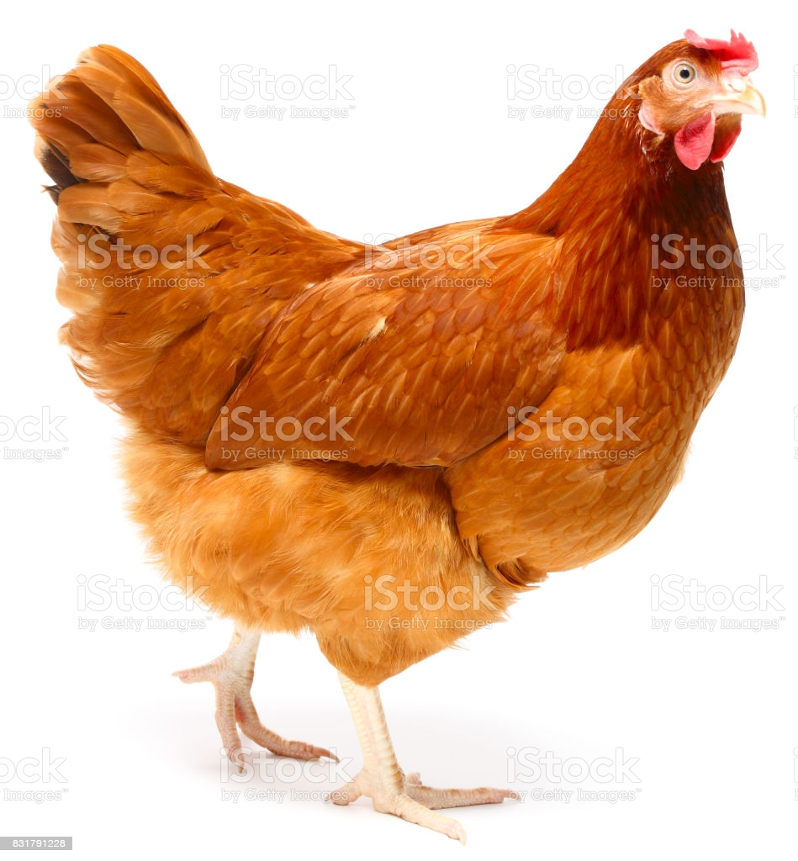
Q.1- Identify and tell the first letter of the given pictures(Revision-Oral)

Slide 3

Revision -5
In note book
Notes:
Revision -5 In

Slide 4

Revision -5
CW
21/09/21
Q 2.See the picture and encircle the related letter
T F E
H T K
I A K
L T E
Notes:
L E T

Slide 5








SAY AND WRITE
H W
21/09/21
Notes:
16/09/21

Slide 6

21/09/21
ASSIGNMENT
Practice the revision work
1.
2.Do the work given in note bk
Notes:
2.Do the work given in note bk

Slide 7
THANKING YOU
ODM EDUCATIONAL GROUP

