Slide 1



CLASS : NURSERY
DATE : 20.09.2021
SUBJECT : ENGLISH
TOPIC- :ALPHABETS
SUBTOPIC:REVISION-5 ORAL & IN NOTE BK

Slide 2








Q.1-Tell the phonetic sound of the given letters(Revision)

Slide 3

Revision -5
In note book
Notes:
Revision -5 In

Slide 4






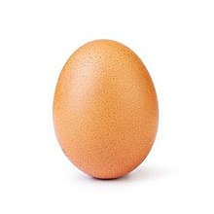

Revision -5
CW
20/09/21
Q 2. Match the picture with the related letter
Notes:
16/09/21

Slide 5




SAY AND WRITE
H W
20/09/21
Notes:
16/09/21

Slide 6

20/09/21
ASSIGNMENT
Practice the revision work
1.
2.Do the work given in note bk
Notes:
2.Do the work given in note bk

Slide 7
THANKING YOU
ODM EDUCATIONAL GROUP

