Slide 1



CLASS : NURSERY
DATE -18/11/21
SUBJECT : ENGLISH
SUBJECT : ENGLISH
TOPIC - BK PG N0-87,84
SUB-TOPIC-LETTER- – Y IN NT BK

Slide 2








Identify the given letter and tell one word related to the letter
Notes:
B

Slide 3
Recapitulation

Slide 4
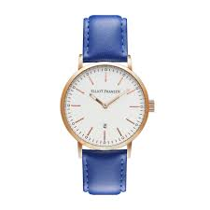



Picture related to letter-W
Notes:
CW

Slide 5

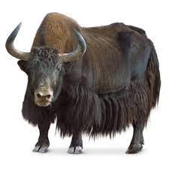
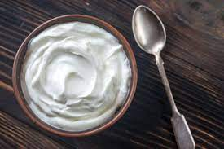
Identify the given pictures

Slide 6


Identiffication of letter Y

Slide 7

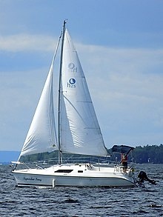
PICTURE RELATED TO LETTER-- Y
Y0-YO
YAK
YELLOW
YACHT
Notes:
YELLOW

Slide 8
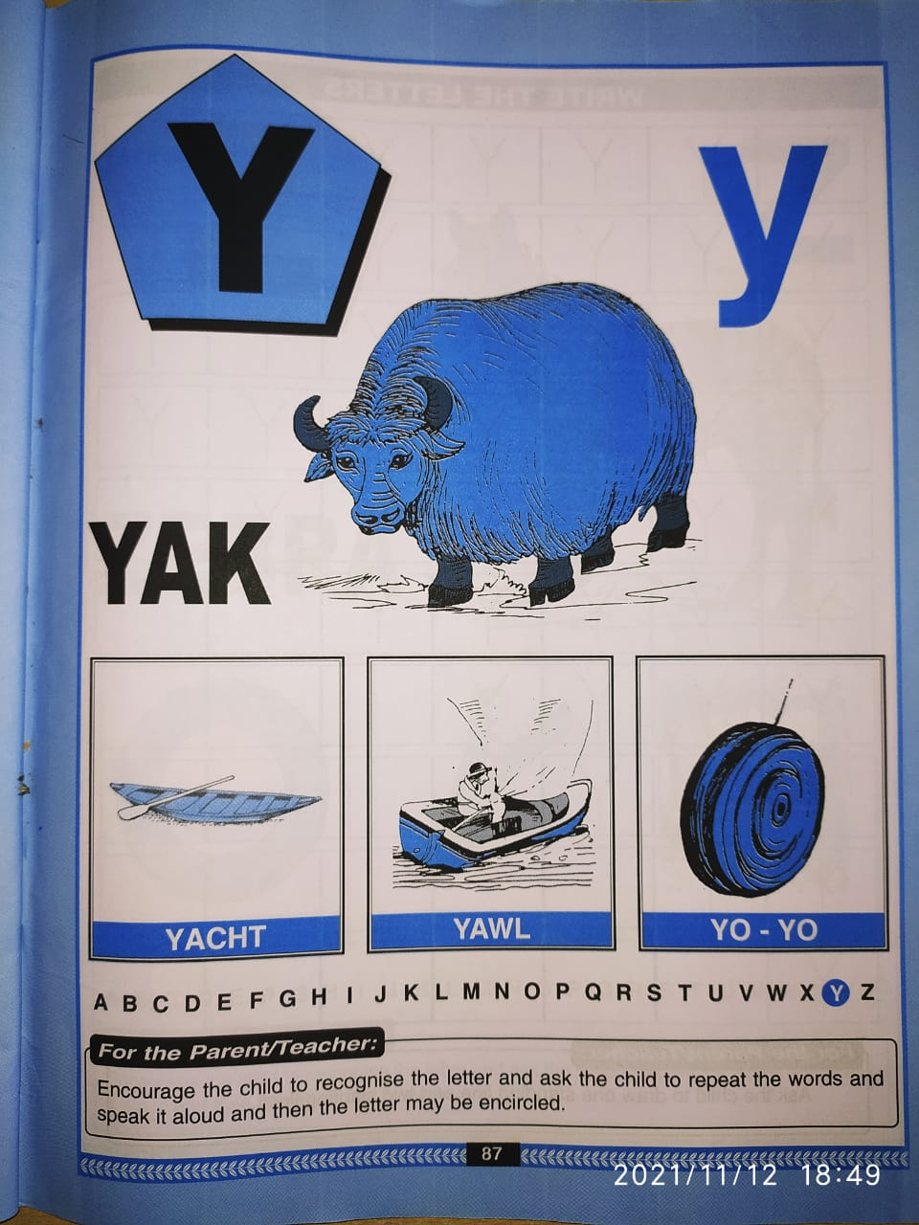

Slide 9

HI children

Slide 10

Hi children let‘s write in bk
Y IN NT BK
Notes:
Hi children let‘s write in a book

Slide 11

CW
18/11/21

Slide 12

Trace and write
CW
18/11/21

Slide 13


18/11/21
ASSIGNMENT
1 .Practice phonic song of letter -Y
.2.Complete the work given in nt bk
Notes:
.COMPLETE BK PG NO-38

Slide 14
THANKING YOU
ODM EDUCATIONAL GROUP

