Slide 1



CLASS : NURSERY
DATE : 18.08.2021
SUBJECT : ENGLISH
TOPIC-BK PG NO-31,32
SUB-TOPIC-LETTER ‘H’ IN BK

Slide 2



Recapitulation

Slide 3

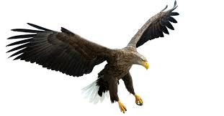

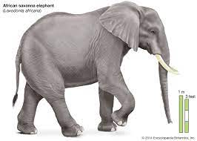

Pictures related to letter-E

Slide 4
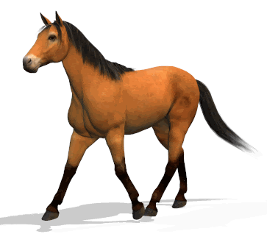

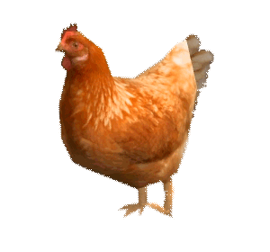


Slide 5



Slide 6
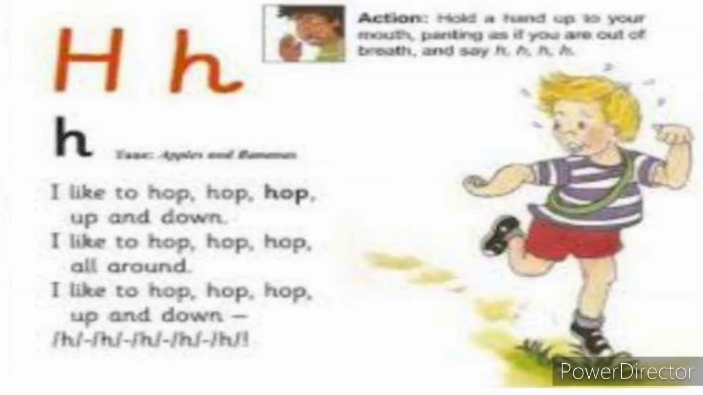

Slide 7


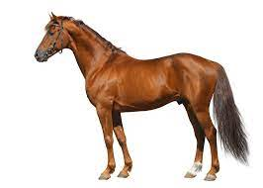
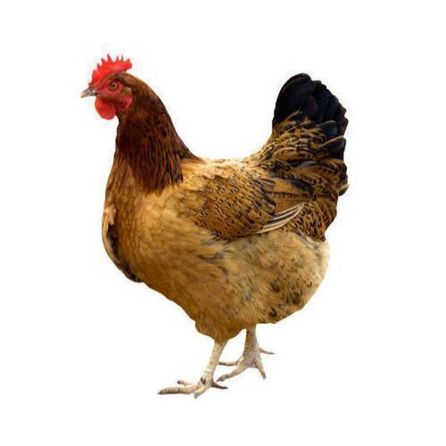
Pictures related to letter-h
HAT
HOUSE
HEN
HORSE
Notes:
HORSE

Slide 8
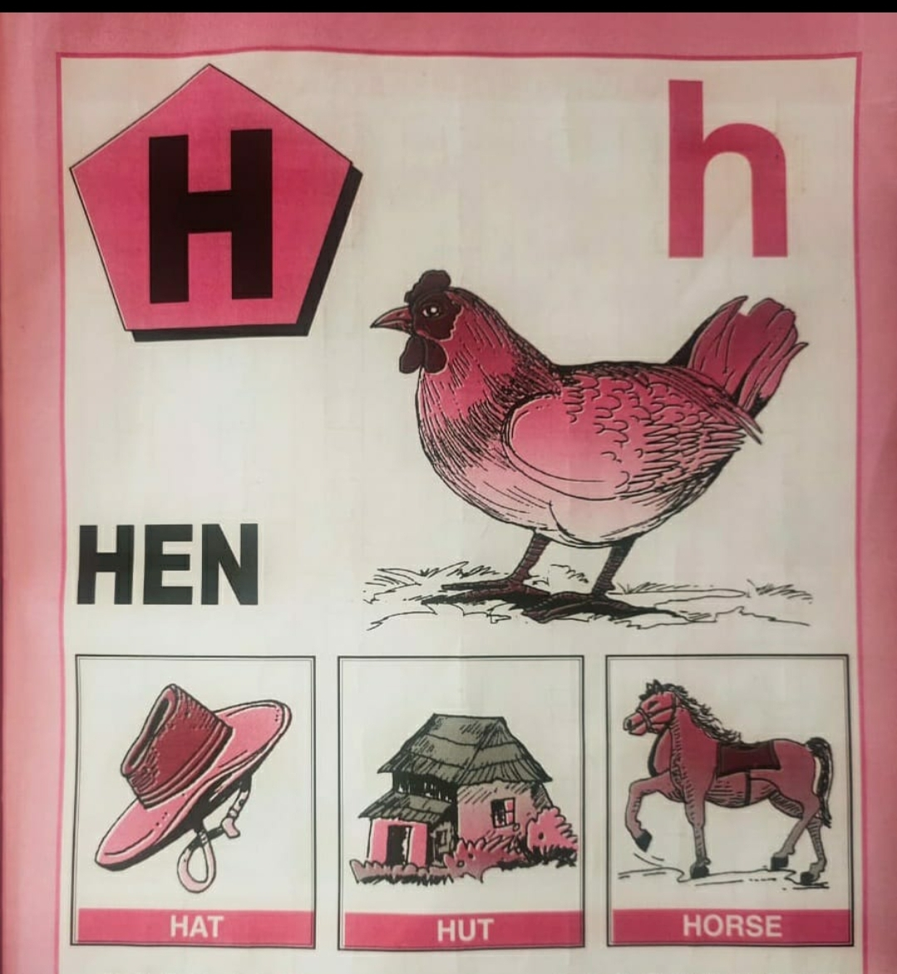
BK PG NO-31
CW
18/08/21
READ IT 5 TIMES
Notes:
18/08/21

Slide 9
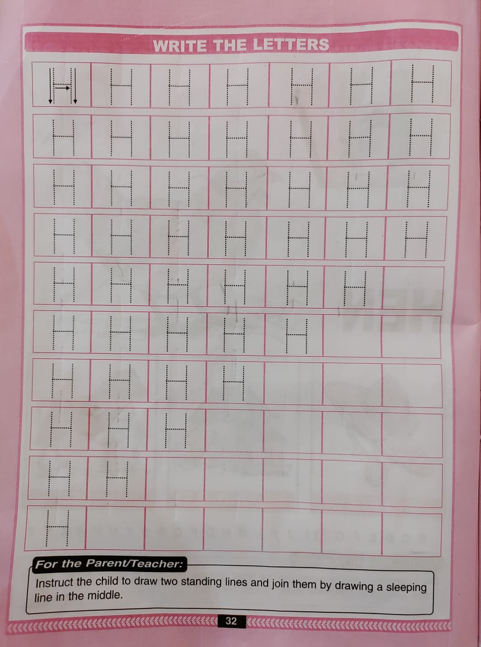
TRACE AND WRITE –BK PG NO-32
CW
18/08/21

Slide 10

ASSIGNMENT
18/08/21
1 .Practice phonic sound of letter H
2.
Complete bk pg no -32
3.PRACTICE TO READ BK PG NO-31 -LETTER H
Notes:
3

Slide 11
THANKING YOU
ODM EDUCATIONAL GROUP

