Slide 1



CLASS : NURSERY
DATE -17/11/21
SUBJECT : ENGLISH
SUBJECT : ENGLISH
TOPIC - BK PG NO-87,88
SUB-TOPIC-LETTER- – Y IN BK PG NO

Slide 2








Identify the given letter and tell one word related to the letter
Notes:
B

Slide 3

IDENTIFICATION OF LETTER W

Slide 4
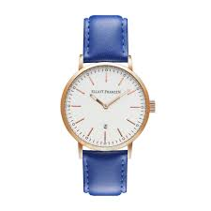



Picture related to letter-W
Notes:
CW

Slide 5

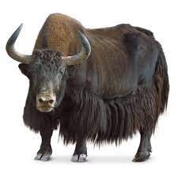
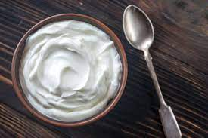
Identify the given pictures

Slide 6


Identiffication of letter Y

Slide 7
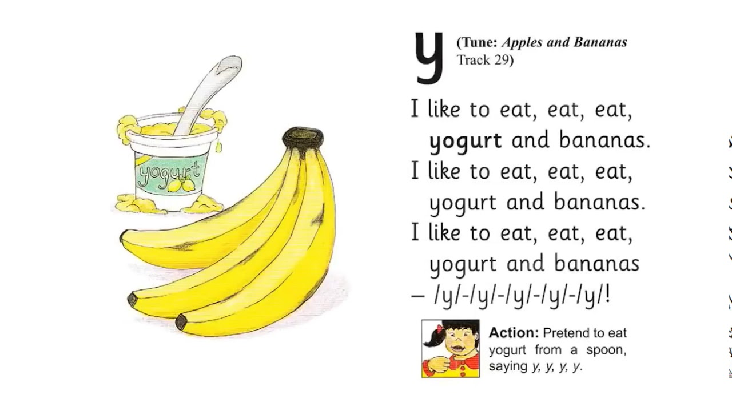
PHONIC SONG ON LETTER-Y

Slide 8

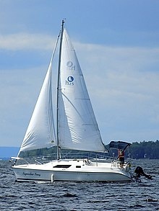
PICTURE RELATED TO LETTER-- Y
Y0-YO
YAK
YELLOW
YACHT
Notes:
YELLOW

Slide 9
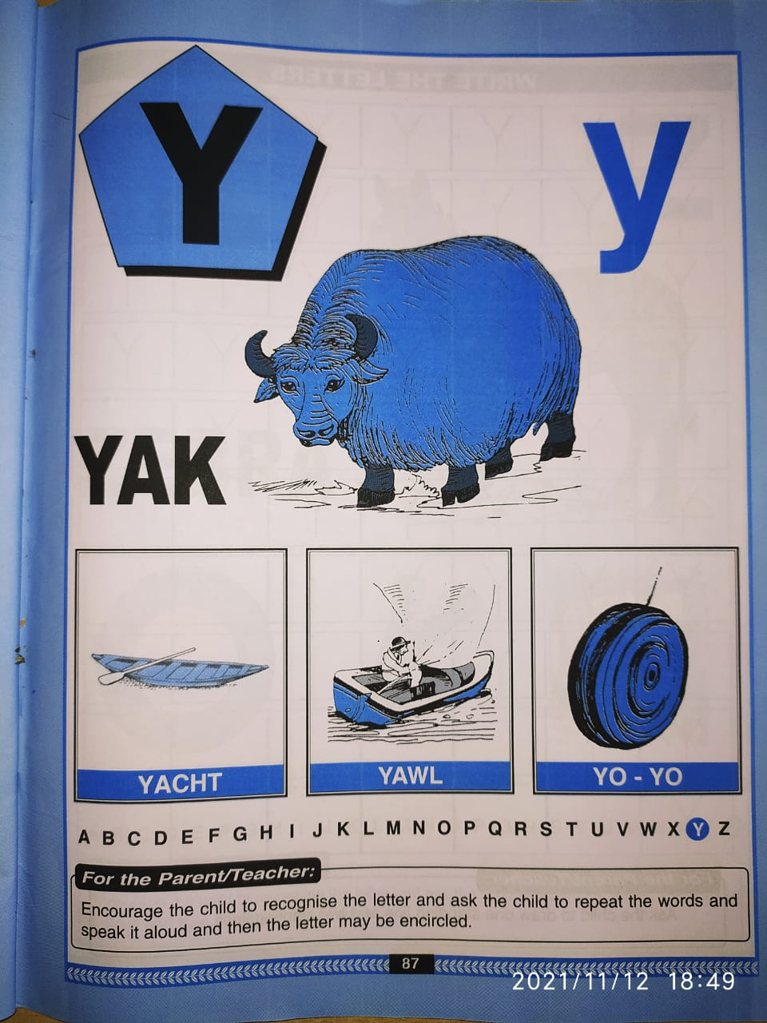

Slide 10
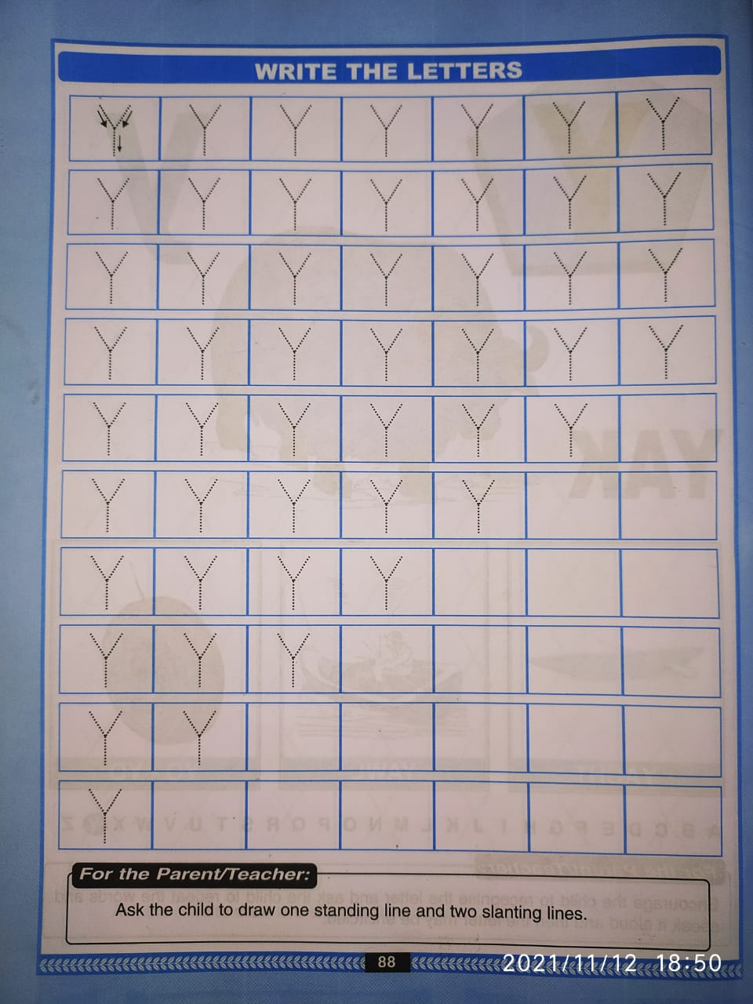
Trace and write
CW
17/11/21

Slide 11
Identify and circle letter Y
CW
17/11/21
H Y T F Y
Y T H Y W
F H Y W Y
Y W Y T F

Slide 12

HI children

Slide 13

Hi children let‘s write in bk
Y IN BK PG NO NO -88
Notes:
Hi children let‘s write in a book

Slide 14
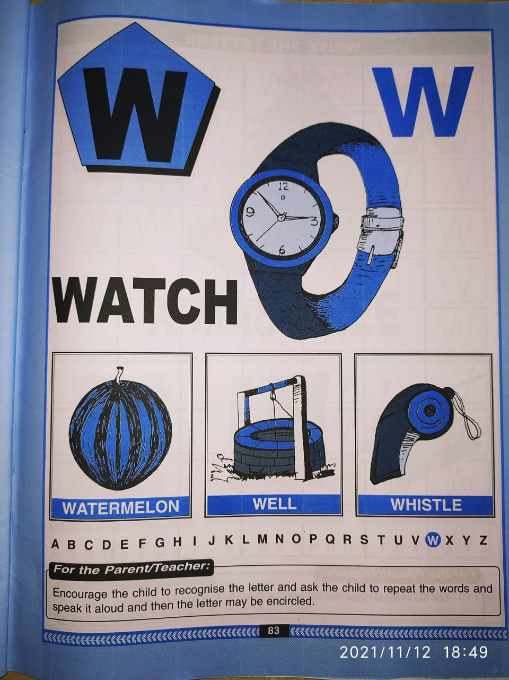
IN BK PG NO-83
CW
15/11/21

Slide 15
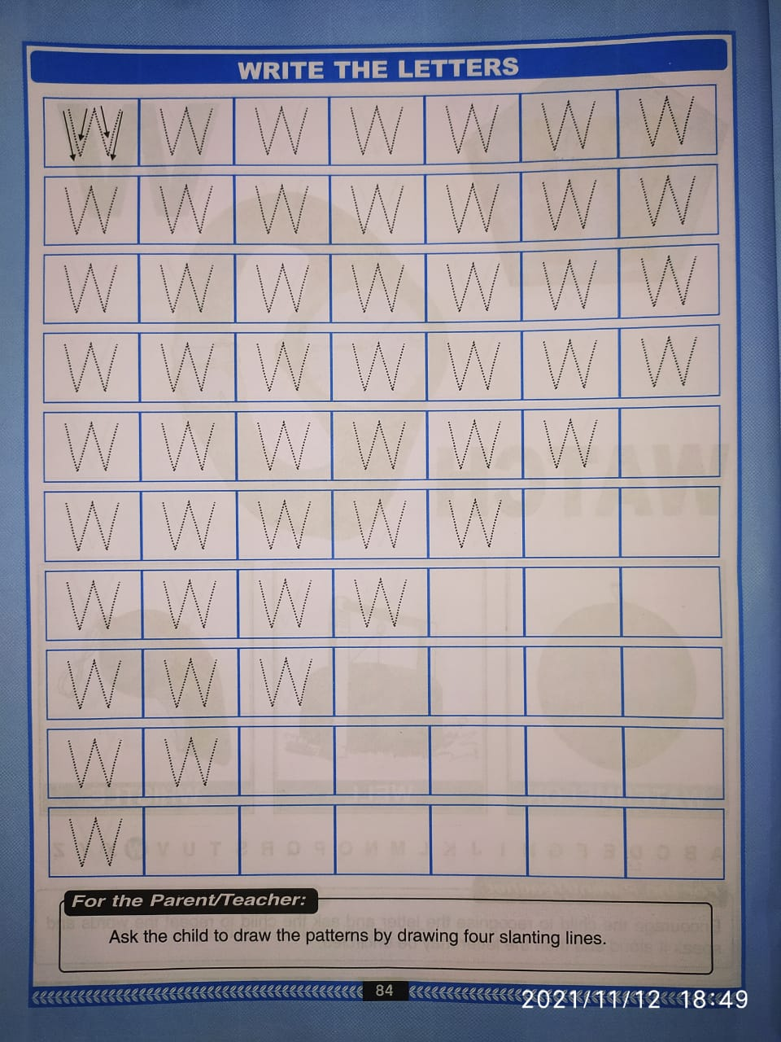
BK PG NO 84
CW
15/11/21

Slide 16
Circle and color letter W
(In nt bk)
HW
T
F
W
T
W
W
S
W
L
R
B
W
W
W
Notes:
(In nt bk)

Slide 17


15/11/21
ASSIGNMENT
1 .Practice phonic song of letter -W
-
.2.Complete the work given in bk pg no-84
Notes:
.COMPLETE BK PG NO-38

Slide 18
THANKING YOU
ODM EDUCATIONAL GROUP

