Slide 1



CLASS : NURSERY
DATE : 07 .07.21
SUBJECT : ENGLISH
TOPIC-BK PG NO-25
SUB-TOPIC-LETTER V

Slide 2








Identify the given letter

Slide 3



Slide 4

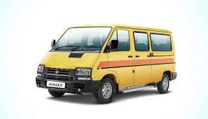

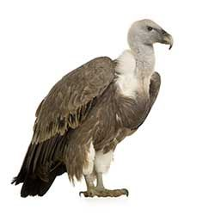
Picture related to letter v

Slide 5

HI children

Slide 6

Hi children let‘s write in a book
In bk pg no 25
Notes:
Hi children let‘s write in a book

Slide 7
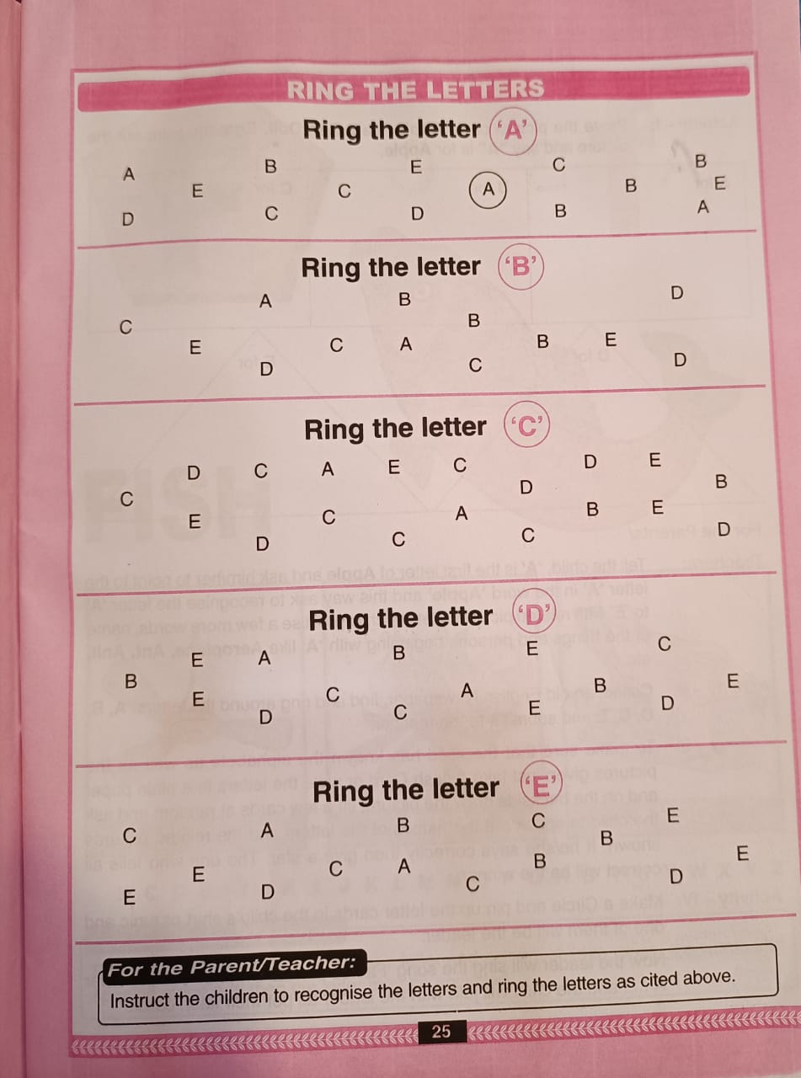
CW
07/07/21
Notes:
F

Slide 8

07/07/21
ASSIGNMENT
1 .Practice phonic sound of letter -V
2.Do bk pg no-4
Notes:
2.Do bk pg no-3

Slide 9
THANKING YOU
ODM EDUCATIONAL GROUP

