Slide 1



CLASS : NURSERY
DATE -16/11/21
SUBJECT : ENGLISH
SUBJECT : ENGLISH
TOPIC - BK PG NO-83,84
SUB-TOPIC-LETTER-W – IN NTBK

Slide 2








Identify the given letter and tell one word related to the letter
Notes:
B

Slide 3

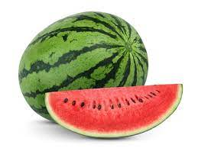
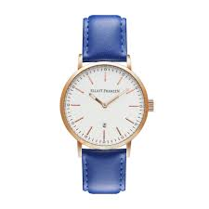



Slide 4


IDENTIFICATION OF LETTER W

Slide 5


Picture related to letter-W
Notes:
CW

Slide 6

HI children

Slide 7

Hi children let‘s write in nt bk
IN NT BK LETTER-W
Notes:
Hi children let‘s write in a book

Slide 8
M STANDS FOR WHEEL

Slide 9


TRACE AND WRITE

Slide 10


16/11/21
ASSIGNMENT
1 .Practice phonic song of letter -W
-
.2.Complete the work given in nt bk
Notes:
.COMPLETE BK PG NO-38

Slide 11
THANKING YOU
ODM EDUCATIONAL GROUP

