Slide 1



CLASS : NURSERY
DATE : 16.08.2021
SUBJECT : ENGLISH
TOPIC-BK PG NO-18,19
SUB-TOPIC-LETTER ‘E’ IN BK

Slide 2


Recapitulation

Slide 3
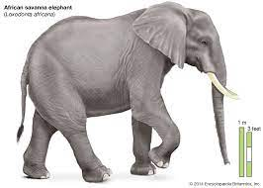


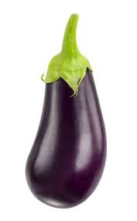

Identify the given pictures

Slide 4


Identification of letter E

Slide 5

Pictures related to letter-E

Slide 6
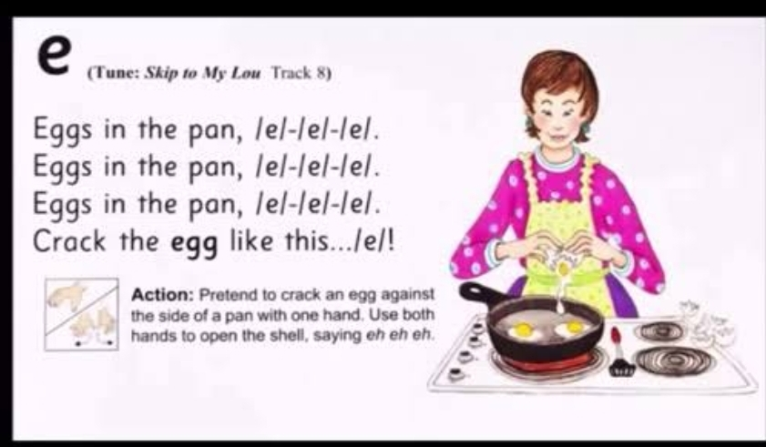
PHONETIC SONG ON LETTER -E

Slide 7
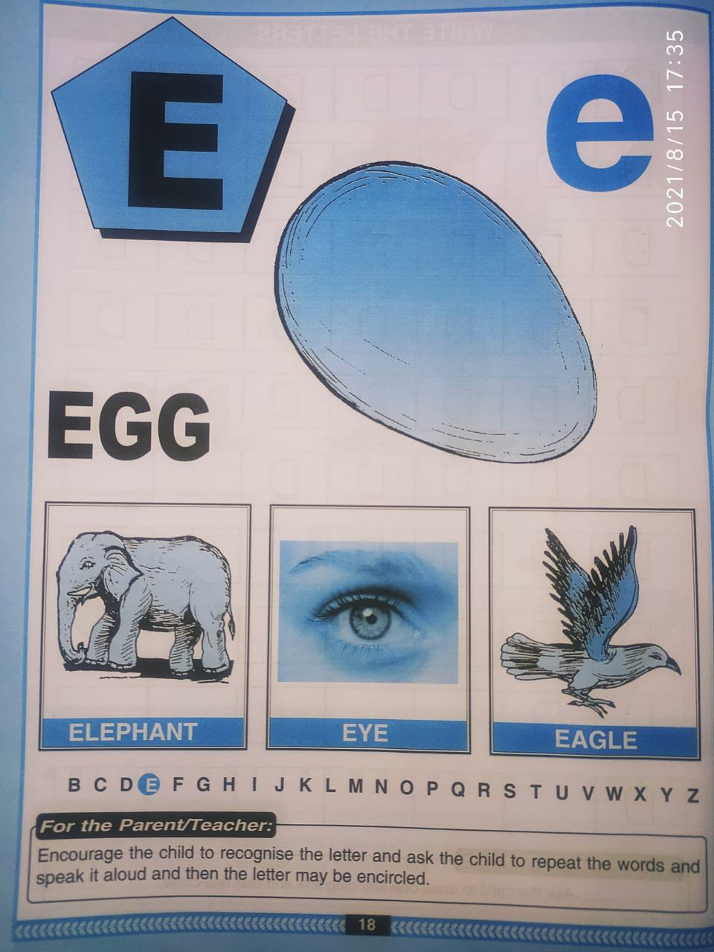
BK PG NO-18(Reading)
CW
16/08/21

Slide 8
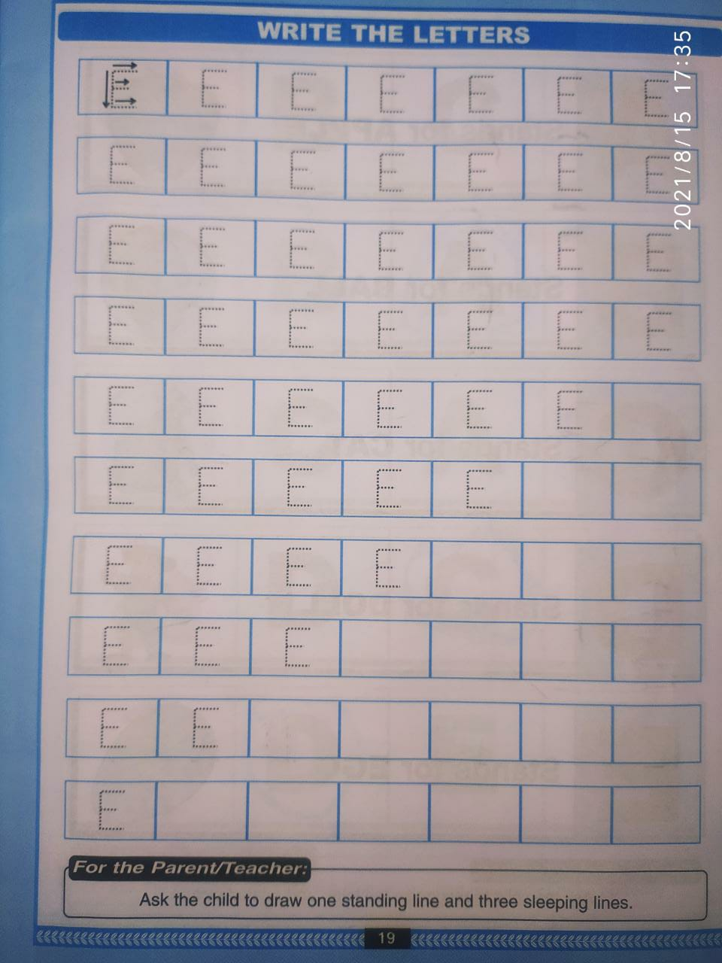
Bk pg no-19 (Trace and write)
CW
16/08/21
Notes:
16/08/21

Slide 9

ASSIGNMENT
16/08/21
1 .Practice phonic sound of letter E
2.
Complete bk pg no -19
3.PRACTICE TO READ BK PG NO-18 -LETTER E
Notes:
3

Slide 10
THANKING YOU
ODM EDUCATIONAL GROUP

