Slide 1



CLASS : NURSERY
DATE -15/11/21
SUBJECT : ENGLISH
SUBJECT : ENGLISH
TOPIC - BK PG NO-83,84
SUB-TOPIC-LETTER-W – IN BK

Slide 2








Identify the given letter and tell one word related to the letter
Notes:
B

Slide 3

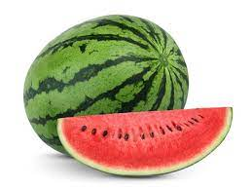
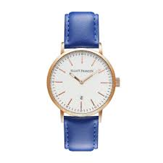



Slide 4


IDENTIFICATION OF LETTER W

Slide 5
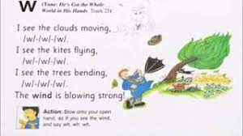

Slide 6


Picture related to letter-W
Notes:
CW

Slide 7

HI children

Slide 8

Hi children let‘s write in bk
Y IN BK PG NO NO -84
Notes:
Hi children let‘s write in a book

Slide 9
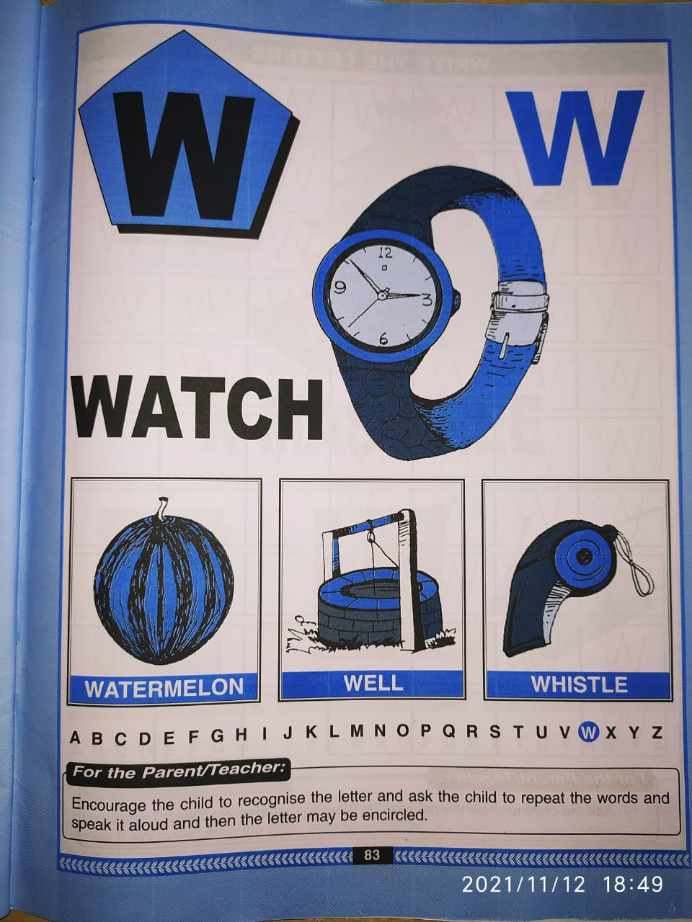
IN BK PG NO-83
CW
15/11/21

Slide 10
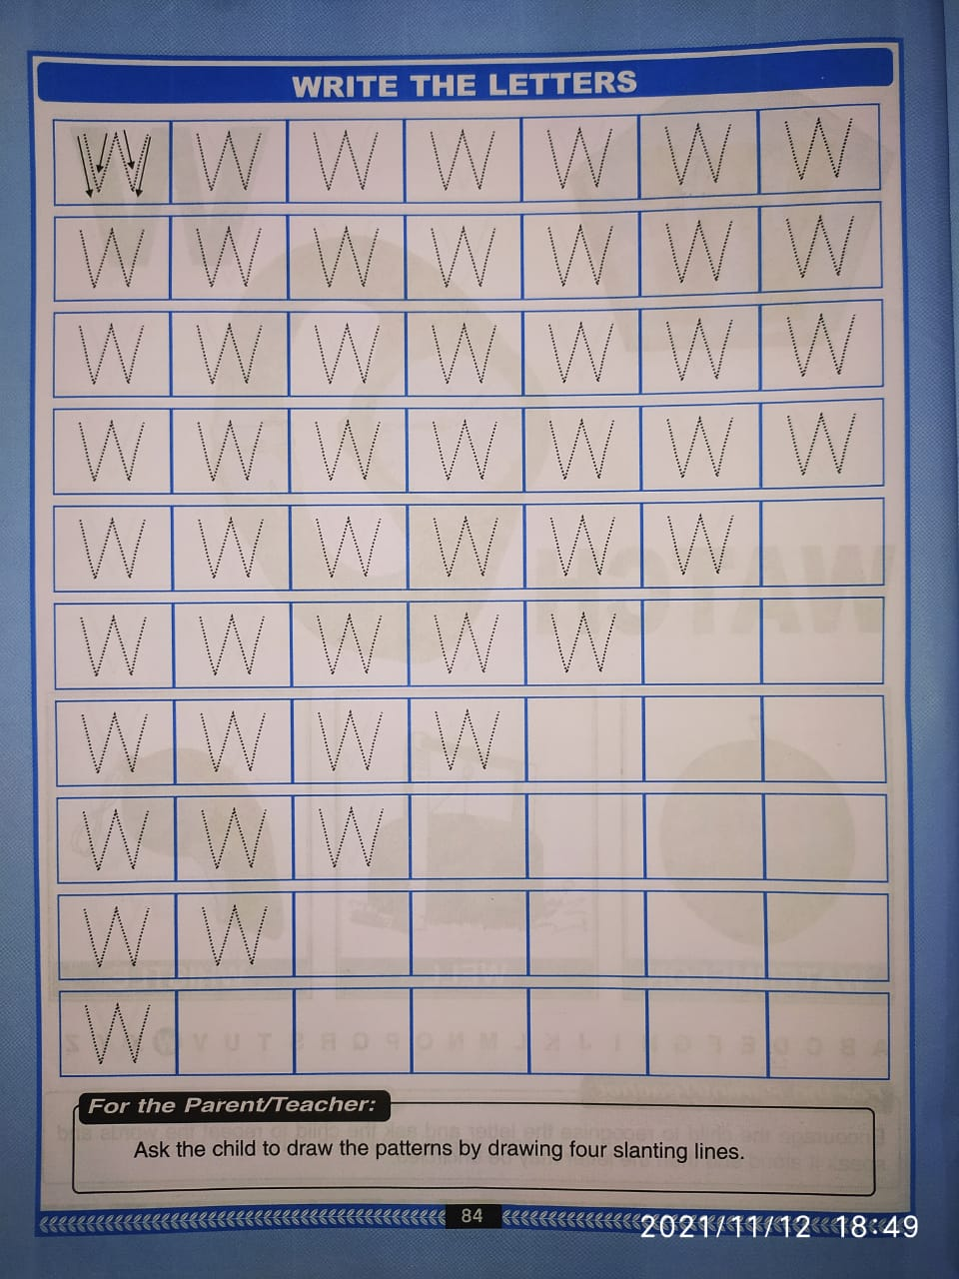
BK PG NO 84
CW
15/11/21

Slide 11
Circle and color letter W
(In nt bk)
HW
T
F
W
T
W
W
S
W
L
R
B
W
W
W
Notes:
(In nt bk)

Slide 12


15/11/21
ASSIGNMENT
1 .Practice phonic song of letter -W
-
.2.Complete the work given in bk pg no-84
Notes:
.COMPLETE BK PG NO-38

Slide 13
THANKING YOU
ODM EDUCATIONAL GROUP

