Slide 1



CLASS : NURSERY
DATE : 14.09.2021
SUBJECT : ENGLISH
TOPIC- :ORAL
SUBTOPIC: ORAL(REVISION-2)

Slide 2







READING

Slide 3
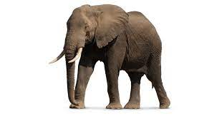


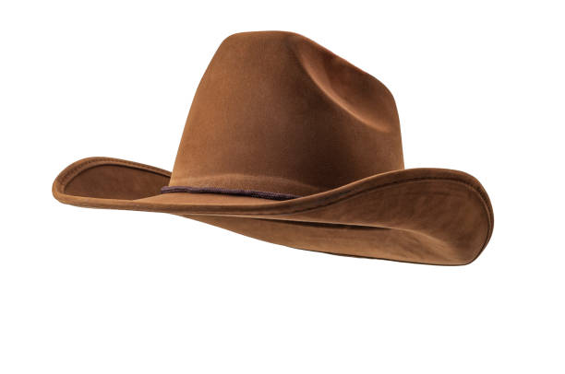

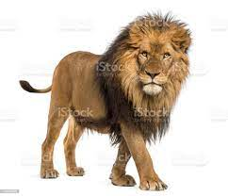
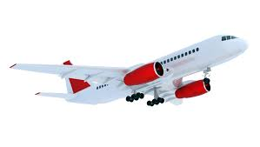
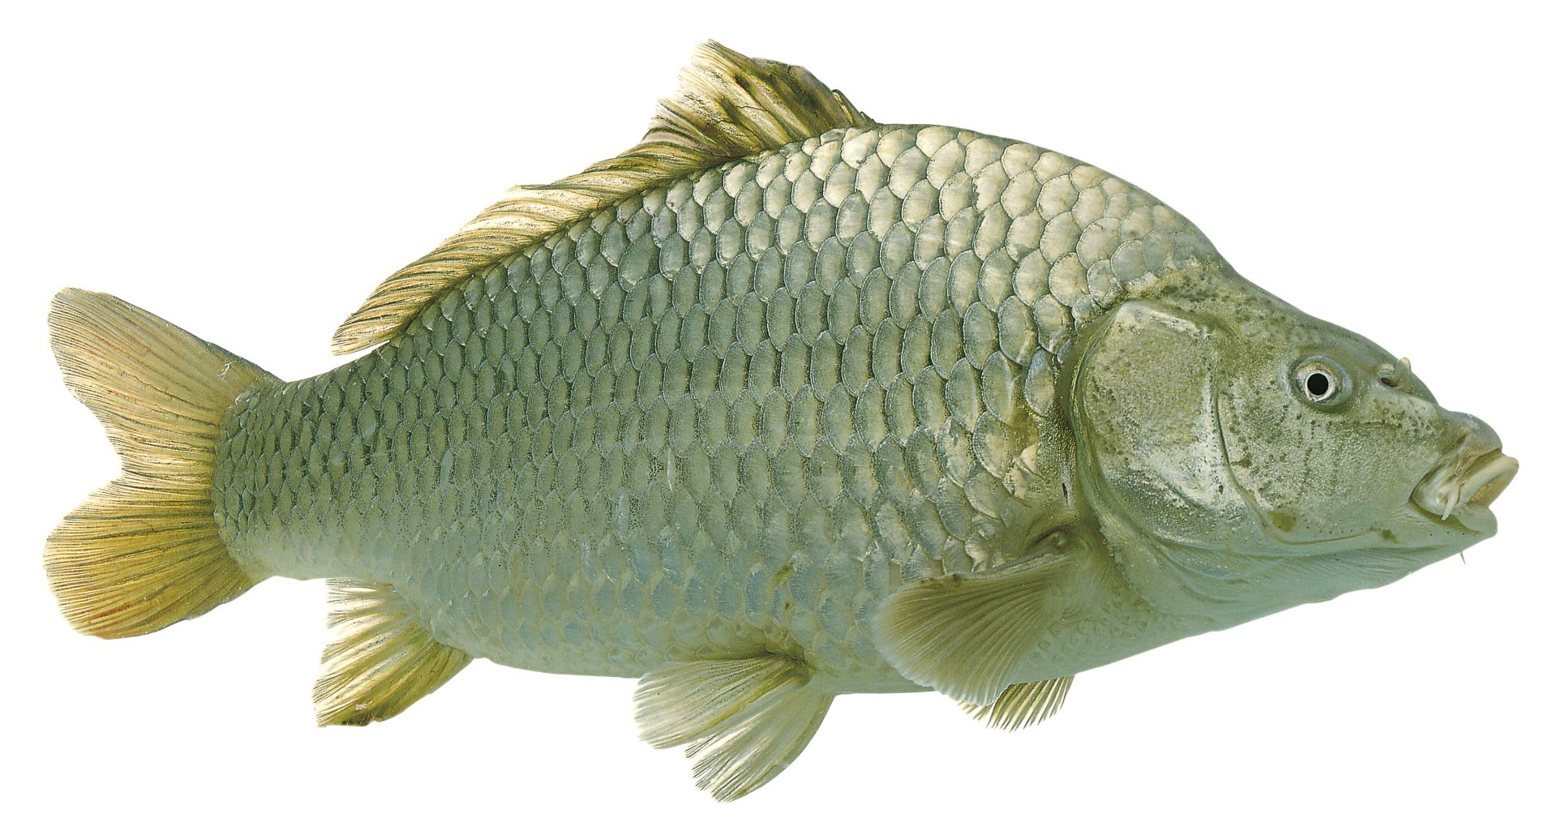
REVISION -2 (Oral))Identify and tell the initial letter of the given picture
H
I
E
E
T
K
L
F
A
Notes:
I E T A F K L

Slide 4

Note book work
Notes:
Note book work

Slide 5




Say and write
HW
14/09/21
Notes:
14/09/21

Slide 6

14/09/21
ASSIGNMENT
Do the given HW in nt bk
1.
2.Practice revision work
Notes:
2.Practice revision work

Slide 7
THANKING YOU
ODM EDUCATIONAL GROUP

