Slide 1



CLASS : NURSERY
DATE : 13.09.2021
SUBJECT : ENGLISH
TOPIC- :LETTER I,F
SUBTOPIC:LETTER I f IN nt bkBK(REVISION-1)

Slide 2








Slide 3
IDENTIFY THE GIVEN LETTER

Slide 4

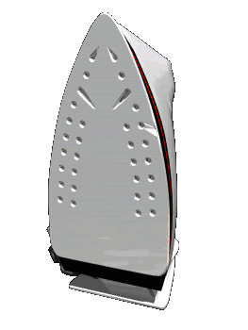



Slide 5


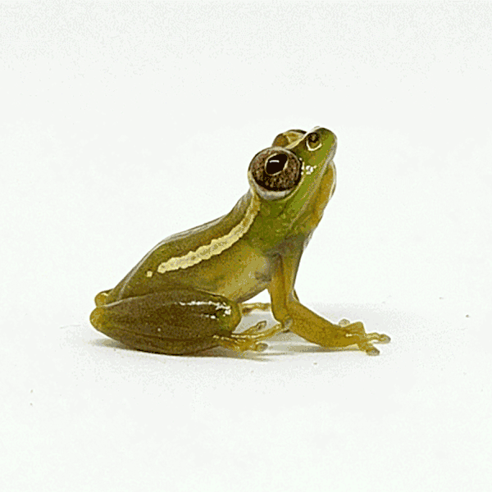


Slide 6

Note book work
Notes:
Note book work

Slide 7
Encircle and colour letter I & F
CW
13/09/21
REVISION -1
-K
I
D
E
F
C
I
F
K
D
F
E
I
F
C
I
K
Notes:
REVISION -1

Slide 8


CIRCLE THE LETTER RELETED TO THE GIVEN PICTURE
F
K
B
K
I
F
Notes:
I

Slide 9

13/09/21
ASSIGNMENT
Practice same work at home
1.

Slide 10
THANKING YOU
ODM EDUCATIONAL GROUP

