Slide 1



CLASS : NURSERY
DATE : 12.08.2021
SUBJECT : ENGLISH
TOPIC-BK PG NO-27,28
SUB-TOPIC-LETTER F IN NT BK

Slide 2

Recapitulation of letter I

Slide 3




Picture related to letter -I

Slide 4

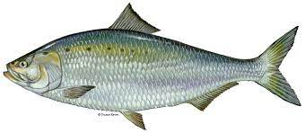

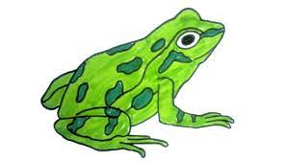
Identify the given picture

Slide 5


Identification of letter-F

Slide 6

Picture related to letter-F

Slide 7
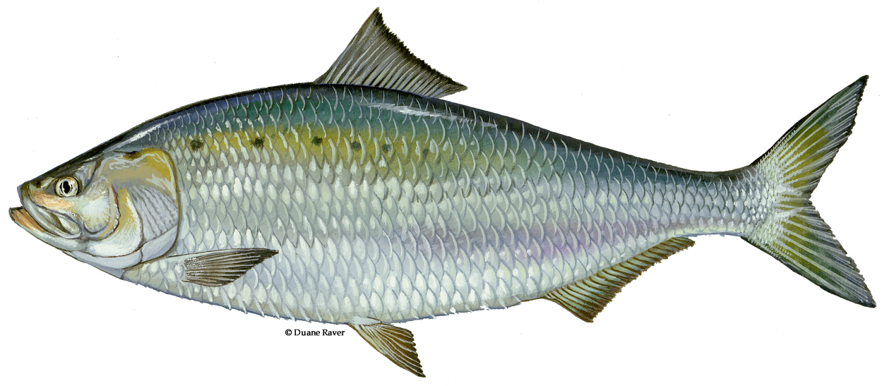
F STANDS FOR FISH

Slide 8


TRACE AND WRITE
CW
12/08/21
Notes:
12/08/21

Slide 9
SAY AND WRITE LETTER F(IN NOTE BK)
HW
Notes:
HW

Slide 10

ASSIGNMENT
12/08/21
1 .Practice phonic sound of letter F
2.
Complete the work given in nt.bk
Notes:
3

Slide 11
THANKING YOU
ODM EDUCATIONAL GROUP

