Slide 1



CLASS : NURSERY
DATE : 11.11.2021
SUBJECT : ENGLISH
TOPIC- : BK PG NO-50.51
SUBTOPIC: LETTER N IN NT BK

Slide 2








Slide 3

IDENTIFICATION OF LETTER M

Slide 4

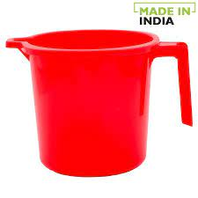
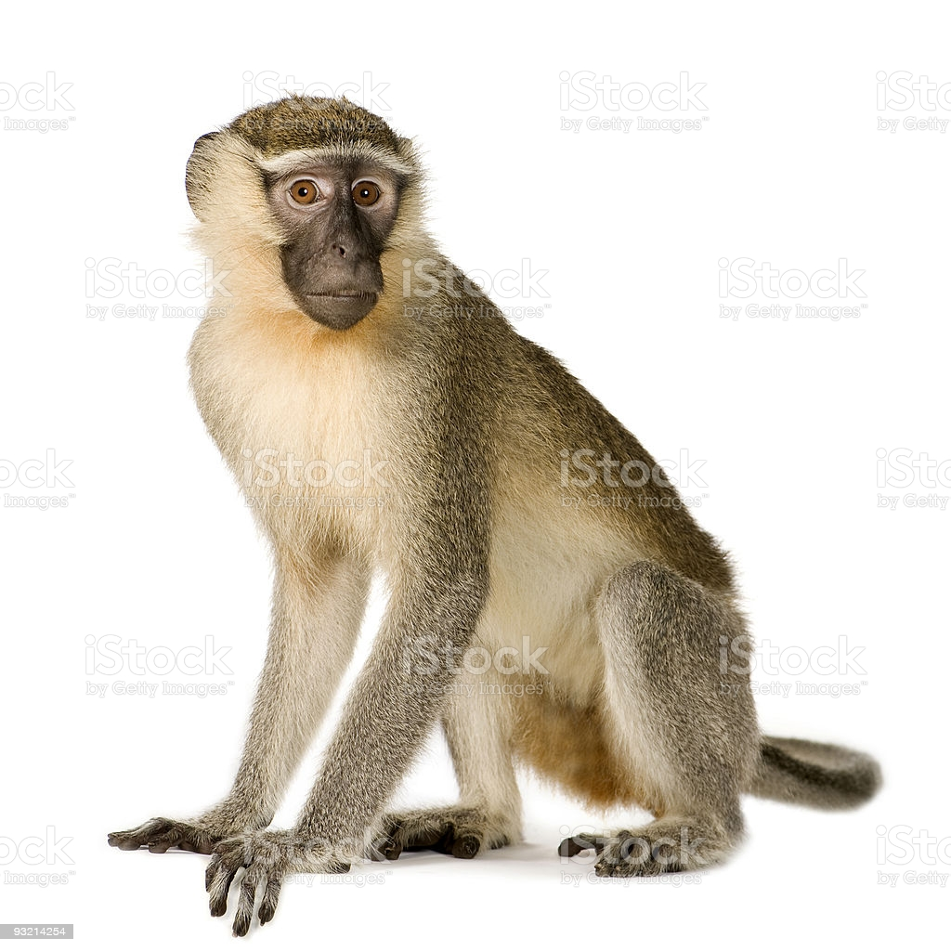
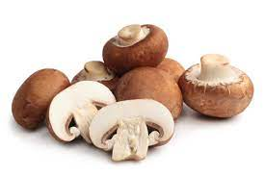
Picture related to letter-M

Slide 5



Slide 6



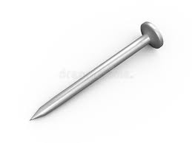
Picture related to letter-N
NURSE
NEST
NET
NAIL
Notes:
NAIL

Slide 7

Letter N in nt book
Notes:
Note book work

Slide 8
N stands for Net
CW
11/11/21

Slide 9


Trace and write
CW
11/11/21
Notes:
11/11/21

Slide 10
Identify and circle letter-N
HW
F
H
A
M
N
T
N
M
N
H
N
N
K
M
H
A
N
E

Slide 11

11/11/21
ASSIGNMENT
Complete nt bk work
1.
2.Practice phonetic sound of letter-N
Notes:
Practice phonetic sound of letter-M

Slide 12
THANKING YOU
ODM EDUCATIONAL GROUP

