Slide 1



CLASS : NURSERY
DATE : 11.08.2021
SUBJECT : ENGLISH
TOPIC-BK PG NO-27,28
SUB-TOPIC-LETTER F

Slide 2

Recapitulation of letter I

Slide 3




Picture related to letter -I

Slide 4



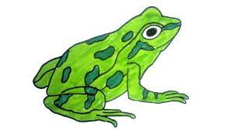
Identify the given picture

Slide 5


Identification of letter-F

Slide 6

Picture related to letter-F

Slide 7
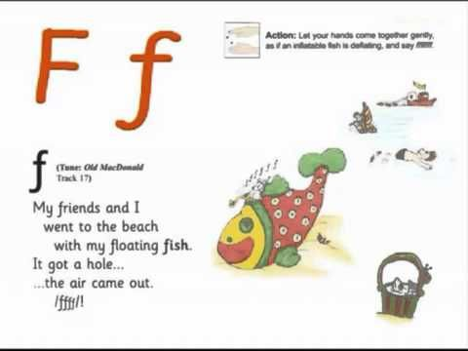
PHONETIC SOUND ON LETTER -F

Slide 8
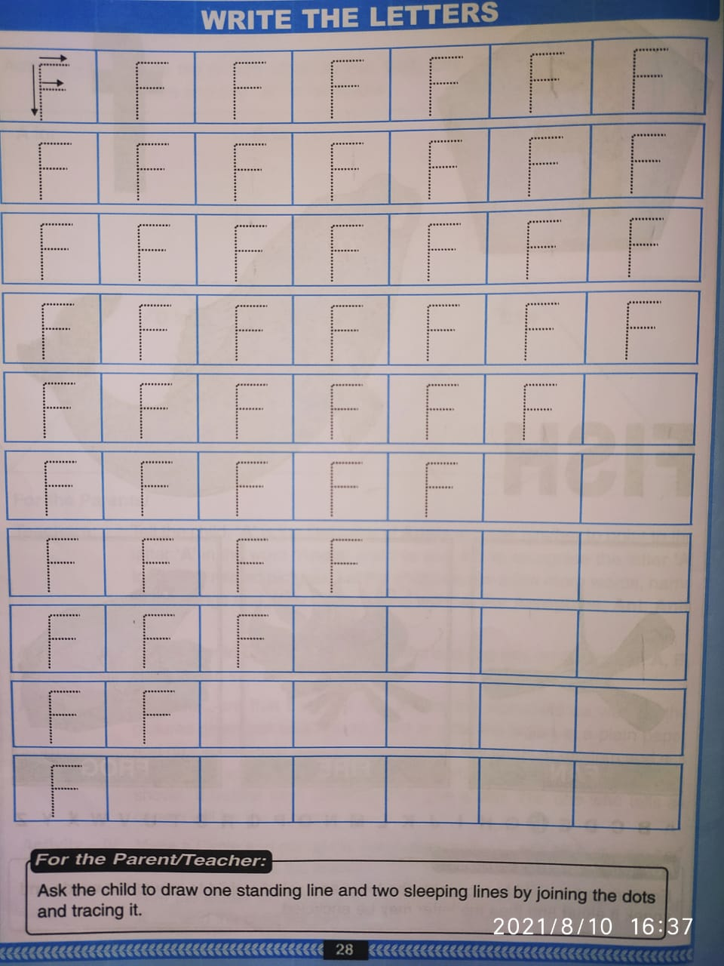
TRACE AND WRITE
CW
11/08/21
Notes:
11/08/21

Slide 9

TRACE AND WRITE

Slide 10

ASSIGNMENT
11/08/21
1 .Practice phonic sound of letter F
2.
Complete bk pg no-28
3.Complete the work sheet
Notes:
3

Slide 11
THANKING YOU
ODM EDUCATIONAL GROUP

