Slide 1



CLASS : NURSERY
DATE : 10.08.2021
SUBJECT : ENGLISH
TOPIC-BK PG NO-34
SUB-TOPIC-LETTER I IN NOTE BK

Slide 2









TELL THE PHONETIC SOUND OF THE GIVEN LETTER

Slide 3
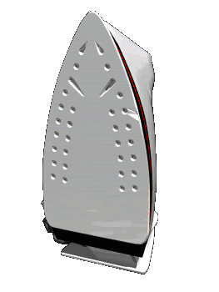



IDENTIFICATION OF LETTER I

Slide 4


Identification of letter I

Slide 5



Picture related to letter -I

Slide 6
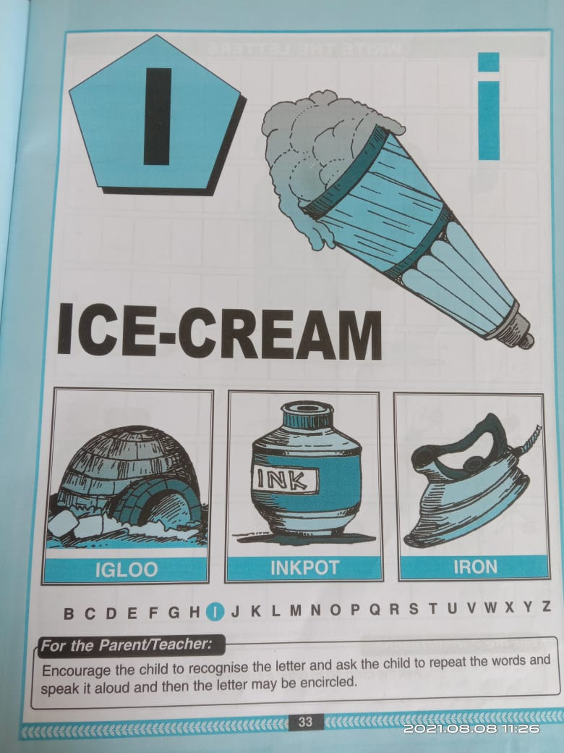
BK PG NO -33
CW
Read out 5 times
09/08/21
Notes:
09/08/21

Slide 7
I STANDS FOR ICE CREAM
CW
10/08/21
 | I stands for icecream
Notes:
I stands for icecream

Slide 8


CW
10/08/21
I stands for icec
Notes:
CW 10/08/21

Slide 9
Say and write letter I
HW
HW
Notes:
HW

Slide 10

ASSIGNMENT
10/08/21
1 .Practice phonic sound of letter I
2.
Complete the work given in note BK
3.PRACTICE TO READ BK PG NO-33 -LETTER I
Notes:
3

Slide 11
THANKING YOU
ODM EDUCATIONAL GROUP

