Slide 1



CLASS : NURSERY
DATE : 09.11.2021
SUBJECT : ENGLISH
TOPIC- : BK PG NO-48,49
SUBTOPIC: LETTER M IN NT BK

Slide 2








Slide 3


IDENTIFICATION OF LETTER M

Slide 4
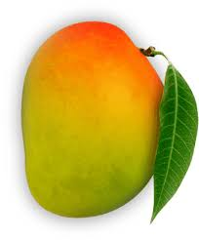
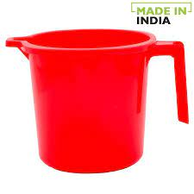
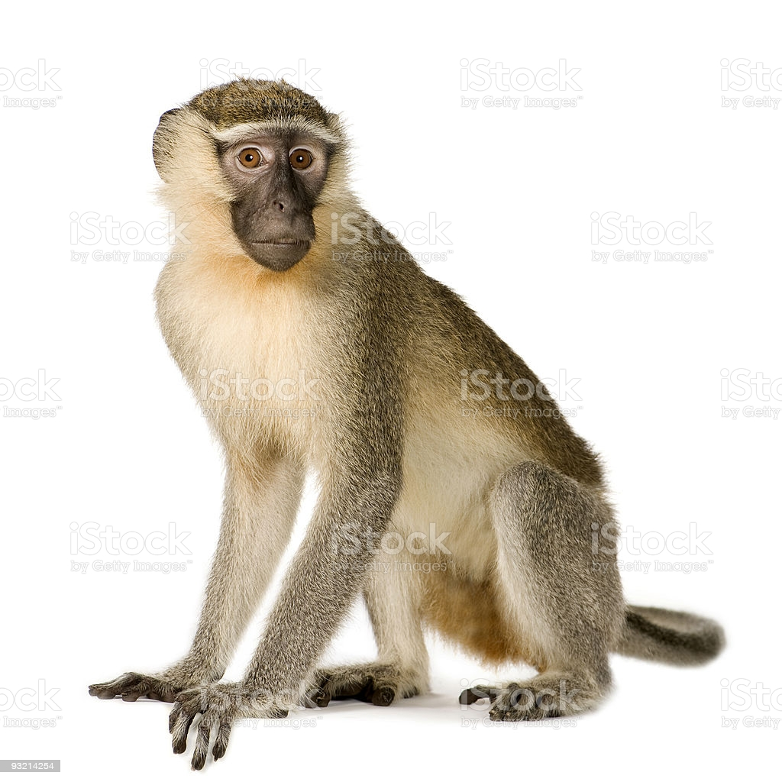
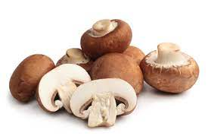
Picture related to letter-M

Slide 5

Letter M in nt book
Notes:
Note book work

Slide 6
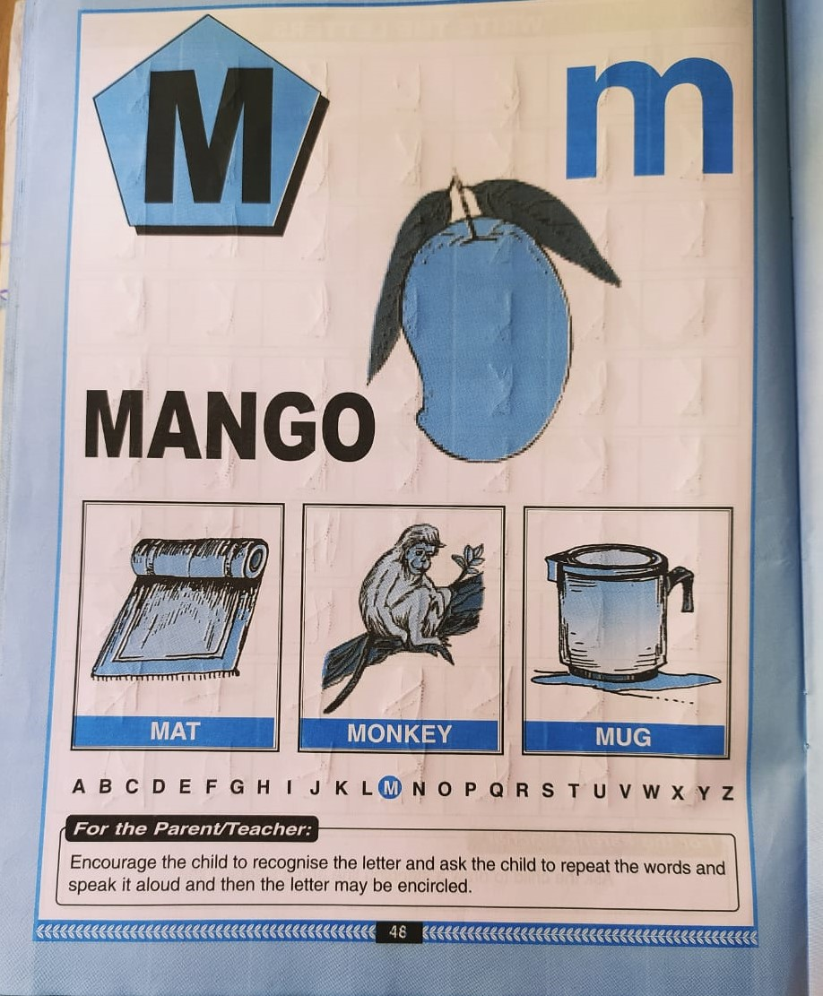
In nt bk –pg no-48
CW
Notes:
CW

Slide 7
M STANDS FOR MANGO
CW
9/11/21

Slide 8

Trace and write
CW
9/11/21
09/11/2109/11/21
Notes:
CW

Slide 9

09/11/21
ASSIGNMENT
1.
Read bk pg no 48 , 5 times
2.Complete the work given in nt bk
3.Practice phonetic sound of letter-M
Notes:
CW

Slide 10
THANKING YOU
ODM EDUCATIONAL GROUP

