Slide 1



CLASS : NURSERY
DATE : 09.09.2021
SUBJECT : ENGLISH
TOPIC- : bk pg no-44,45
SUB-TOPIC: LETTER-K

Slide 2








Slide 3
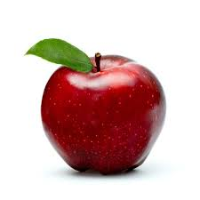
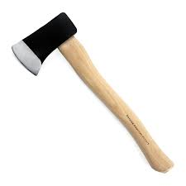
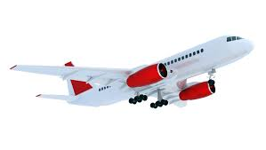
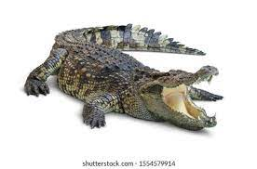
PICTURE RELATED TO LETTER -A
APPLE
AXE
ALLIGATOR
AEROPLANE
Notes:
ALLIGATER

Slide 4
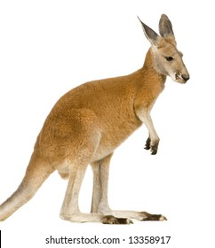
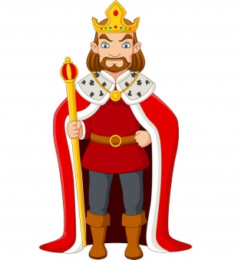
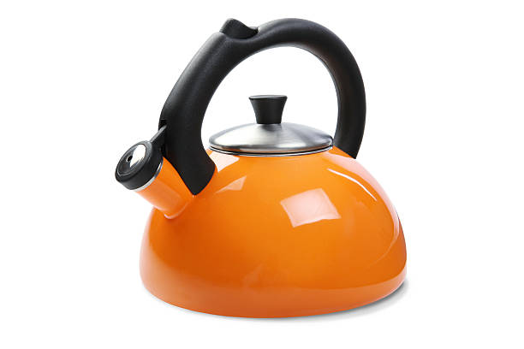

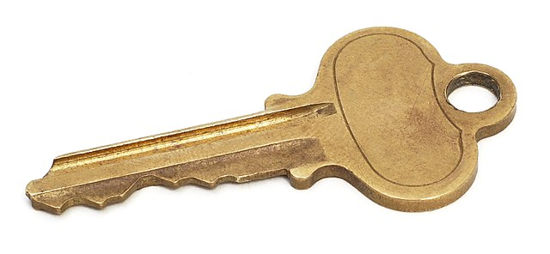
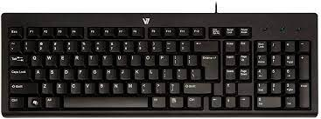

Slide 5



Slide 6
Picture related to letter K
KANGAROO
KING
KEYBOARD
KEY

Slide 7

IN NT BK BOOK PG NO-44,45
Notes:
IN BK PG NO-9

Slide 8


K STANDS FOR KITE
CW
09/09/21
Notes:
CW

Slide 9

CW
09/09/21

Slide 10
SAY AND WRITE
HW
Notes:
HW

Slide 11

ASSIGNMENT
09/09/21
1 .Practice phonic sound of letter -K
2.
Complete the work given in nt bk

Slide 12
THANKING YOU
ODM EDUCATIONAL GROUP

