Slide 1



CLASS : NURSERY
DATE : 08.11.2021
SUBJECT : ENGLISH
TOPIC- : BK PG NO-48,49
SUBTOPIC: LETTER M

Slide 2








Slide 3
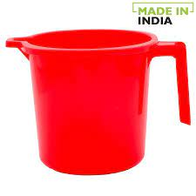

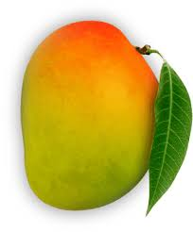

Identify the given picture

Slide 4


IDENTIFICATION OF LETTER M

Slide 5

Phonetic sound of letter-M

Slide 6
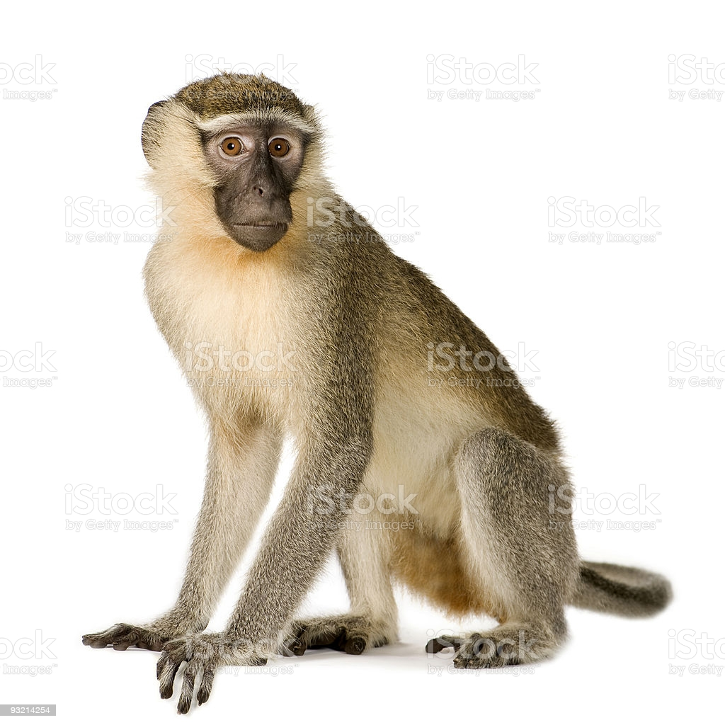
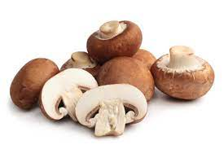
Picture related to letter-M

Slide 7

Letter M in book pg no-49
Notes:
Note book work

Slide 8
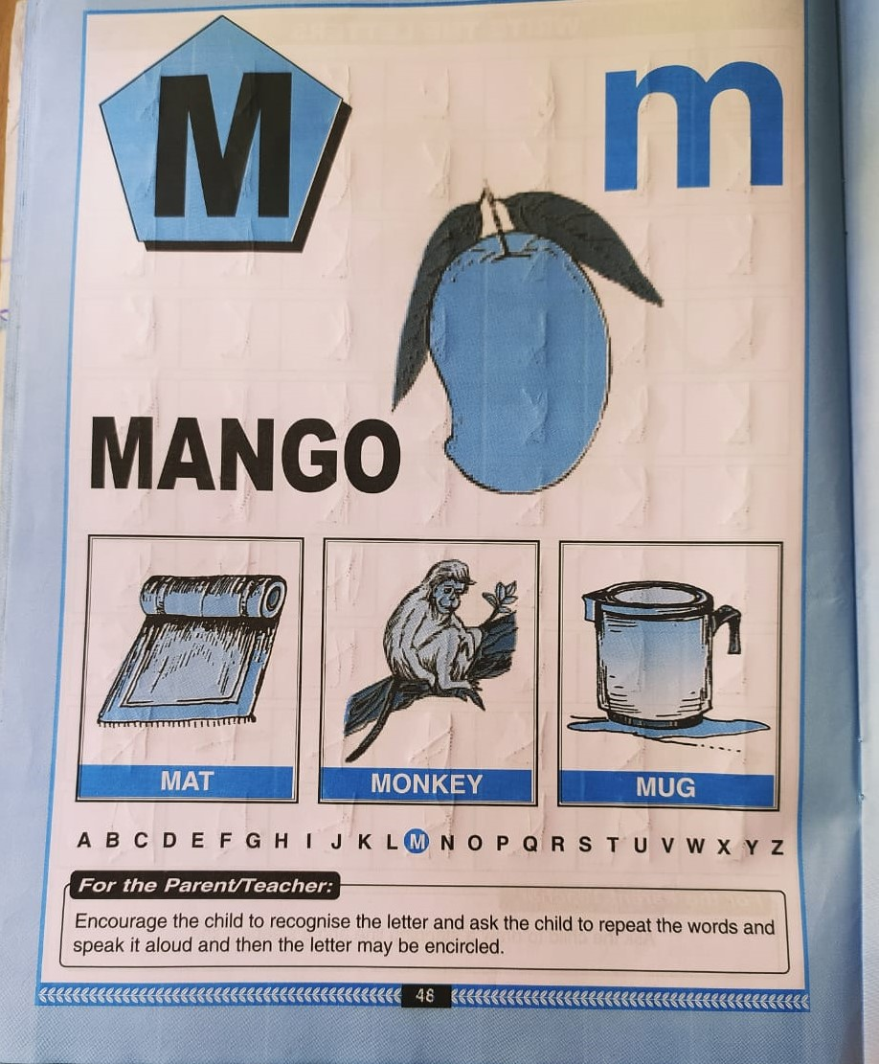
In nt bk –pg no-48
CW
Notes:
CW

Slide 9
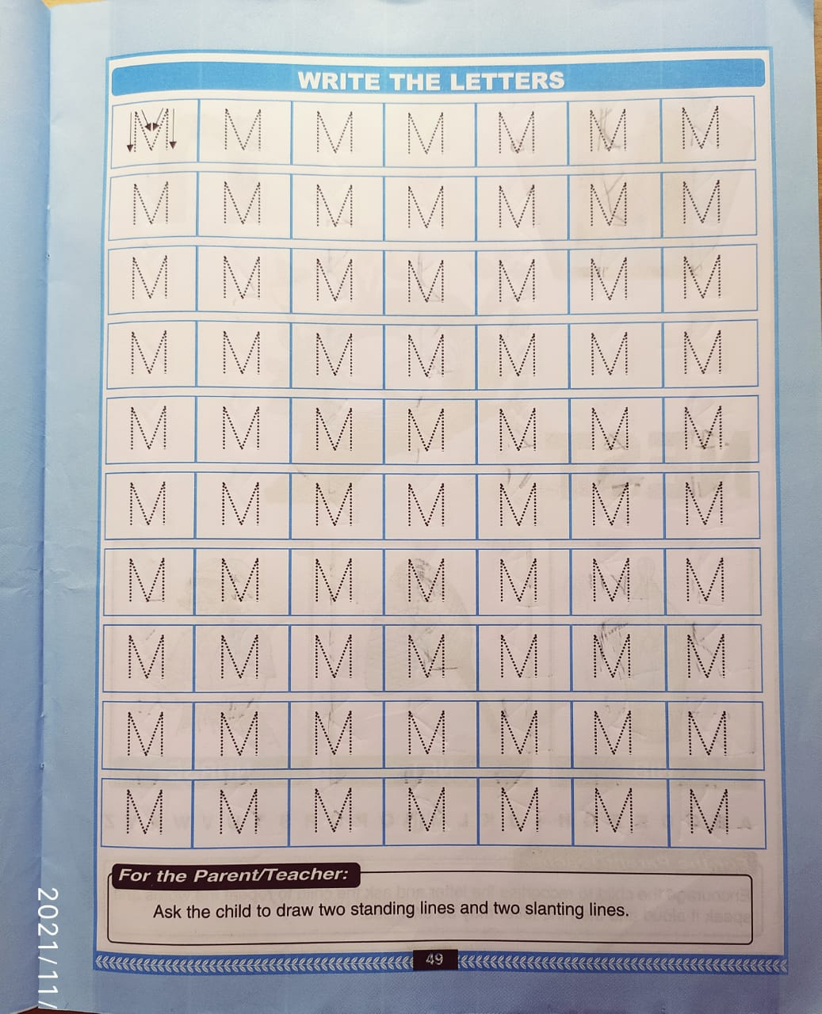
Bk pg no-49
CW
8/11/21
Notes:
8/11/21

Slide 10
Identify and circle letter-M
F
H
A
M
M
M
F
M
A
H
H
A
F
M
M
A
M
H
Notes:
F H A

Slide 11

08/11/21
ASSIGNMENT
Complete bk pg no 49
1.
2. DO BK PG NO-8,9
3.Practice phonetic sound of letter-M
Notes:
Practice phonetic sound of letter-M

Slide 12
THANKING YOU
ODM EDUCATIONAL GROUP

