Slide 1



CLASS : NURSERY
DATE -7/12/21
SUBJECT : ENGLISH
SUBJECT : ENGLISH
TOPIC - BK PG NO-52,53
SUB-TOPIC- LETTER-O – IN NT BK

Slide 2


Identification of letter O

Slide 3

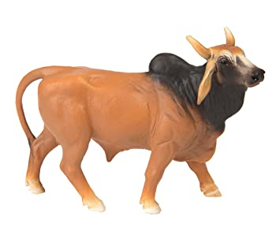
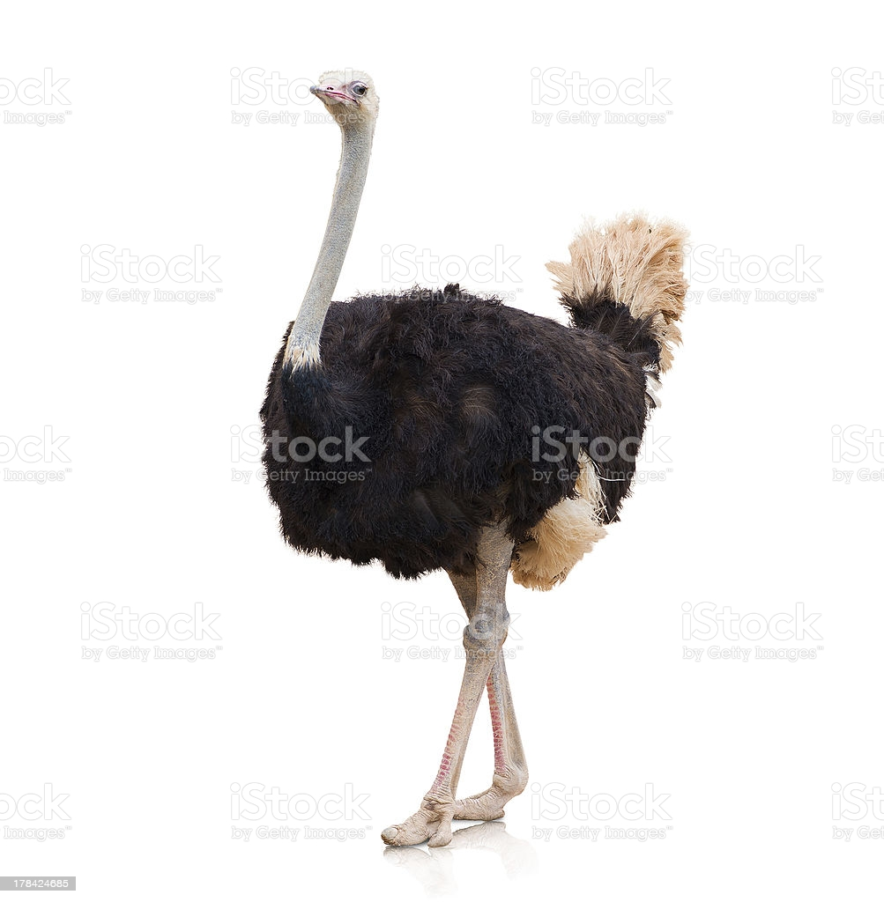

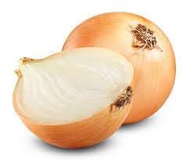
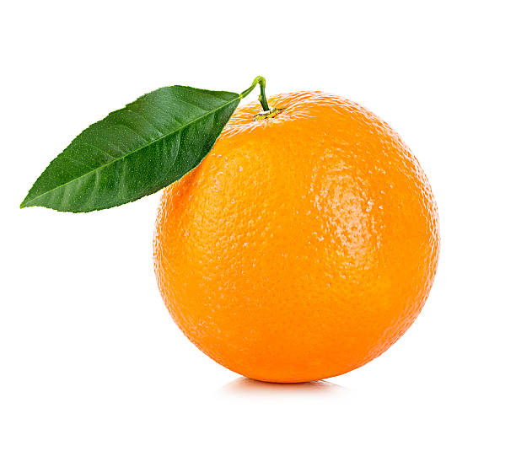
Picture related to letter O
OWL
OX
OSTRICH
ORANGE
OCTOPUS
ONION

Slide 4

HI children

Slide 5
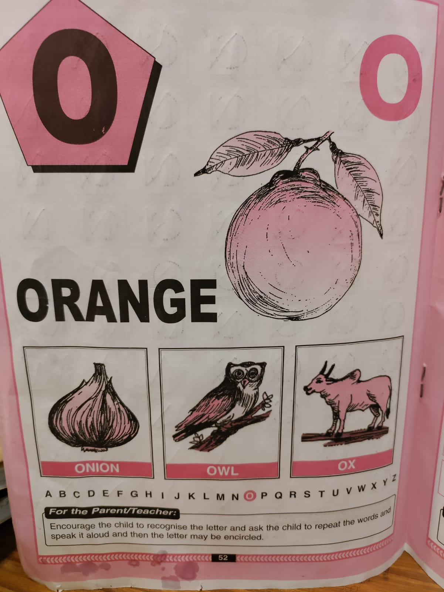

Slide 6

Hi children let‘s write in bk
IN NT BK LETTER O
Notes:
Hi children let‘s write in a book

Slide 7

O Stands for orange
cw
07/12/21

Slide 8

Trace and write letter O
cw
07/12/21

Slide 9


7/12/21
ASSIGNMENT
1 .Practice phonic song of letter -O
.2.Complete the work given in nt bk
Notes:
.COMPLETE BK PG NO-38

Slide 10
THANKING YOU
ODM EDUCATIONAL GROUP

