Slide 1



CLASS : NURSERY
DATE : 07.09.2021
SUBJECT : ENGLISH
TOPIC- : bk pg no-10,11
SUB-TOPIC: LETTER-A

Slide 2







Slide 3

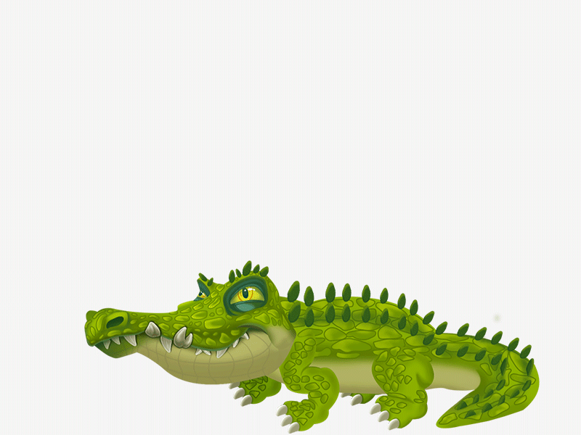
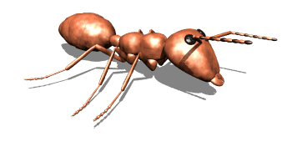
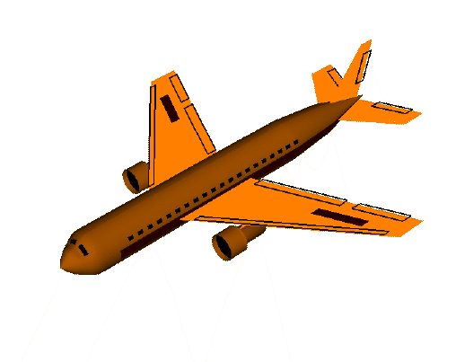
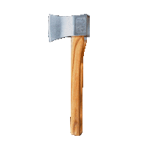

Slide 4


IDENTIFICATION OF LETTER-A

Slide 5

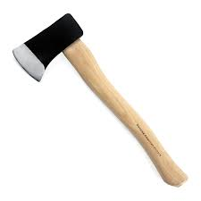
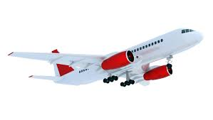
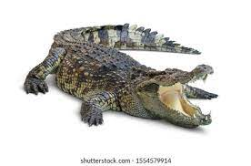
PICTURE RELATED TO LETTER -A
APPLE
AXE
ALLIGATOR
AEROPLANE
Notes:
ALLIGATER

Slide 6

IN NT BK BOOK PG NO11
Notes:
IN BK PG NO-9

Slide 7
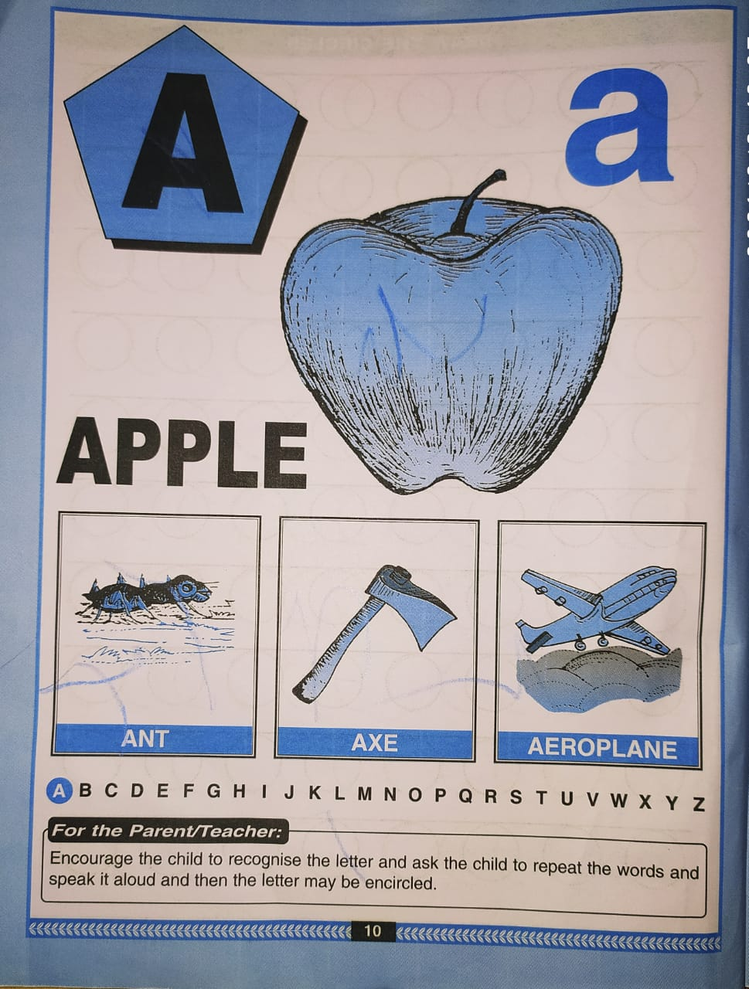
TRACE AND WRITE LETTER-A BK PG NO-11

Slide 8

A STANDS FOR APPLE

Slide 9



Slide 11

ASSIGNMENT
07/09/21
1 .Practice phonic sound of letter -A
2.
Complete the work given in nt bk
3. Do BK PG NO-7,8

Slide 12
THANKING YOU
ODM EDUCATIONAL GROUP

