Slide 1



CLASS : NURSERY
DATE -6/12/21
SUBJECT : ENGLISH
SUBJECT : ENGLISH
TOPIC - BK PG NO-52,53
SUB-TOPIC- LETTER-O – IN BK

Slide 2


Identification of letter G

Slide 3
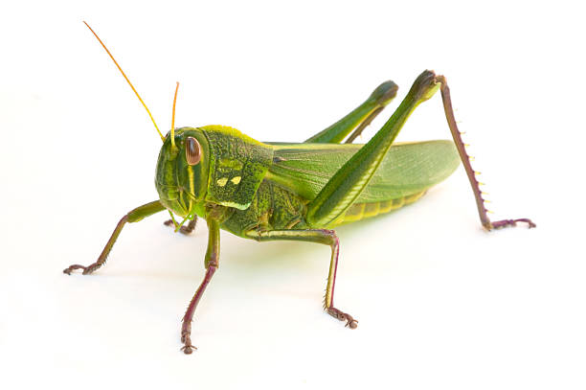
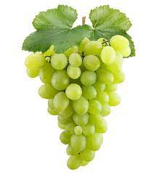
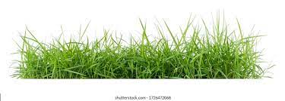

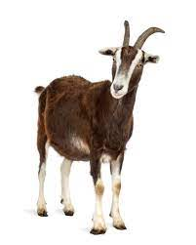
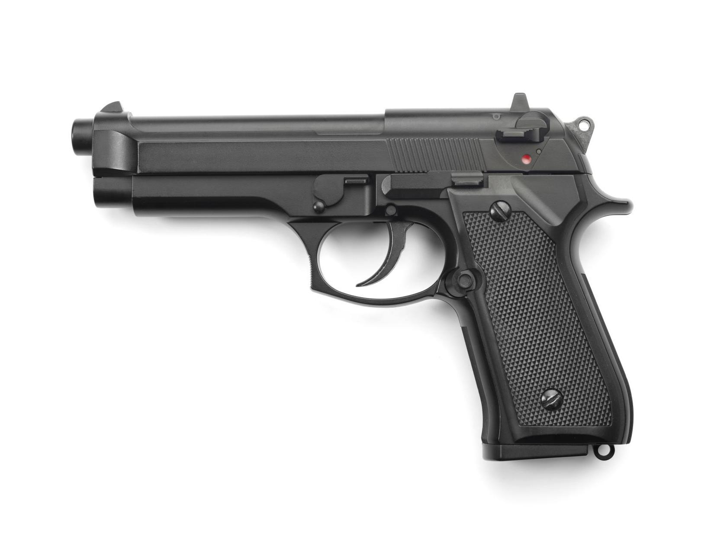
Picture related to letter G
GRASS
GRASS HOPPER
GRAPES
GOAT
GIRL
GUN

Slide 4
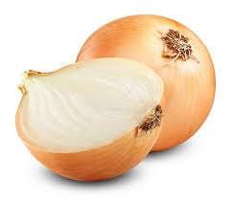
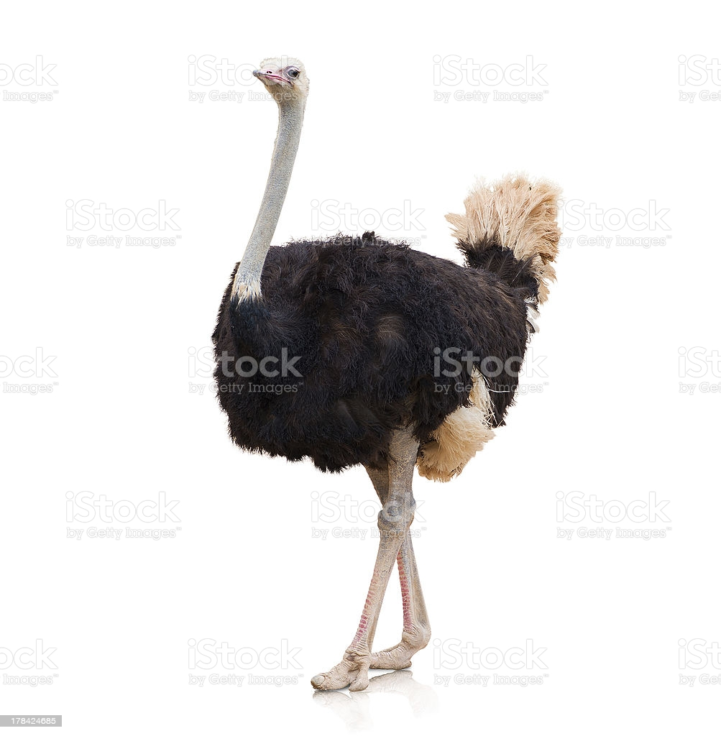
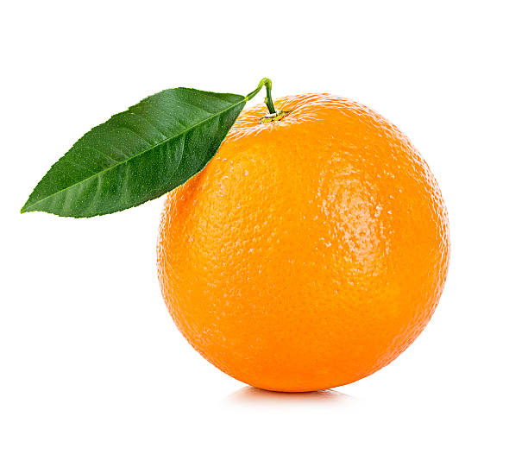
Identify the given picture and tell the name

Slide 5


Identification of letter O

Slide 6
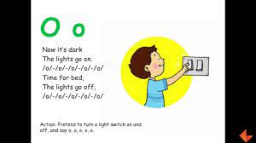
Song on letter O

Slide 7

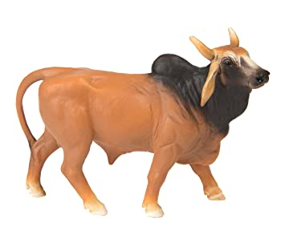

Picture related to letter O
OWL
OX
OSTRICH
ORANGE
OCTOPUS
ONION

Slide 8

HI children

Slide 9

Hi children let‘s write in bk
O IN BK PG NO -52,53
Notes:
Hi children let‘s write in a book

Slide 10
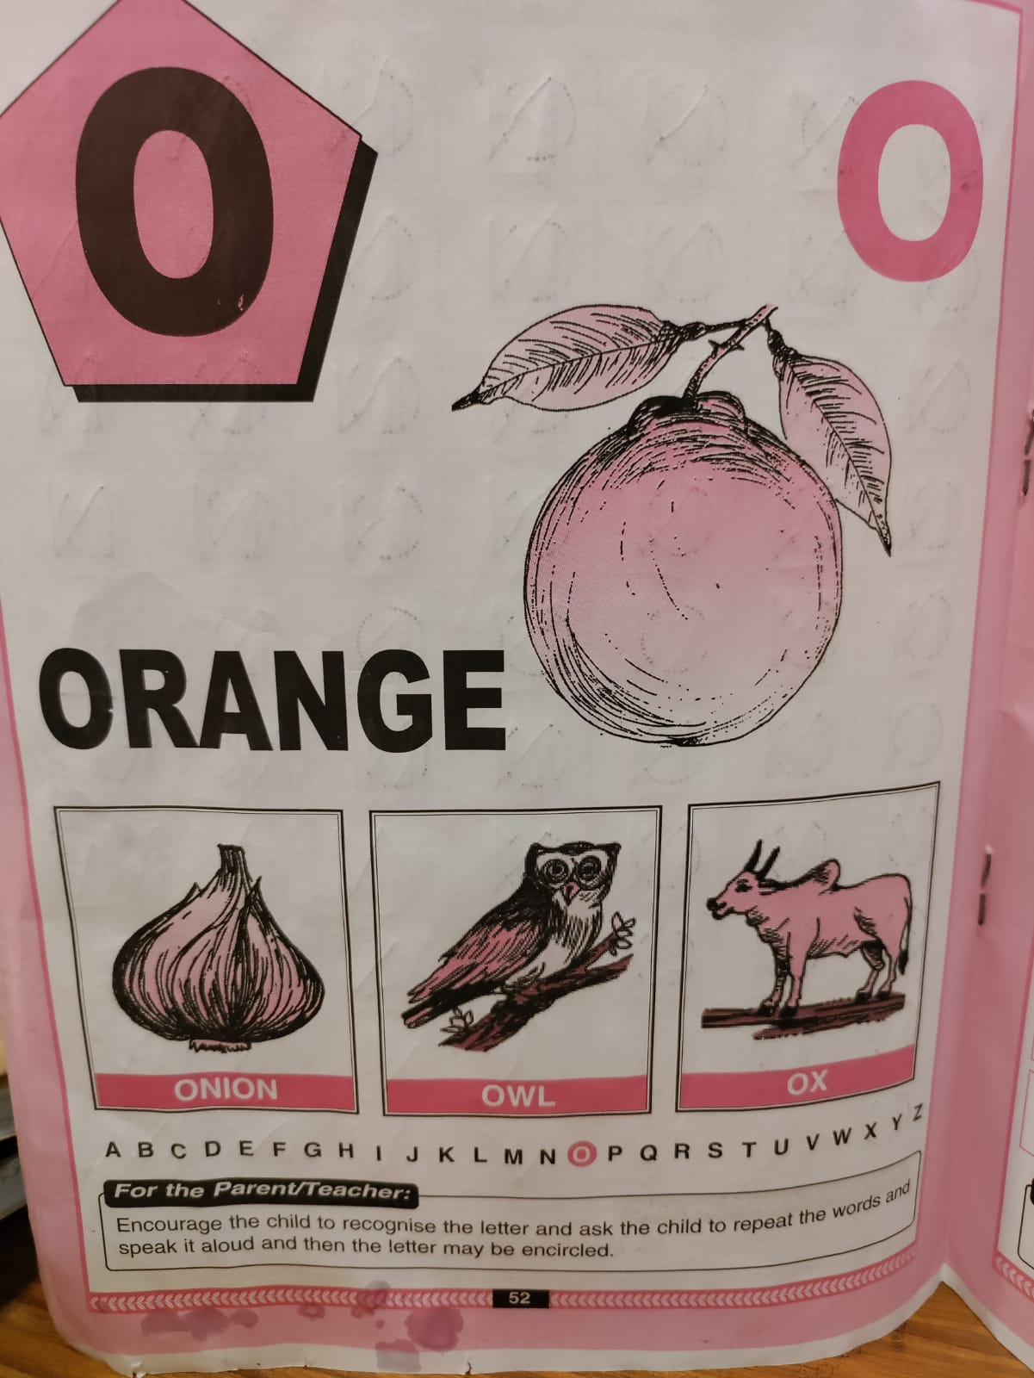

Slide 11
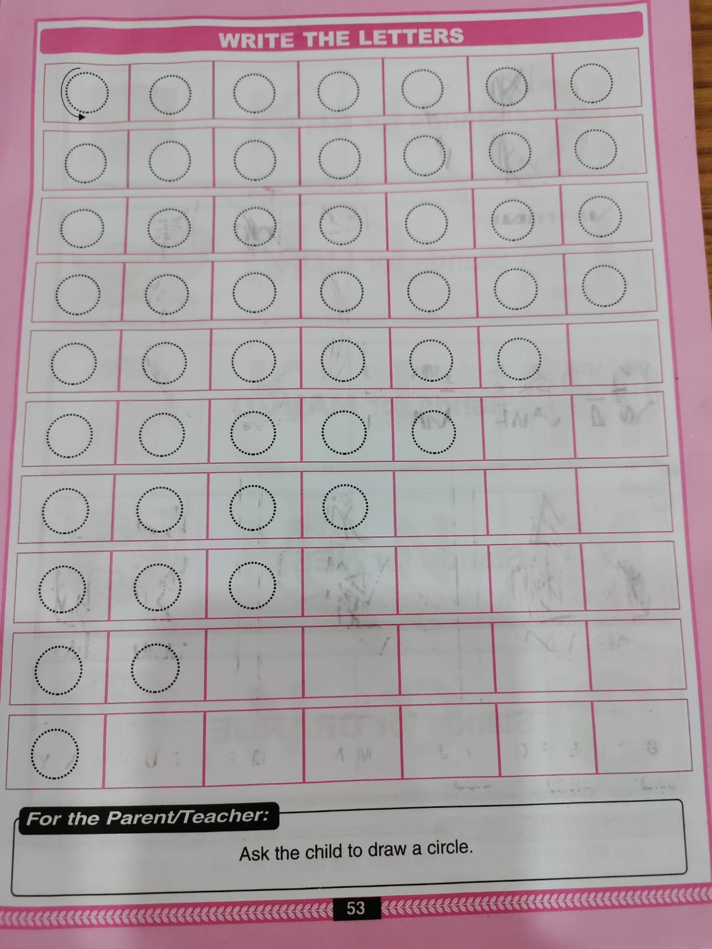
TRACE AND WRITE
CW
6/12/21

Slide 12
Circle and color letter O
HW
(In nt bk)
6/12/21
6206/12/21/12/21
T
G
O
C
O
O
H
O
C
T
E
O
O
O
Notes:
(In nt bk)

Slide 13


6/12/21
ASSIGNMENT
1 .Practice phonic song of letter -O
.2.Complete the work given in BK PG NO-53
Notes:
.COMPLETE BK PG NO-38

Slide 14
THANKING YOU
ODM EDUCATIONAL GROUP

