Slide 1



CLASS : NURSERY
DATE -06/01/22
SUBJECT : ENGLISH
SUBJECT : ENGLISH
TOPIC - BK PG NO-16,17
SUB-TOPIC- LETTER-D – IN NT BK

Slide 2



Slide 3
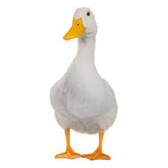

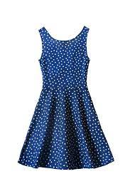
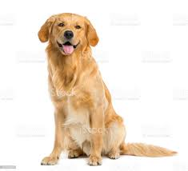
Objects related to letter -D
DUCK
DRUM
DRESS
DOG
Notes:
DUCK

Slide 4
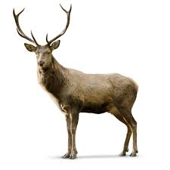
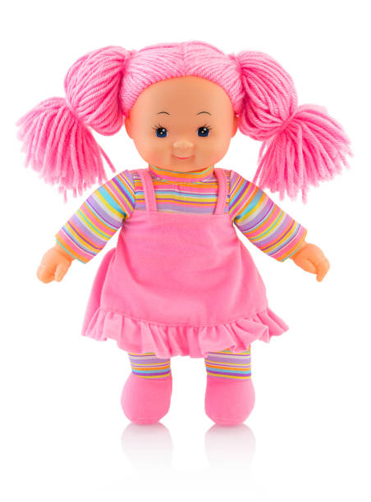

Objects related to letter -D
DEER
DUCK
DOLL
DOOR

Slide 5

PHONIC SONG OF LETTER -D

Slide 6

HI children

Slide 7

D Stands for drum
CW
06/01/22

Slide 8

SAY AND WRITE
CW
06/01/22

Slide 9


06/01/22
ASSIGNMENT
1 .Practice phonic song of letter -D
.2.Complete the work given in nt bk
Notes:
.COMPLETE BK PG NO-38

Slide 10
THANKING YOU
ODM EDUCATIONAL GROUP

