Slide 1



CLASS : NURSERY
DATE 05/08/21
SUBJECT : ENGLISH
SUBJECT : ENGLISH
TOPIC BK PG NO-89( LETTER-Z)
SUB-TOPIC-ACTIVITY IN NOTE

Slide 2
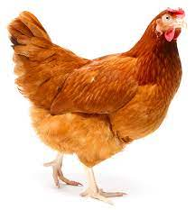



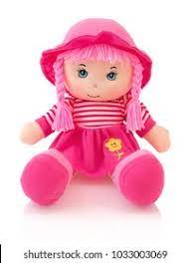


IDENTIFY THE PICTURE AND TELL THE RELATED LETTER
T
C
B
K
H
F
M
J
S
K
G
A
D
V
W
N
X
Y
Notes:
N

Slide 3


RECAPITULATION OF LETTER Z

Slide 4
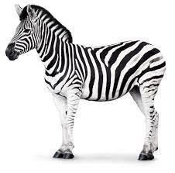

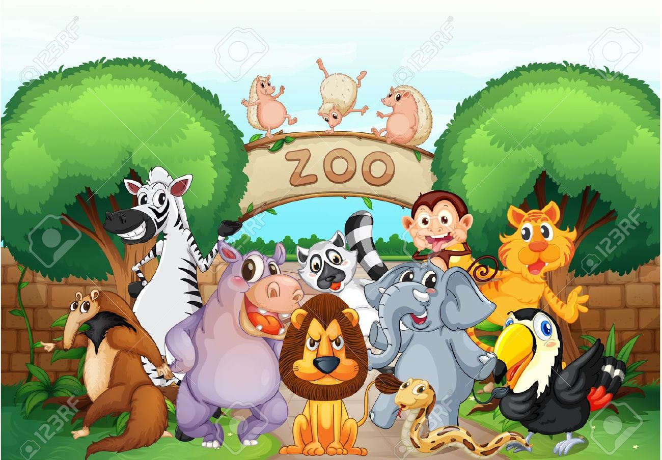

PICTURE RELATED TO LETTER -Z

Slide 5
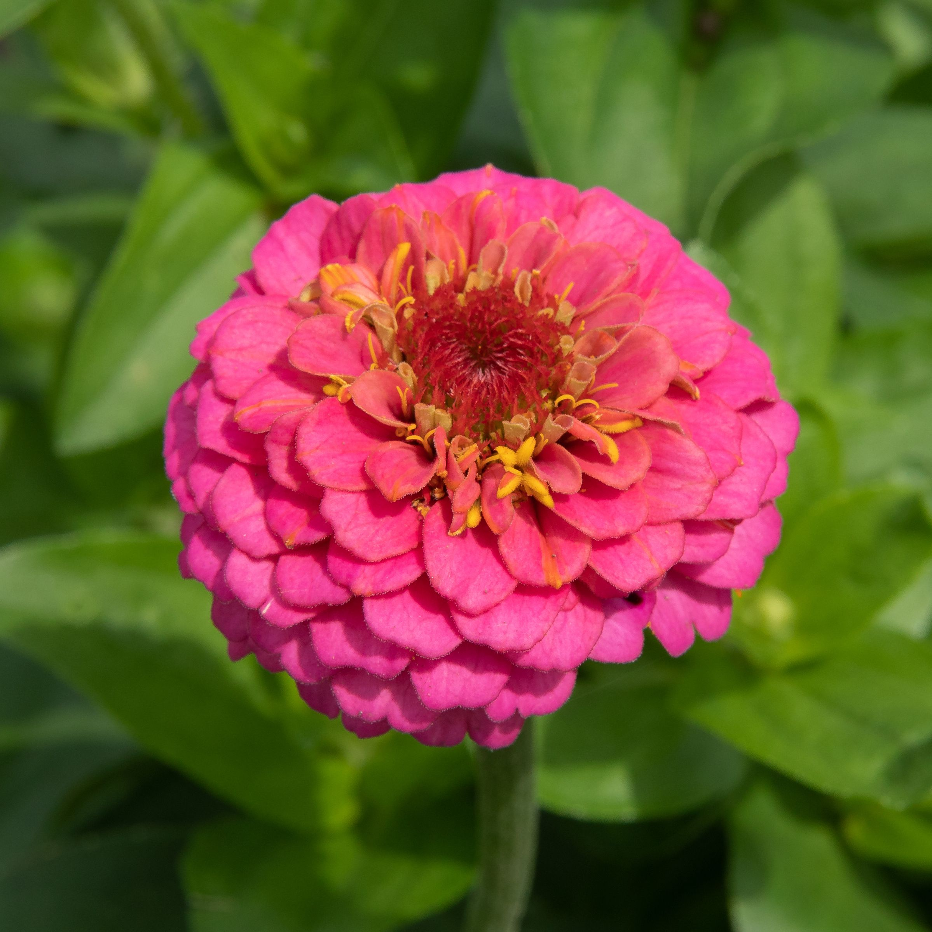



Activity in note bk
CW
05/08/21
Circle the picture starting with letter z
z
Notes:
z

Slide 6

05/08/21
ASSIGNMENT
1 .Practice phonic song sound of letter -Z
2. Paste -4 pictures related to letter Z in nt .bk
Notes:
.3’

Slide 7
THANKING YOU
ODM EDUCATIONAL GROUP

