Slide 1



CLASS : NURSERY
DATE -05/01/22
SUBJECT : ENGLISH
SUBJECT : ENGLISH
TOPIC - BK PG NO-16,17
SUB-TOPIC- LETTER-D – IN BK

Slide 2


Identification of letter B

Slide 3
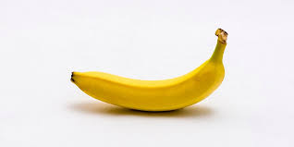

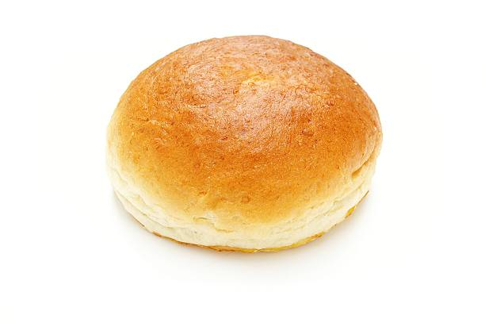
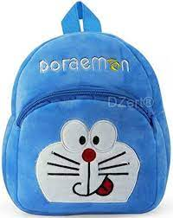


Picture related to letter B
BEE
BANANA
BUN
BAT
BALL
BAG

Slide 4

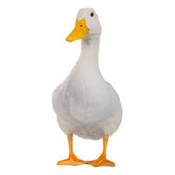

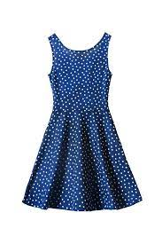

Slide 5



Slide 6


Slide 7
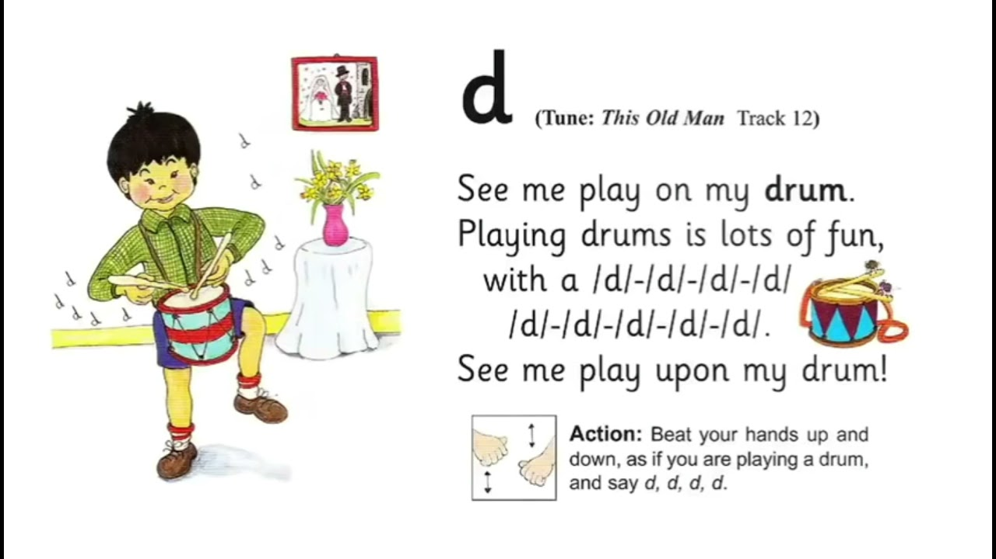

Slide 8
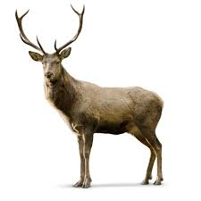
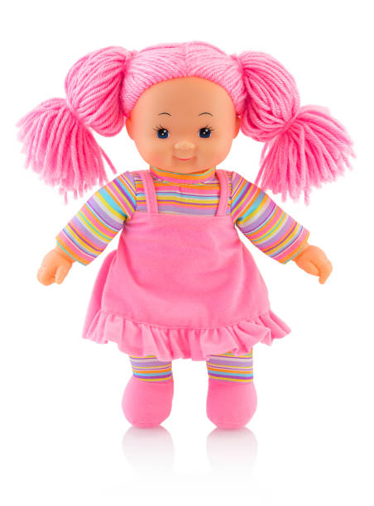

Objects related to letter -D
DEER
DUCK
DOLL
DOOR

Slide 9

HI children

Slide 10
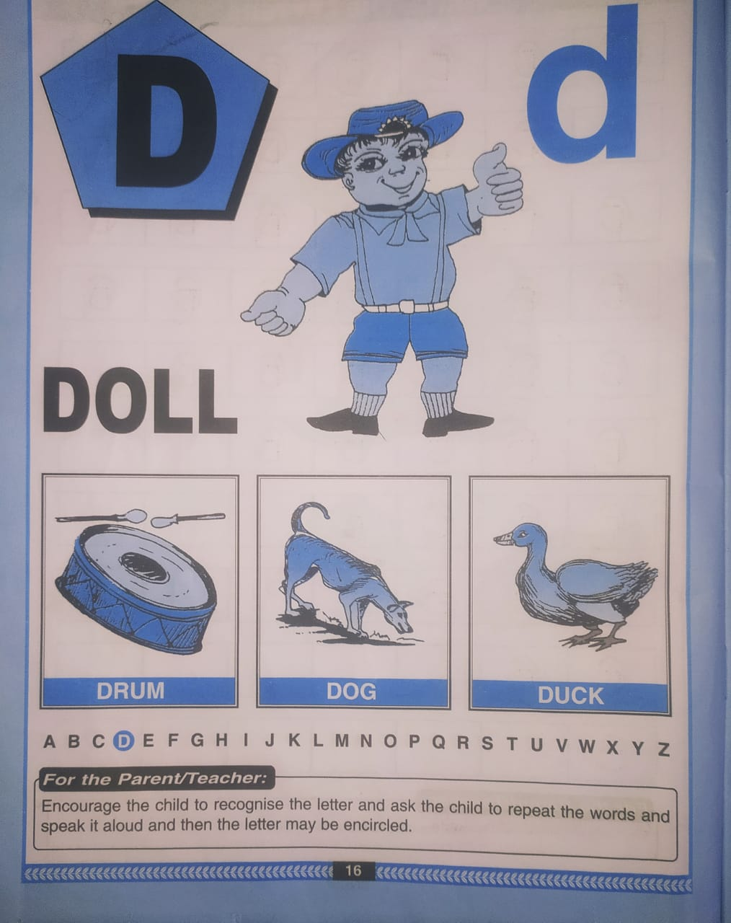

Slide 11
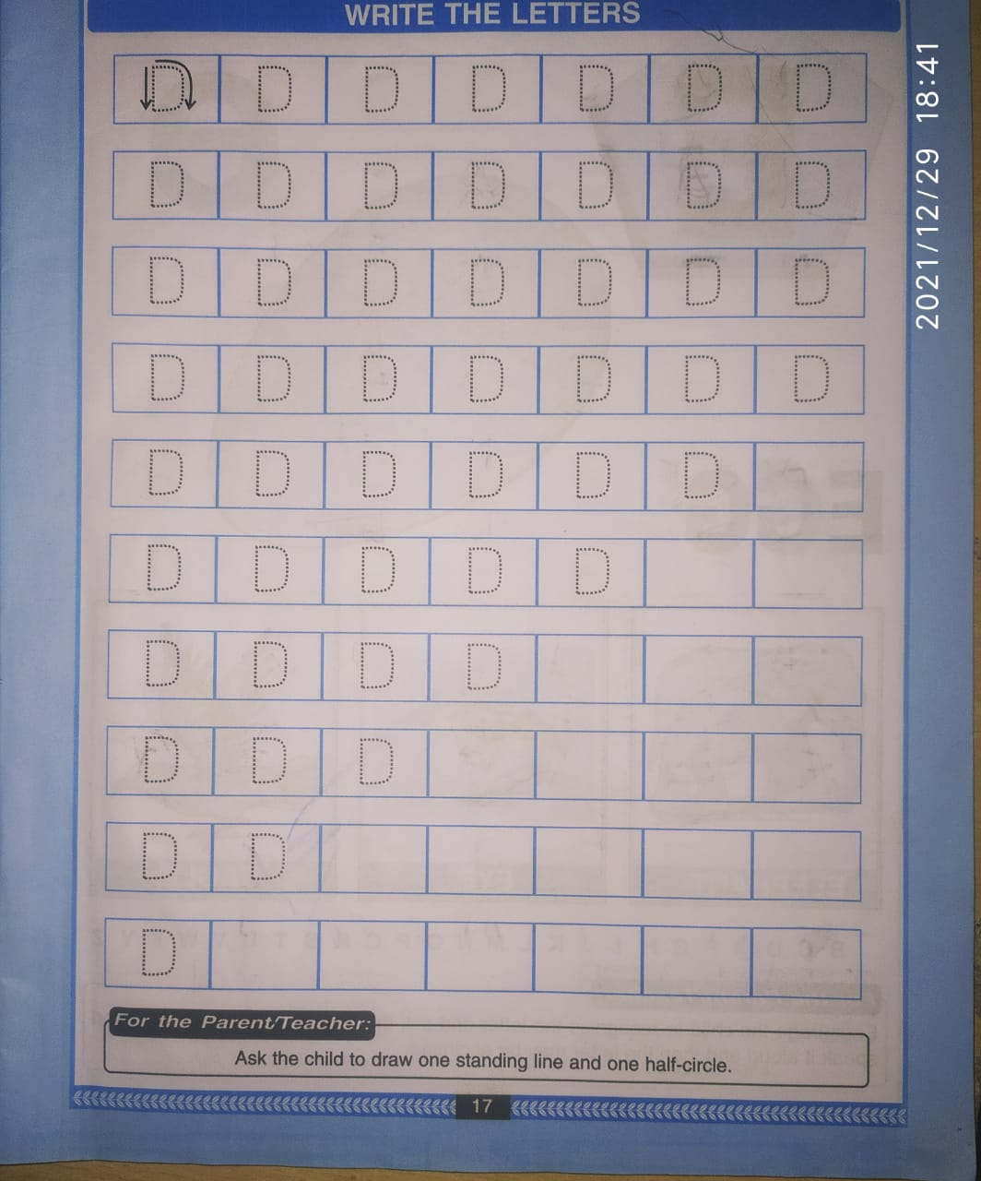
Say trace and write letter –D(BK.PG NO-17)
CW
05/01/22

Slide 12
Say and write the given letters
HW
05/01/22
I | K | L | M
N | O | Q | T

Slide 13


05/01/22
ASSIGNMENT
1 .Practice phonic song of letter -D
.2.Complete the work given in nt bk
Notes:
.COMPLETE BK PG NO-38

Slide 14
THANKING YOU
ODM EDUCATIONAL GROUP

